Slide 1
Adult Patient Access
Ambulatory Overview
Porshia Mack, MD, MBA; Associate CMO, Ambulatory Services
Temisan (Temi) Amoruwa, RN-CEN, MHA; Ambulatory VP

Slide 2
New Primary Care Access 10 clinical days (CalAim, CMS, DMHC)
Notes:
July 2025: HGH Adult – 8 day
EWC Adult – 35 days
HWC Adult – 48 days
NWC Adult – 36 days

Slide 3


RUN RATE

Slide 4
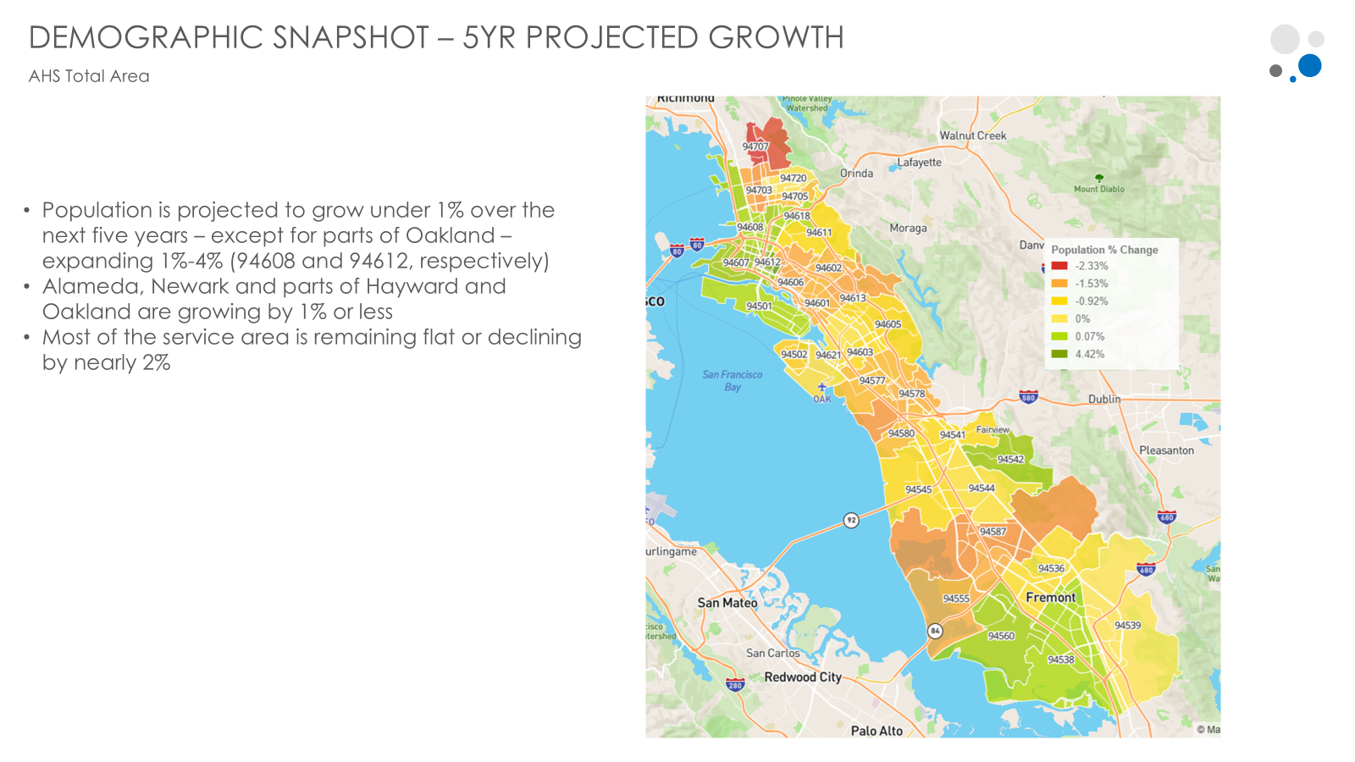
*Christy Romberg

Slide 5
TNAA for Established patients at goal, but not PCP Continuity*
>75% standard
Better health outcomes
Better PCP experience
Higher patient satisfaction
*The extent to which a patient sees the same PCP over time for non acute care

Slide 6
Primary Care Access Priorities
01 | Clinician staffing to demand and for patient experience
02 | Various Care Delivery Models: Telehealth, Evening hours, Convenient/Same Day clinic appointments, Group Medical Visits
03 | Support Care Expansion: Chronic Care Teams, Centralized Nursing
04 | Optimizing Space and Appointments
05 | Digital Patient Engagement (MyChart Fast track & Patient scheduling)

Slide 7
Specialty Care Ambulatory Access

Slide 8
New Patient Specialty referrals
~7,000 monthly AHS specialty referrals
Most community referrals from CHCN
Referrals CBOs, private practices, surrounding EDs

Slide 9
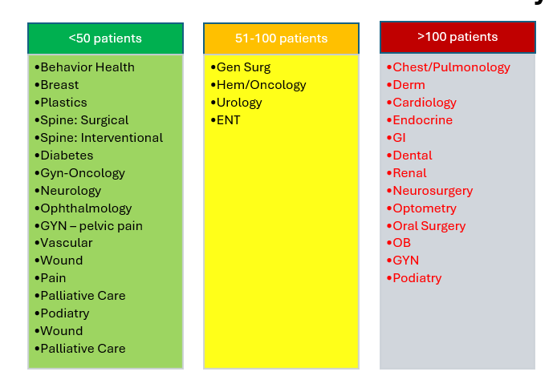

New Patient Specialty Access: Measured in Volume
Opportunity to convert to Days

Slide 10
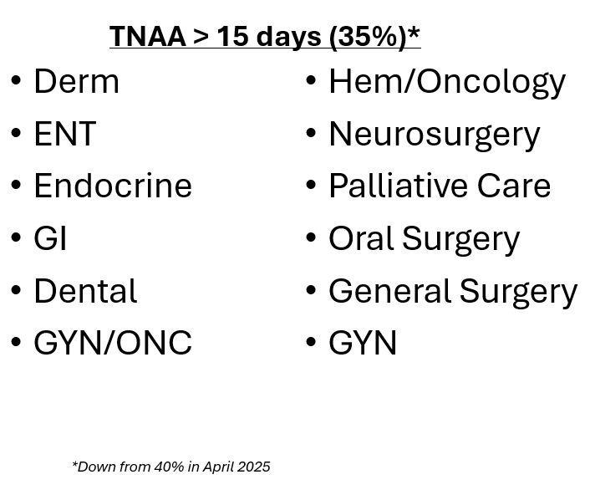
Established Patients: TNAA
Goal of no more than 20% of specialties above 15 days

Slide 11
Specialty Access Priorities
01 | Clinician staffing to match demand
02 | Trend tracking
03 | Waitlist revamp (going from volume to days)
04 | Scheduling metrics
05 | Enhanced data sharing
06 | Space Optimization

Slide 12
What is patient capacity for AHS Ambulatory clinics?
Not a definitive number, not so simple…..

Slide 13

Variables
Patients on Medi-caid now and in the future*
Starting 12/31/2026 Adults 19-64 must prove they are working 80hrs/months to keep Medi-Cal
Adults in ACA expansion must continuously prove their income-based eligibility every 6 months instead of current 12 months
Competitor services
CHCN 2x the assigned lives of AHS
Surrounding Demographics
Socioeconomic & Age
*John Minot-Schwartz

Slide 14
Questions?

