Slide 1



Internal Medicine Residency Home Visits Program
Alejandro Diaz, MD
Internal Medicine Residency Program Director
Vice-Chair Department of Medicine

Slide 2

Highland Home Visits Program
Objectives:
Promote understanding of the macrosocial determinants of health and illness
Provide a practical opportunity to identify areas for partnership with patients in achieving their health goals
Provide excellent patient-centered medical care for historically underserved and marginalized persons in their homes and on their terms
Notes:
The home visit program is intended to provide supplementary experience during training that allows trainees to develop correlates in their own experience for some of the barriers to care our patients encounter. This in turn helps them practice better medicine in the hospital and clinic because it expands their imagination as they seek to partner with patients in the service of their health.

Slide 3
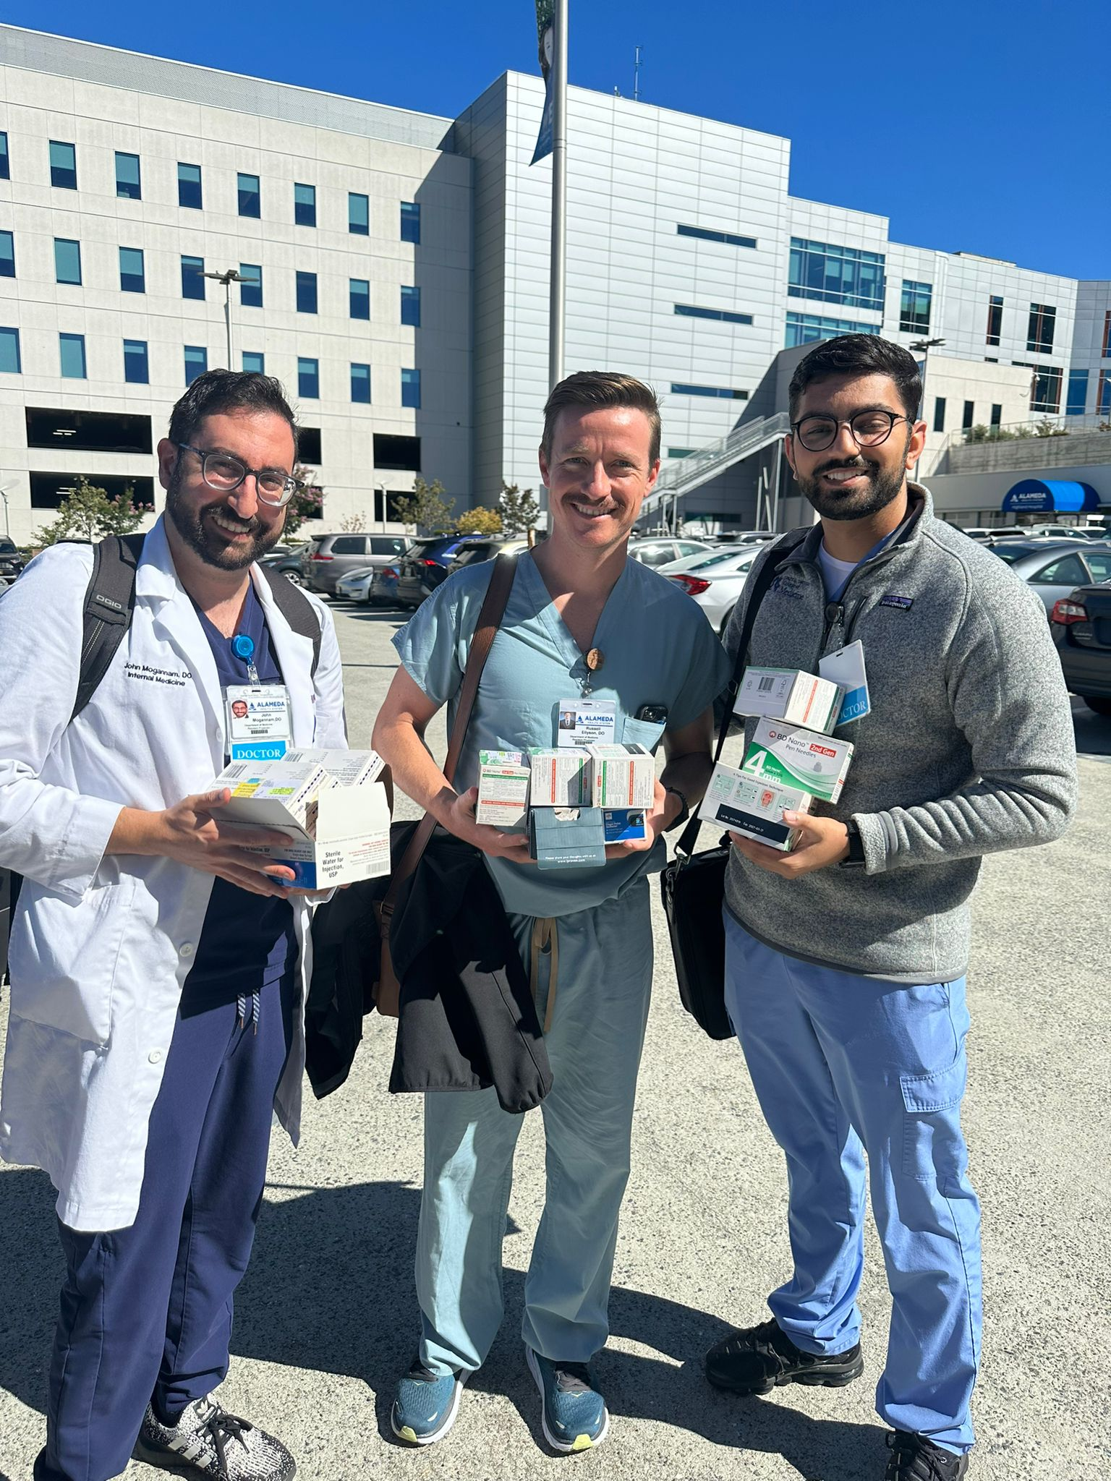
Highland Home Visit Program
Founded in 2016
PGY1-PGY3s participate in home visits twice a year
3-4 residents + attending
Types of home visits:
Hospital discharge follow-up/high risk for re-admission
Clinic patients who have barriers to in-person visits
Patients with multiple complex chronic conditions
Palliative Care Needs

Slide 4
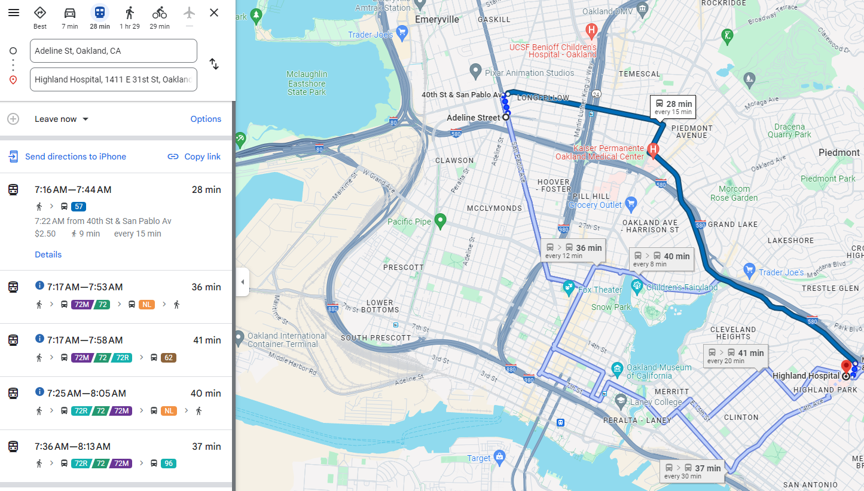

Slide 5
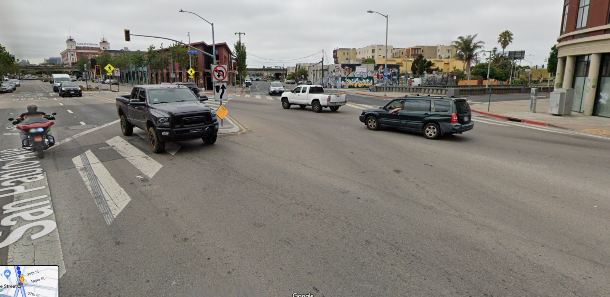

Slide 6
Highland Home Visit Program
Comprehensive Assessment
Assess ADLs/iADLs
Nutrition
Medications
Safety: Home safety issues. Assess for fall risk
Spiritual health: Faith and wellbeing
Services needs
Medical Examination

Slide 7

Resident Reflection
“Although we try our best as providers to do patient centered care for every patient that we see in clinic, I see this as a true return to the original form of patient centered care”

Slide 8
Resident Reflection
“Home visits give me a lot of context behind my patients lives and perhaps why they may be struggling to keep up with their health maintenance or chronic issues. Allows me to tailor my office visits to include social context while making shared medical decisions with my patients.”

Slide 9
Resident Reflection
“I hadn’t realized the incredible amount of work the family put in to keep the patient relatively independent despite her significant disability, and I likely never would have understood it if I limited my interactions with the patient to the clinic.”

Slide 10
Patient Feedback
“Patient states she really appreciated the care she received in her home visit. She felt that her providers listened to what she had to say and spoke slowly so that she could understand.”

Slide 11
Patient Feedback
“Patient stated she is very grateful for her in home visit. Patient states that the in home visit improved her health management greatly”

Slide 12
Patient Feedback
“Patient is extremely satisfied and is hoping on receiving another home visit soon. Patient states she "doesn't know how our in home visits can get any better" Patient is grateful for in home visits as she has difficulty coming into the hospital.”

Slide 13
Patient Survey Data: Fall and Spring 2024 home visits
29 Patients Surveyed
Patients felt that the Home Visits team was knowledgeable, provided clear treatment recommendations, treated them and their home environment with respect, and that the team’s visit improved their ability to manage their health at home.
Patients overwhelmingly rated the care they received during their home visit as excellent and said that they would welcome more home visits in the future.

