Slide 1
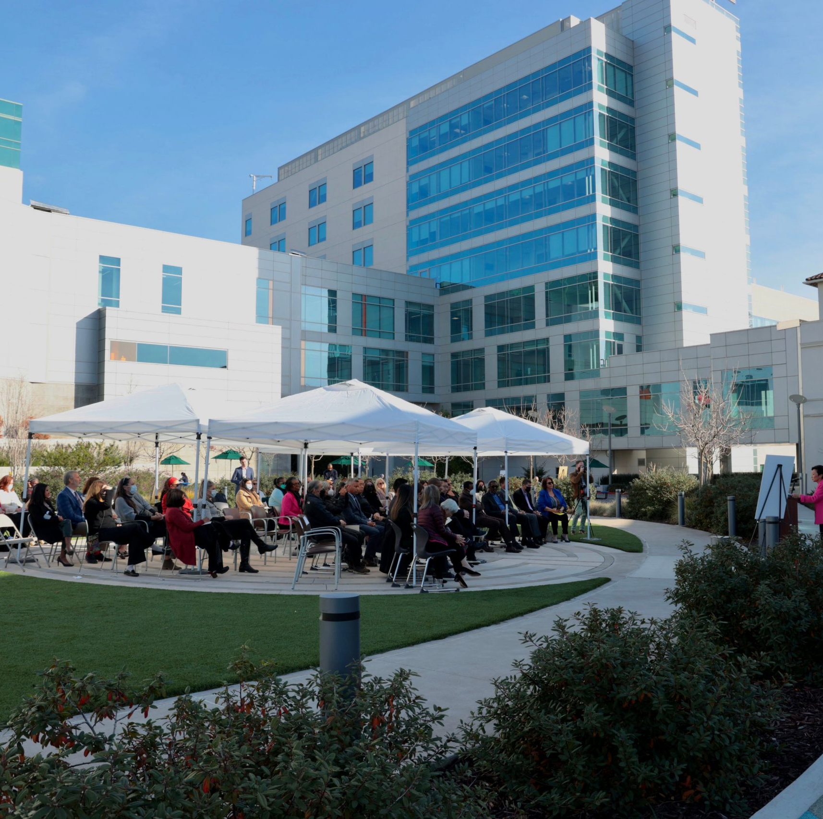
AHS CEO Board Report
James Jackson 7/9/2025 BOT Meeting

Slide 2
Quality Care
01
AHS Pillars
AHS provides Safe, Timely, Effective, Efficient, Equitable and Patient-Centered care that is accessible to all.

Slide 3
Alameda Health System was awarded a little less than $2 million to expand the Addiction Medicine Fellowship program (funding from Health Resources and Services Administration: Project Period Start Date 07/01/2025 ‐ End Date 06/30/2030). Congratulations Drs. Anderson, Herring, Lind, and Simms-Mackey for their leadership and aligned vision.
Transmission of a HRSA Notice of Award
(Addiction Medicine Fellowship)

Slide 4
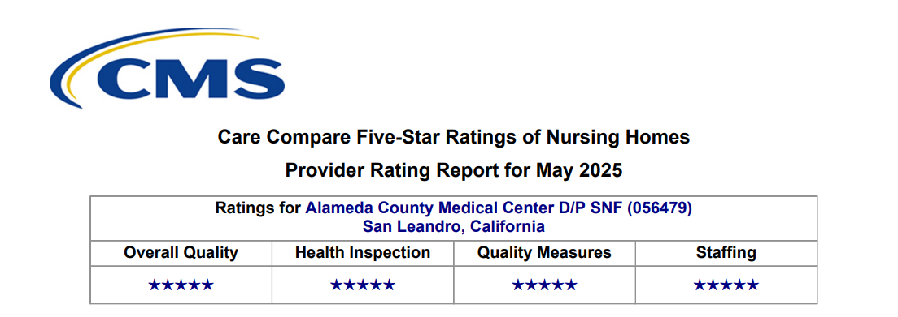
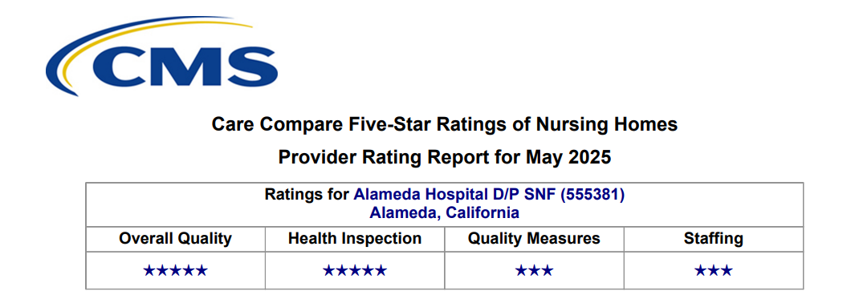

Slide 5
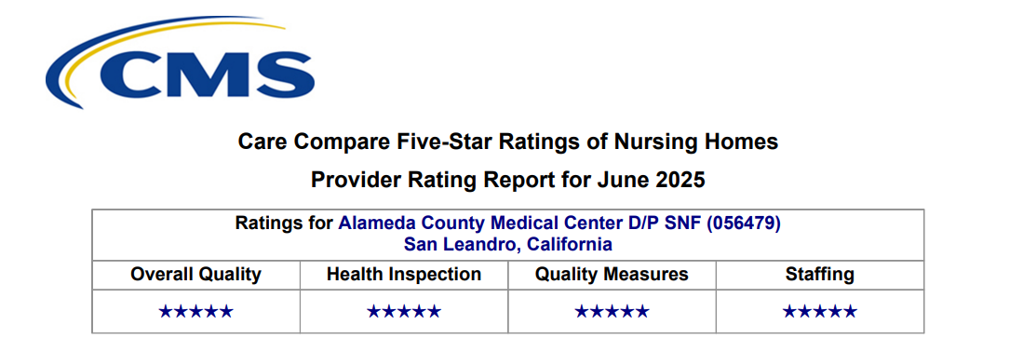
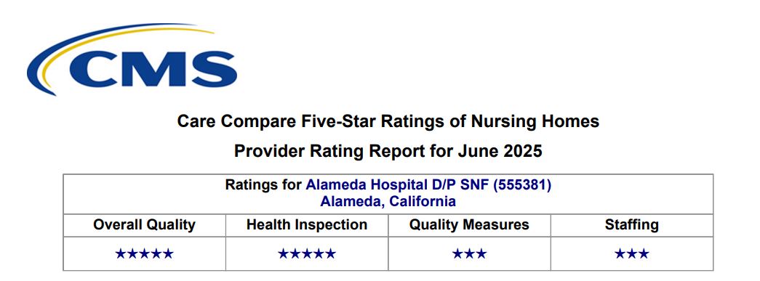

Slide 6

Sustainability
01
AHS Pillars
AHS will pursue innovative approaches to invest in new programs while managing targeted investments in infrastructure to support the delivery of high-quality care.

Slide 7
Support for St. Rose Hospital
The operational plan for SRH has tactics for improvement that require expeditious execution. To implement these plans quickly, we are deploying an operational support team to collaborate with Mario Harding, CAO of SRH and the leadership team at SRH to help support all the work required.
The support team will consist of Aemal Aminy, VP of Support Services, and Callisha Mays our interim VP of Patient Care Services. Aemal and Callisha will officially begin their support role at SRH on Monday July 7 and be on this assignment until September 30, 2025. This assignment will be temporary through September 30, 2025.

Slide 8
Proposed Federal Medicaid Cuts
Dear Trustees,
Yesterday, the Senate passed the budget reconciliation bill that includes sweeping and harmful cuts to Medicaid, known as Medi-Cal in California. These proposed changes pose a significant threat to public health systems across the country, including Alameda Health System (AHS).
As a safety net provider serving nearly 127,000 patients annually, many of whom rely on Medi-Cal, AHS could face substantial financial consequences if this legislation becomes law. Our preliminary analysis indicates that AHS could lose more than $100 million annually by 2030 due to reductions in the Enhanced Payment Program (EPP), the Quality Incentive Program (QIP), and other key funding mechanisms.
The impact would begin as early as 2027, when we project a more than $50 million reduction, with additional cuts compounding in the years that follow. As you know, these dollars are essential to supporting our frontline care teams, core services, and critical programs for our most vulnerable populations.
While we remain hopeful that advocacy at the local, State and Federal levels can help to lessen the final impact to AHS, we are also preparing for the possibility that these cuts will be enacted. Our leadership team is actively planning for multiple funding scenarios, with a focus on protecting access to care and preserving our mission.
We will continue to keep you informed as the situation develops and as we engage policymakers and partners on behalf of our patients and community.
Thank you for your continued support.

Slide 9

Staff & Physician Experience
01
AHS Pillars
AHS values its physicians, clinicians, and staff and seeks to grow, engage, retain, and empower them to serve all.

Slide 10
“Gold Pins” Program Plan
Purpose: The Gold Pins program is a CEO-led employee recognition effort celebrating staff who exemplify AHS values through community service and exceptional visibility. It aims to reinforce our culture of service, pride, and engagement by acknowledging team members who go above and beyond publicly and personally.
Eligibility: Employees who:
Volunteer their personal time at CEO-led community events, like Food Bank volunteer events and Wilma Chan Highland Hospital Clean-ups
Are recognized during the CEO’s weekly leadership chat for exceptional service, dedication, or visibility.
Eligibility: Employees who volunteer at least one of the PACE-led community tabling events each year on their own time.
Recognition:
Eligible employees are invited to a Twice-Yearly Recognition Lunch with the CEO and PACE leaders.

Slide 11
Bargaining Agreement Reached with CNA at AHS Skilled Nursing Facilities
I’m pleased to share that on June 11, 2025, Alameda Health System (AHS) reached a tentative agreement with the California Nurses Association (CNA) on the salary reopener for the Skilled Nursing Facility (SNF) unit. We understand that the ratification vote is scheduled for June 30th, 2025.
This reopener is in effect from March 1, 2025, to February 28, 2027. It covers approximately 30 employees at Park Bridge Rehabilitation and Wellness and South Shore Rehabilitation and Wellness.
After a series of productive discussions, we are pleased to share that the tentative agreement includes RN training provisions, a wage increase in the first year that brought SNF nurses up to fair market value salary level and cost-of-living adjustments of 3% beginning March 1, 2026, and 4% on March 1, 2027.
AHS appreciates CNA's partnership and remains committed to supporting our nursing workforce through competitive compensation and professional development opportunities. Feel free to reach out if you have any questions.

Slide 12
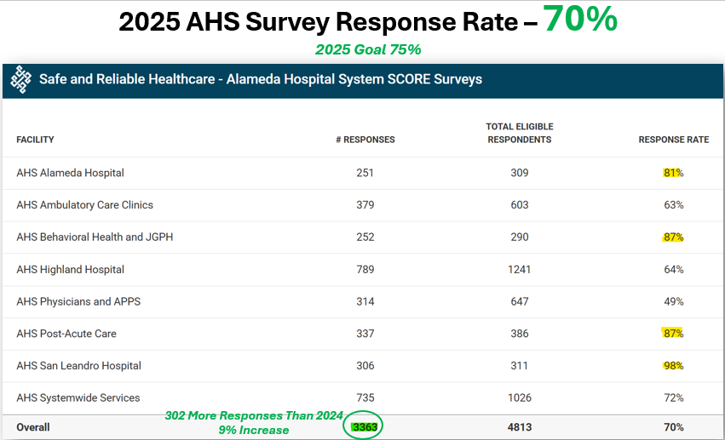
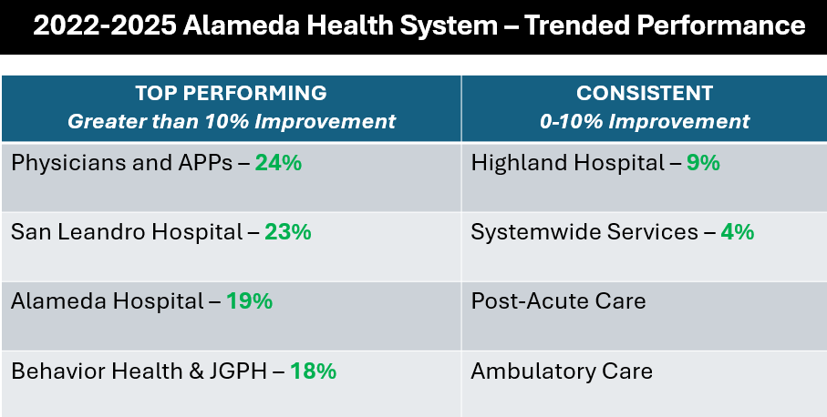
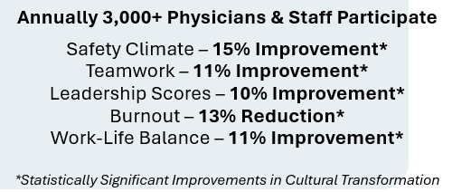
2025 Performance
2022-2025 Trended Performance
100% Departments will have a neutrally facilitated debriefing
180 Departments will develop action plans by 7/31/25
Action plans implemented and monitored in August-Sept.

Slide 13
Ongoing Commitment to a Culture of Safety
AHS Success Through Sustained Commitment
Make Culture a Strategic Priority Embed culture in boardroom priorities, measured alongside financial and clinical outcomes.
Measure and Improve Use data-driven tools to assess and advance culture maturity.
Lead by Example Ensure leaders model transparency, safety, and engage frontline teams.
Empower the Front Line Promote open reporting and team ownership of cultural initiatives.
Align Recognition with Values Celebrate and reward behaviors that reflect cultural priorities.

Slide 14
June 24, 2025
County of Alameda
GSA - Real Property Management 1401 Lakeside Drive, Floor 10
Oakland, CA 94612 To:
Alameda County Medical Center AlTN: Chief Executive Officer 15400 Foothill Boulevard
San Leandro, CA 94578
Subject: Fairmont Campus Property - Site Work Improvements and Repairs Notice
Dear Mr. Jackson,
We are writing to inform you that the County of Alameda has engaged Swinerton Management and
Consulting to oversee several upcoming projects at the Fairmont Campus in San Leandro, CA
("Fairmont Campus"). In addition, the County has contracted Orea Construction-along with its
subcontractors Welton Underground and Advanced Repipe Specialist-and Consolidated CM to perform
specific capital improvements to the Fairmont Campus.
It is our understanding that your staff has been in ongoing communication with the County and the
contractors over the past two years in preparation for this work. The work will be ongoing for
approximately five years to come. As construction has now started or is set to begin, we would like
to provide the following project details:
Scope of Work:
The planned improvements involve stormwater and sewer line repairs, as well as hard-scape
enhancements throughout designated areas of the Fairmont Campus.
Locations Affected (see Exhibits attached for reference):
• John George Pavilion
• Administration Buildings
• Areas adjacent to the Chapel Parking Lot
• Vicinity near the cafeteria
• Outside Fairmont Hospital Admin Building
• Area between Eden Mental Health, AHS Engineering, Cherry Hill Detox
Current Construction Schedule:
• Storm Drain and Sewer Pipe Repair Work (Subcontractors: Welton Underground and Advanced Repipe Specialist)
• Repair work: Area between Eden Mental health, AHS Engineering, and Cherry

Slide 15

Community Connection
01
AHS Pillars
AHS is an anchor in its community and aligns its services to deliver a comprehensive continuum of care by providing needed services and being a trusted partner in its community at large.

Slide 16
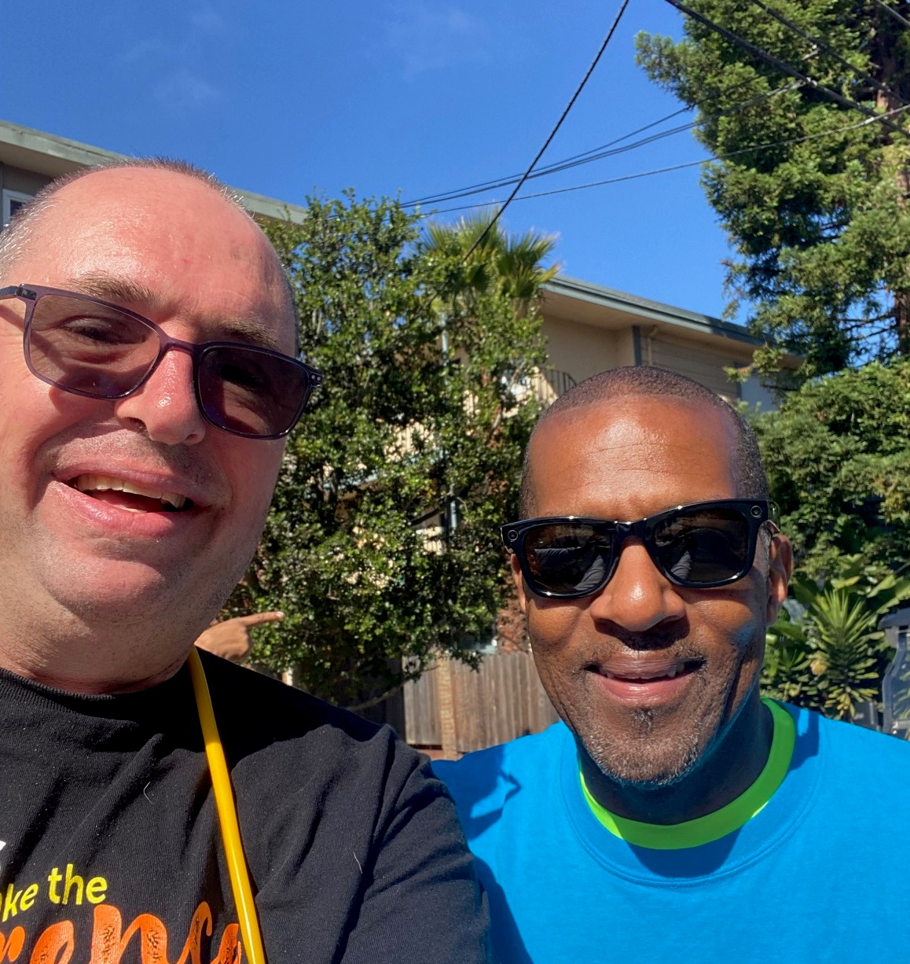
AHS Fourth Of July Parade 2025

Slide 17


Slide 18
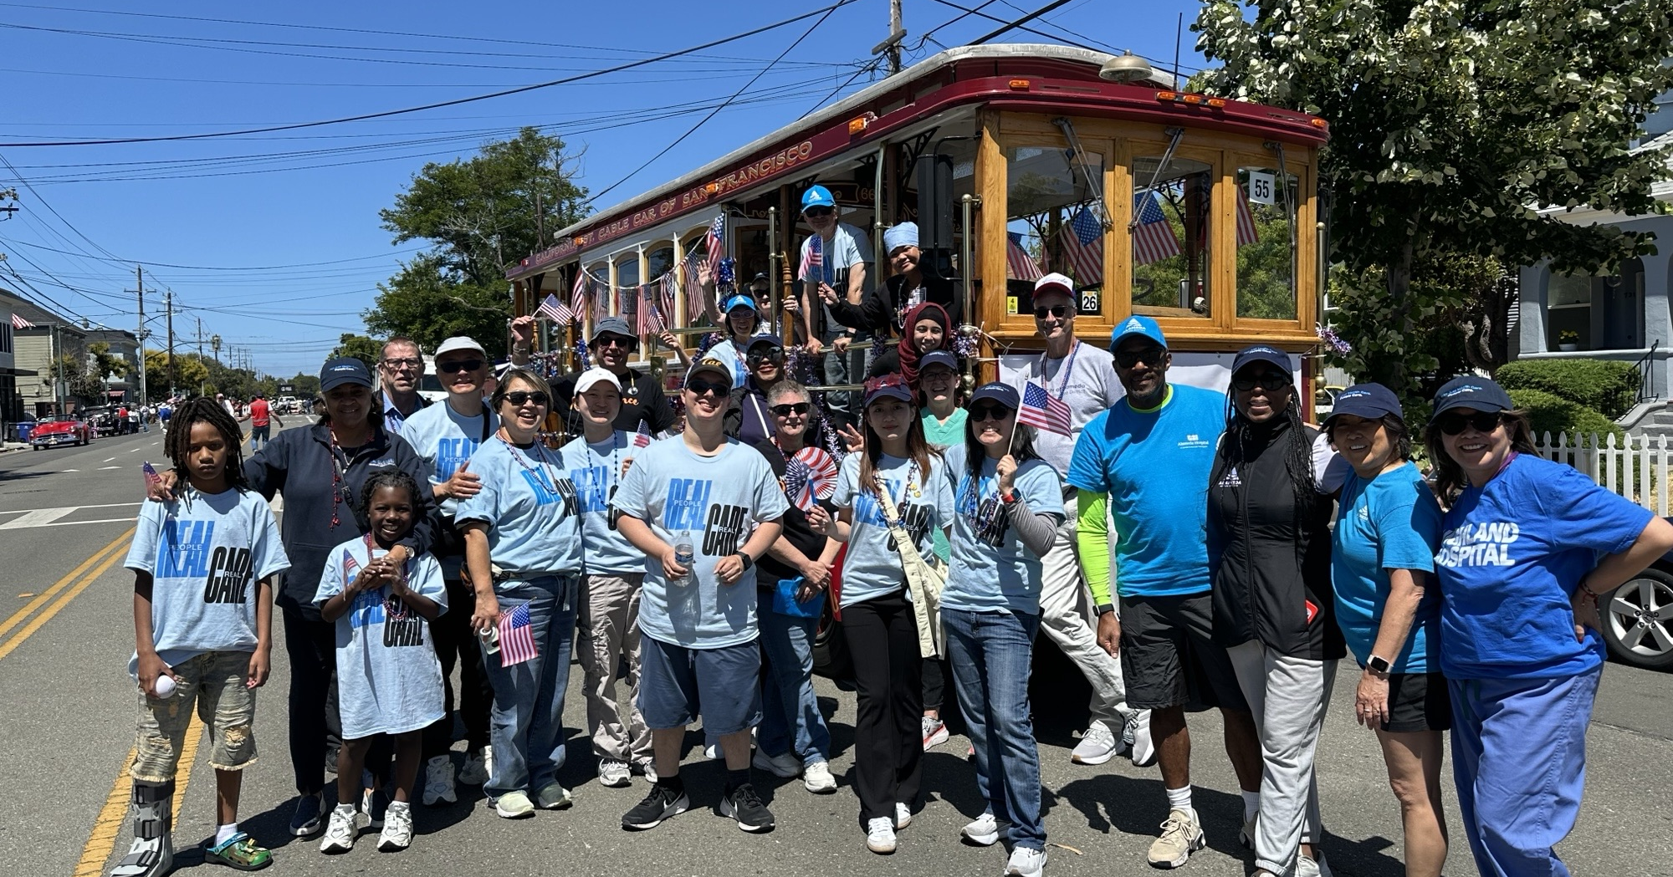

Slide 19
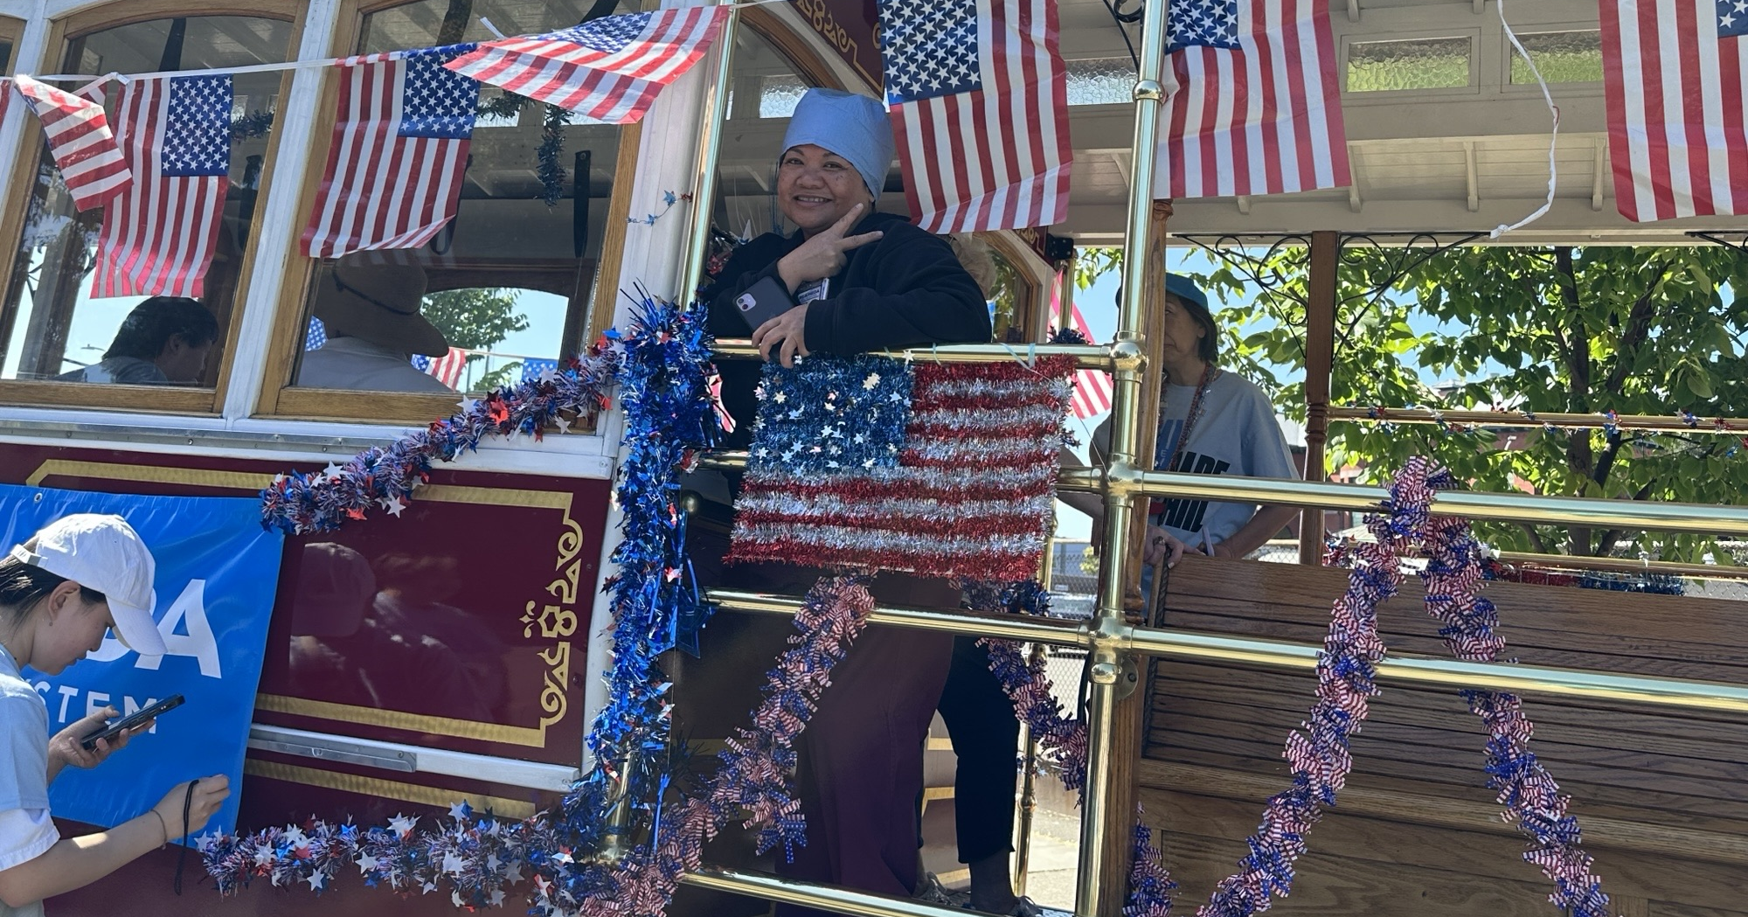

Slide 20
$100K Grant Awarded by Delta Dental Community Care Foundation for Highland Dental Relocation
Dear Dr. Ng,
I am delighted to let you know that my proposal for support of the Highland dental relocation was awarded a $100,000.00 grant by Delta Dental Community Care Foundation. We are so happy to be able to support the relocation. The funds will be wired within the next two weeks, and I know you will work with Precious regarding invoices/disbursements, etc. As always, I appreciate any updates I can share with the funder as the relocation progresses. Thank you and the team for all you do!
Warm regards,
Vera
Vera Hannush (they/them) Director of Philanthropy
Alameda Health System Foundation
55 Harrison St. | Suite 600 | Oakland, CA 94607
510-271-2517 | vhannush@alamedahealthsystem.org
FoundationAHS.org | Facebook | LinkedIn
Donate to AHS Foundation!

Slide 21
Questions
James Jackson 7/9/2025 BOT Meeting

