Slide 1
CEO Board Report Board of Trustee Meeting February 9th, 2022

Slide 2
Patient Centered Story Alameda Hospital Ophthalmology Department

Slide 3
AHS Operations and Program Update

Slide 4
Sustainability

Slide 5
Transition of Highland Ambulatory Clinics to a Federally Qualified Health Center
Effective March 1, 2022, our Highland ambulatory clinics on K7, E2, HCP4 and HCP5 will join K6 to resume being a campus wide Federally Qualified Health Center (FQHC). Some of the benefits of being a federally qualified health center include:
• Patient-led governance that drives health equity; information about our Co-Applicant Board is here.
• Higher payment rates for MediCal and Medicare due to FQHC status.
• Ability to participate in pharmacy programs that are lower cost to our system.
• Alignment of financial statements for all AHS FQHCs that are consistent with our reporting requirements with Alameda County.
• Eliminate current conflicting regulatory requirements at Highland ambulatory clinics.
AHS will continue to get paid at our existing FQ rate for all clinics starting on 3/1 until the new rate is finalized.

Slide 6
Patient Experience

Slide 7
Improving our Patient Experience
As an organization, we aspire for our patients to trust us, have great clinical outcomes, and choose us as their healthcare provider of choice.
The right thing for us to do is to provide our patients with exceptional experiences when they interface with us.
We have been measuring our patient satisfaction scores for several years, and the scores have shown some improvement, but we can do much better as we continue on our journey to be BEST.
One of the tools staff are expected to utilize is a commitment to our Service Standard Related to Greeting a Patient (GIFT)
G - Greet the patient
I - Introduce yourself (name, title, and department)
F - For: I am here for…. Is there anything else I can do for you?
T - Thank you
G.I.F.T. is a very effective method of initial communication with our patients, helping us seek to understand their needs.
Another effort underway is Building Institutional Leader Knowledge
All leaders are required to complete Boot Camp sessions by September 30, 2022, led by the Patient Experience Department to build a consistent understanding of patient experience.
During these Boot Camp sessions, leaders will create action plans with performance monitoring and will integrate these into their day-to-day work.
We believe by hard-wiring these practices we will create standard work and expectations for the way all staff interact with those we serve

Slide 8
Falck Ambulance’s Hard Offload Initiative
Last month we were made aware that Falck Ambulance intended to implement a process known as a “hard offload’ policy on Feb. 1, 2022, across Alameda County.
The hard offload policy states when a paramedic has been waiting for 60 minutes with a patient at a hospital that does not have a location to place the patient, Falck Ambulance will leave patients in hospital emergency departments in chairs or cots.
In partnership with member hospitals of the Bay Area Hospital Council AHS noted four primary concerns:
This policy puts patients at risk, creating a false prioritization for the most recent patients arriving by ambulance regardless of their level of acuity when compared with existing patients in the ED and/or those arriving by other modes of transport.
This policy ignores the many underlying factors contributing to ED overcrowding and consequent delays in offloading ambulance patients that are beyond the control of hospitals, especially during the COVID pandemic.
This policy may result in ambulance staff abandoning in the ED patients who the hospital has neither the staff nor the resources to properly care for immediately.
The arbitrary time limits and financial threats embodied in this policy are unsupported by law.
After consultation with our Labor partners and making our concerns known to Falck and the Alameda County EMS Falck made the determination to defer the implementation of this policy for one month to allow for further consideration and planning. Deadline is now March 1.
AHS leadership is working on action steps that will alleviate the delays currently experienced in our EDs with accepting patients in a timely manner including the following:
Expansion of the hours and staffing of the AHS Transfer Center
Pursuit of the Care Optimization work as a part of the BEST initiative, with a specific focus on ED throughput.
Development of a Transitional Care unit

Slide 9
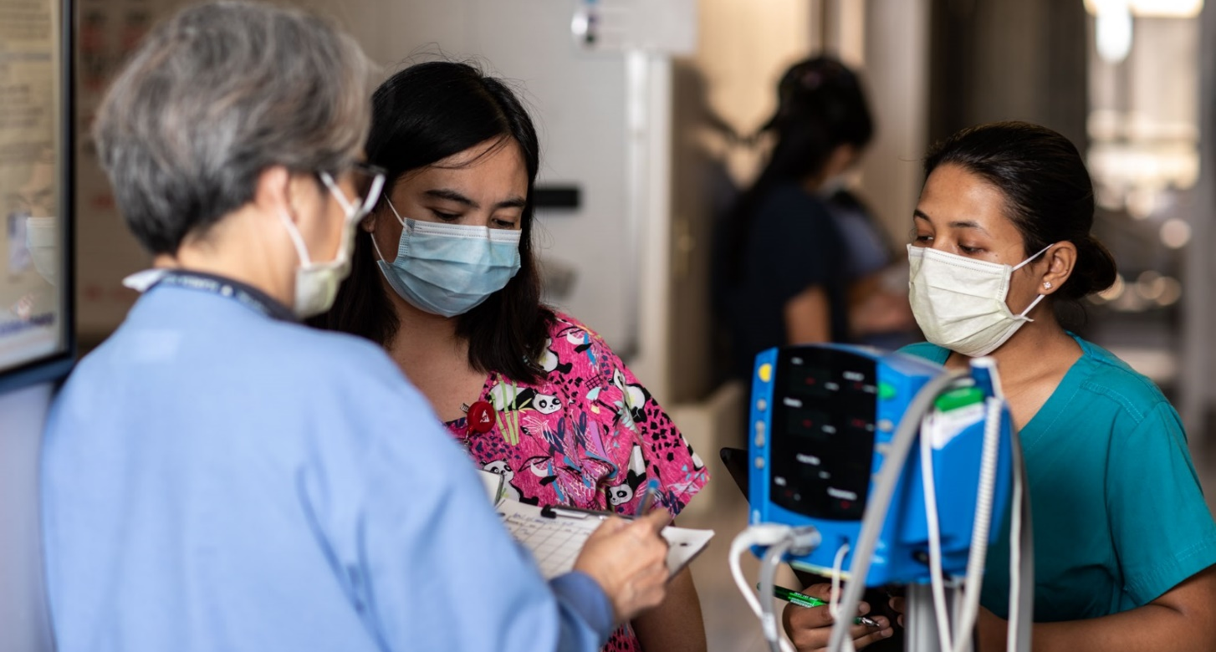
Workforce

Slide 10
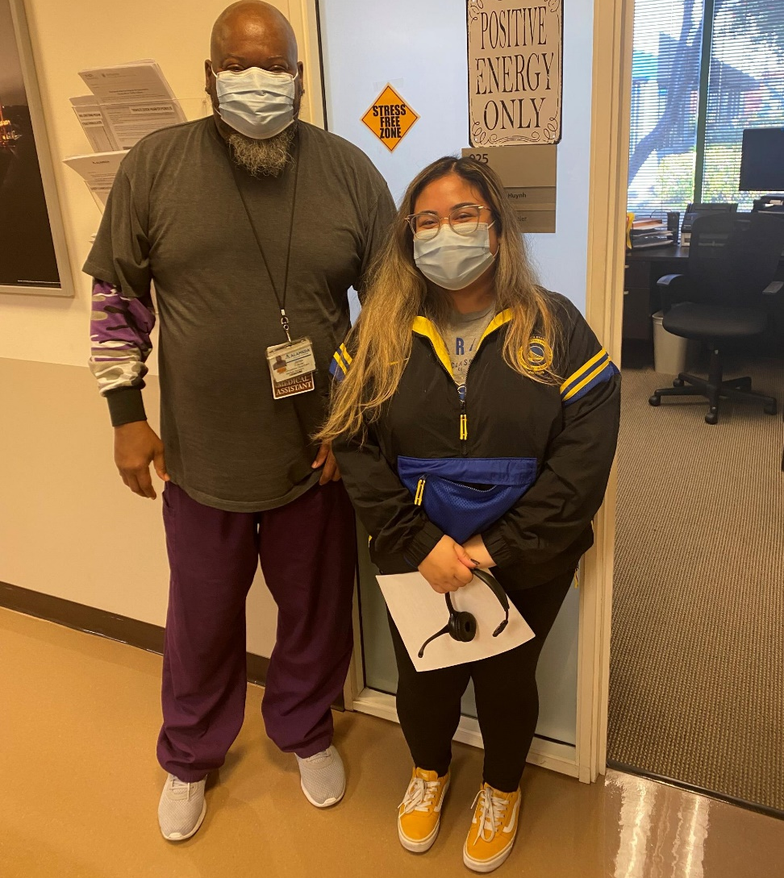
CEO Rounding
Productive way to connect with staff and identify and eliminate obstacles.
Can contribute to a positive work environment.
Rounding at all AHS sites:
54 facility visits
121 meetings with individual staff
77 meetings with physicians

Slide 11
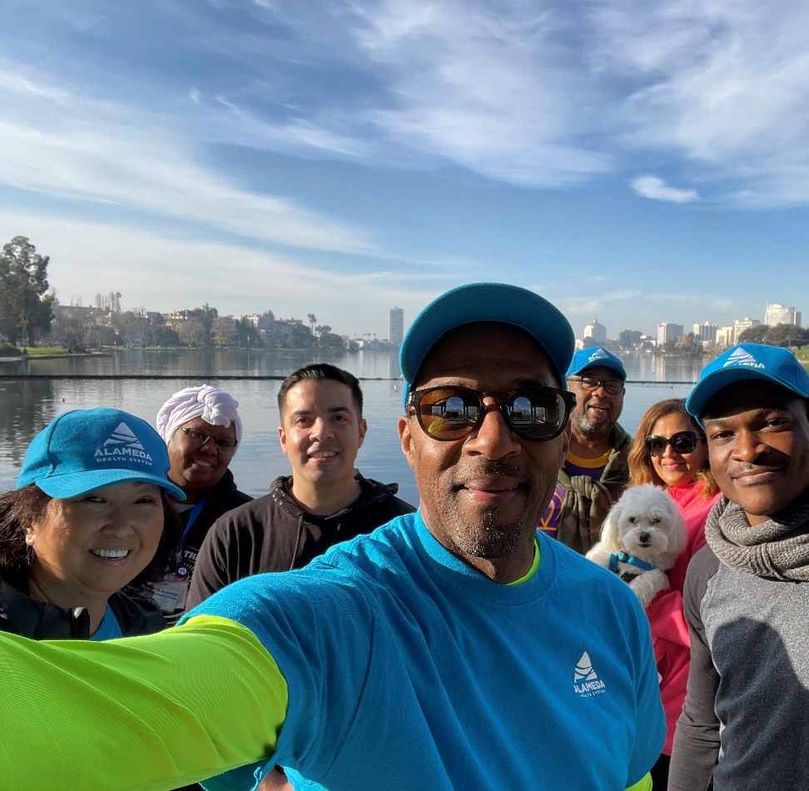
“The Walks” w/ the CEO Lake Merritt (1/29/2022)
6 + Employees participated and 1 dog (pets are welcomed)
Parking spaces provided in partnership w/ the DT Senior Center located in the historic Veteran’s Memorial Building
T-shirts, baseball caps, towels, water and coffee provided

Slide 12
COVID-19 Vaccination Update
As of February 7th, 2022, we have Active employees only (LOA/WC/ACTIVE – Fully Vaccinated): Total – 5,166
95% - Active Employees Fully Vaccinated.
5% - AHS Employees Unvaccinated.
77% - AHS employees received boosters.

Slide 13
Clinician Spotlight
Highland Hospital surgeon Dr. Timothy Browder was featured on KTVU Local News this week for a TV segment called "The surgeon who wouldn't let Ersie Joyner say goodbye." It covers how Dr. Browder saved former Oakland Police Capt. Ersie Joyner's life, after he was shot 22 times in a robbery gone-wrong.
If you haven't seen it yet, you can watch it here: https://www.ktvu.com/video/1030212 Dr. Browder gave a terrific interview. The result is a news clip that champions AHS, Highland, and our critical role in the community. It does a great job of recognizing public health care workers for the heroic work they do.

