Slide 1
Affinity Group Update

Slide 2
Affinity Groups
Purposes of Affinity Groups (Employee Resource Groups)
Affinity Groups (AG) create an open forum for staff who share common interests/concerns to meet and support one another in creatively addressing those concerns
They provide a resource to AHS leadership regarding staff/community interests, needs, and policies
They can advance a respectful and caring community
Guiding principles for Affinity Groups
All AGs are open to all employees
AGs promote diversity, openness, understanding, and inclusiveness
AG participation by employees is voluntary
AGs strive to provide long-term benefit to the Health System as well as professional/personal benefit to participants
Benefits of AGs at AHS
AGs help to create an inclusive workplace by:
Contributing to an inclusive workplace through recruiting and retention, and by providing an informal welcome to new employees and networking and mentoring opportunities for their members
Creating an open forum for staff who share common interests/concerns to meet and support one another

Slide 3
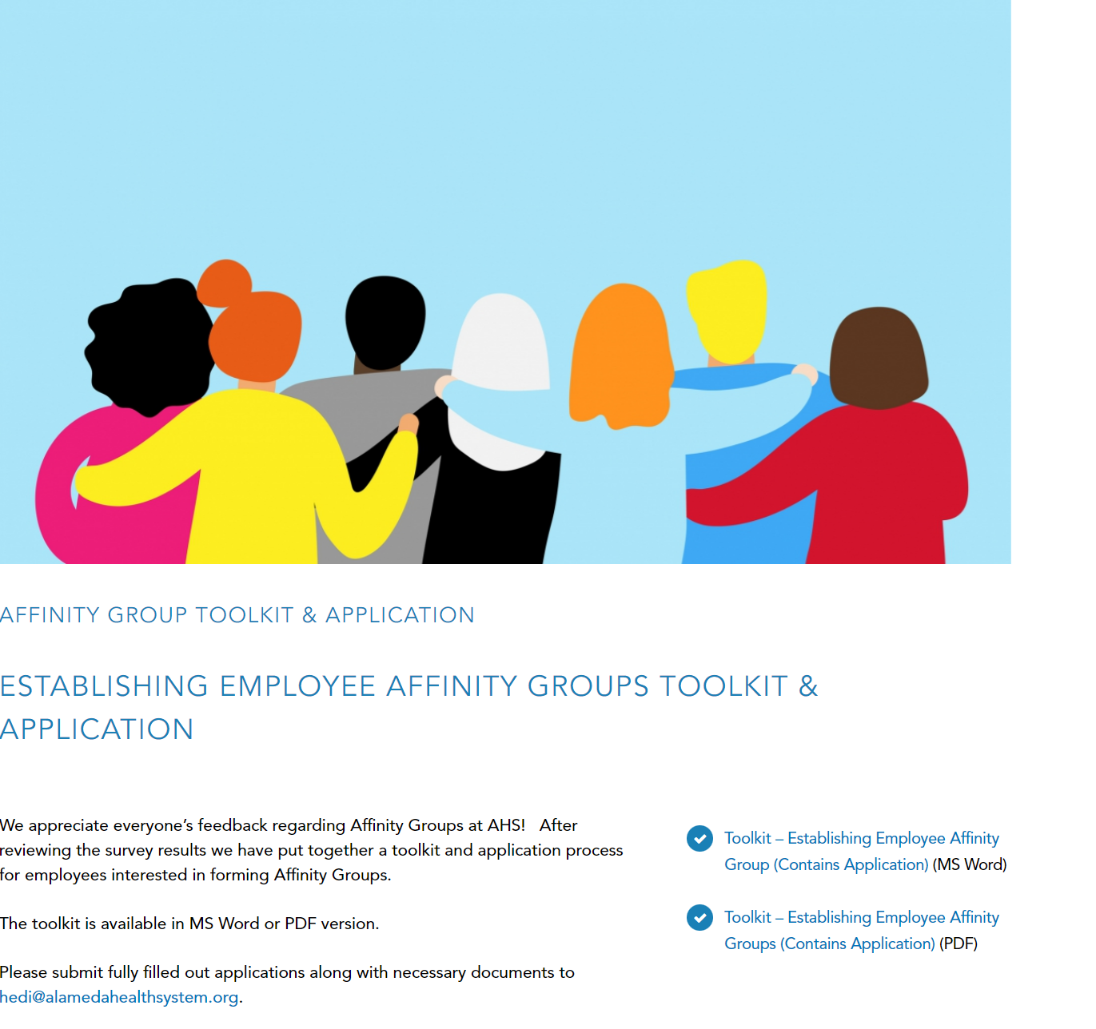
AFFINITY GROUP TOOLKIT

Slide 4
Toolkit
Application
Sample Charter
Sample Bylaws
How to request support
Meeting support/Agenda’s/structure
Booking conference rooms
Zoom access
Marketing & Communication support

