Slide 1
Board of Trustees Meeting
PLEASE USE MICROPHONE
OCTOBER 24, 2019
Audio Recording in Progress

Slide 2
CEO Report
OCTOber 24, 2019
AHS Board of Trustees Meeting

Slide 3
Updates
True North Metrics Dashboard
Mission Moments
SAPPHIRE Update

Slide 4
Performance dashboard
AHS OPERATIONAL PLAN FY 2020

Slide 6

System UpdATEs

Slide 7
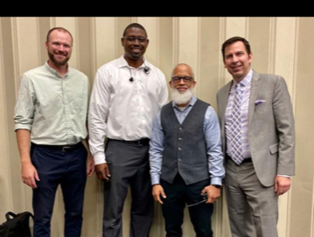

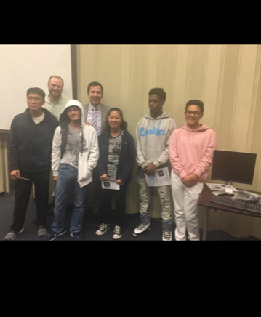
AHS Donates surplus tech hardware to OUSD in support of our future leaders!

Slide 8


2019 Employee Service Awards

Slide 9

Royal Ambulance/Lyft/AHS Partnership

Slide 10
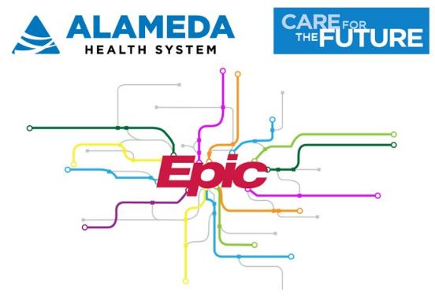

Project S·A·P·P·H·I·R·E Update
We did it!

Slide 11
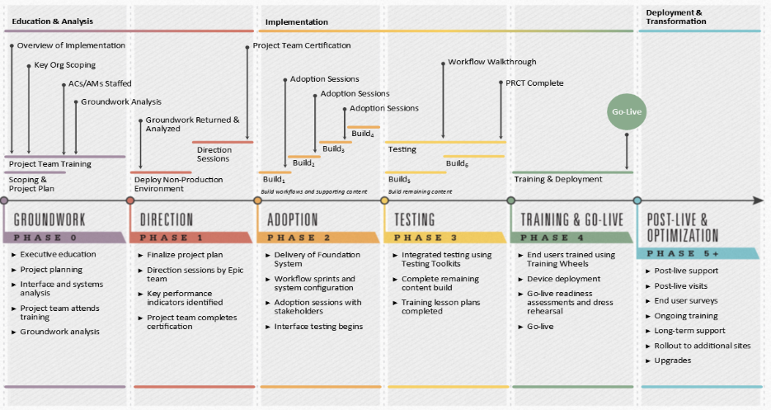
Implementation Overview
  Training, Cutover, and Go-Live
  September & October 2019
  Cutover
  Go-Live
  At-the-Elbow Support
  9/28-10/25

Slide 12
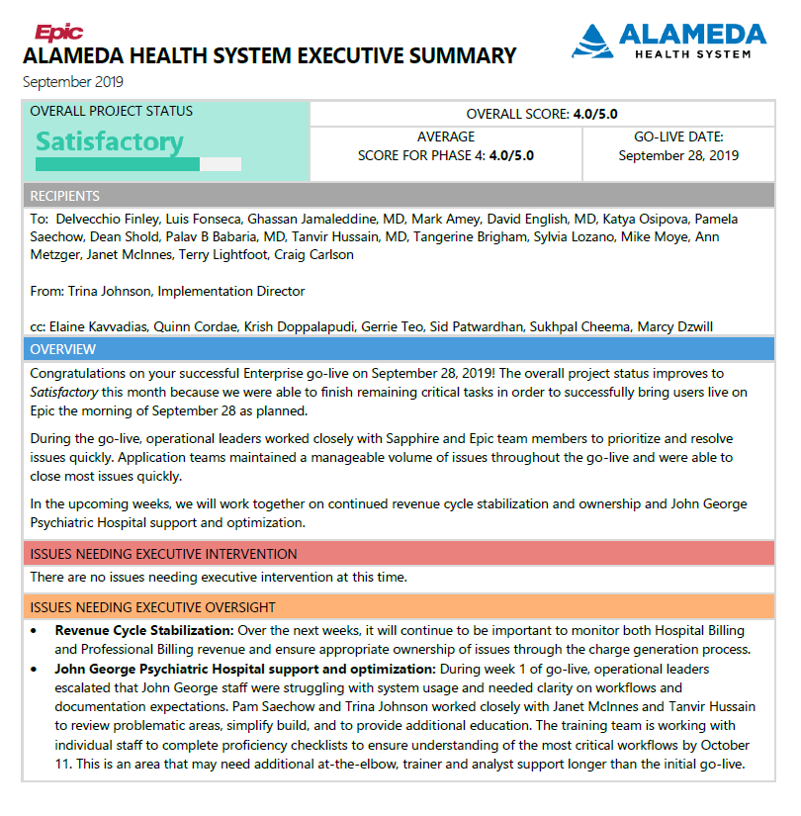

Project Status

Slide 13
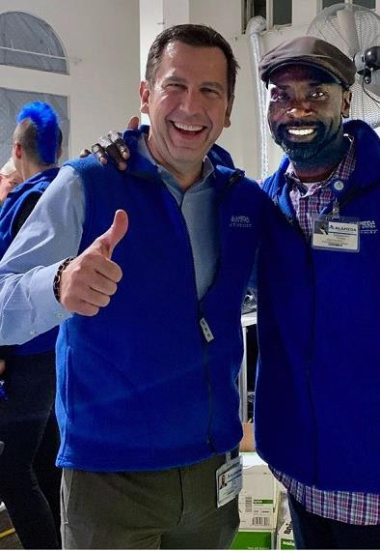
Go-Live Highlights
AHS went live on Epic at 5:51 a.m. on Saturday, September 28, 2019
AHS joins more than 400 other health systems and ~60% of California patients using Epic’s EHR
Notes:
Note: Balloon pumps can be integrated

Slide 14
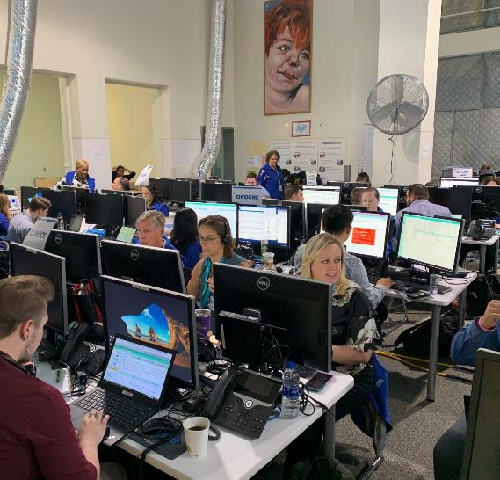
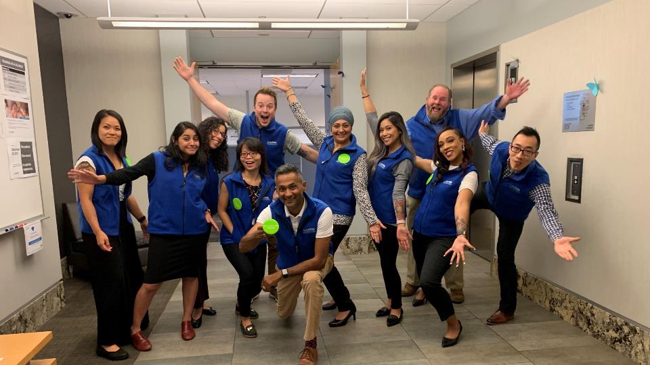
Highland Command Center

Slide 15
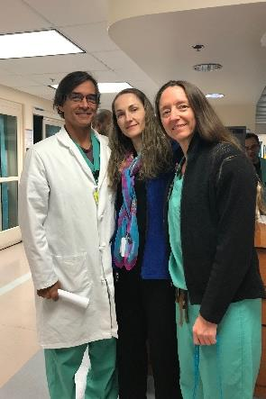
Epic Modules Live for AHS
Beaker (Lab)
Cupid (Cardiology)
Radiant (Radiology)
Long Term Care
Willow IP (Rx)
Willow Amb (Rx)
ASAP (ED)
Care Everywhere
EpicCare Link
EpicCare Inpatient
EpicCare Ambulatory
Healthy Planet
Behavioral Health
Bones (Ortho)
Caboodle & Cogito (Analytics Suite)
Cadence (Scheduling)
Grand Central (ADT)
Prelude (Enterprise Registration)
MyChart
OpTime and Anesthesia
Resolute Hospital Billing and Claims
Resolute Professional Billing and Claims
Wisdom (dental)
Stork (OB)
Tapestry (Managed Care)
HIM
Bugsy (Infection Control)
Rehab
Haiku/Canto/Rover (mobile)
Dr. Victorino, Katya Osipova, and Dr. Emily Miraflor
My M.A. loves Epic. She’s so happy to be able to secure chat with me.
-- Emily Miraflor, MD

Slide 16
Stats At-a-Glance
5,622 | AHS Users
79 | Trainers
95% | CPOE: % of orders entered into the system by ordering provider
29 | Epic modules implemented
126 | Interfaces live on Corepoint (New interface engine)
50+ | Legacy applications being decommissioned
1,254 | Patients enrolled in MyAlamedaHealth as of October 24
111 | Appointments schedule online
300+ | AHS Super Users
170 | Epic support staff
367 | External at-the-elbow supporters, including 10 MDs
“[With Epic] I’m a better doctor now. It’s more work, but well worth it.”
Taft Bhuket, MD
Chief of Gastroenterology

Slide 17
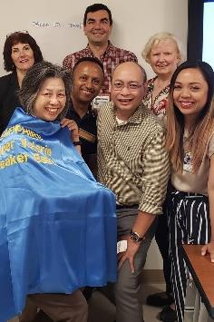
Key Post Go-live Focus Areas
  CMS survey
  John George readiness
  Lab processing

Slide 18
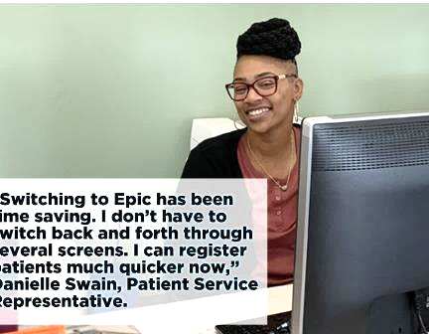
Coming Up
Stabilization
- 24/7 Service Desk Support
- Ongoing IS Epic Analyst support (Creekside)
Optimization
- Establish intake, prioritization, vetting processes for enhancement requests
Epic Post Go-Live Visits
at 2, 4, and 8 months
Training
Epic’s “Thrive” training to reinforce workflows, quick tips, etc. (2020)

Slide 19
Budget Projections
$26m positive variance is due largely to the timing issues
August – December is a significant spend (catch-up) time:
  $11+ mill for go-live support
  Consultants due to staff attrition
  ~$8.7m forecasted to be spent on consultants from Jul-Dec ‘19
Through FY2021 the project is projecting ~$3 mil positive variance

Slide 20
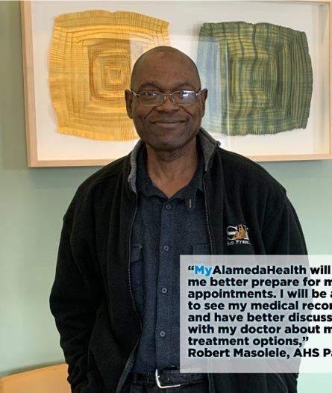
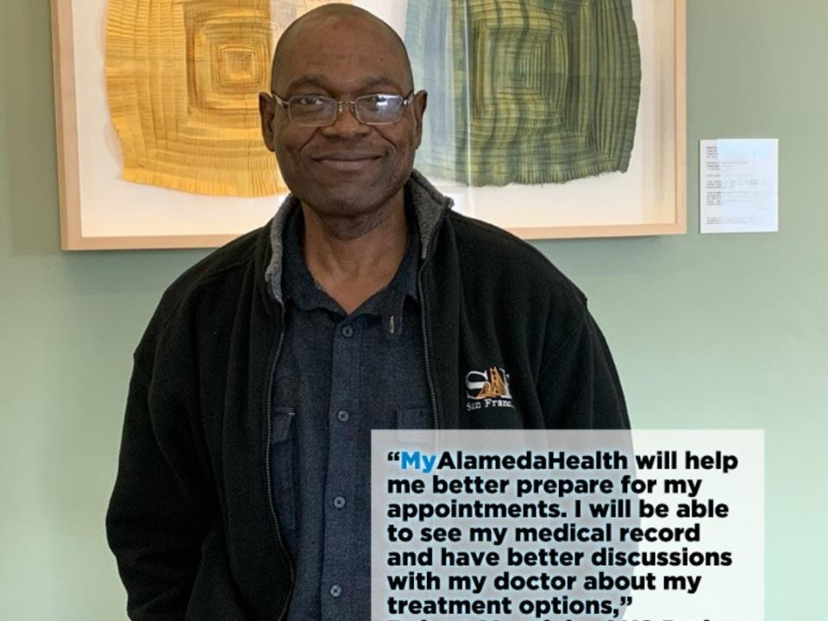
AHS Patient

Slide 21
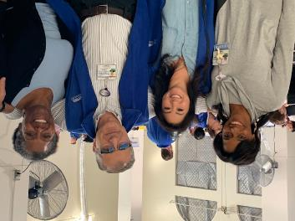
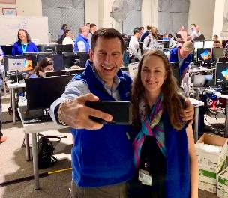
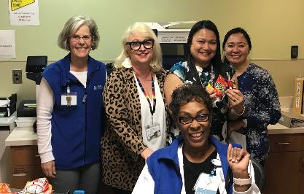
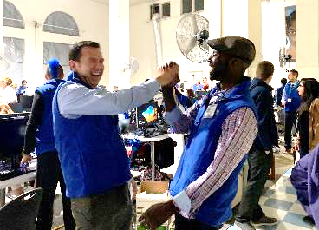
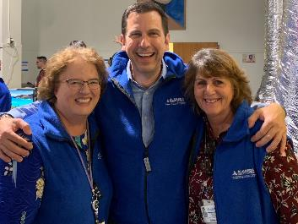
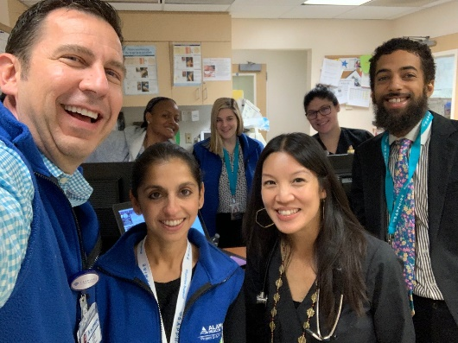
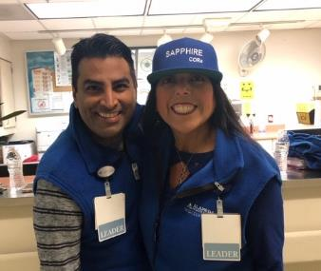
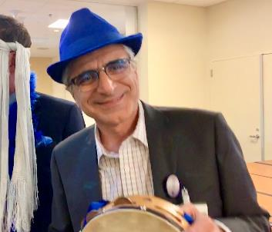
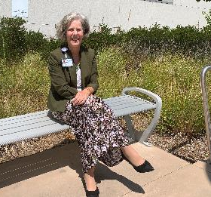
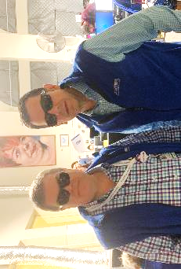
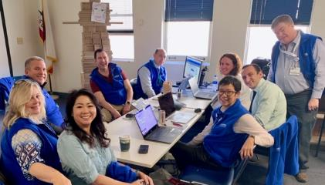
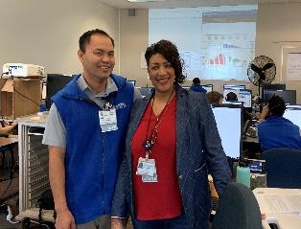
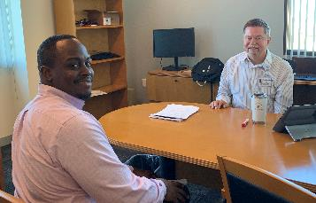
Teamwork makes the dream work.
Thank you to our Board and the entire AHS team!

Slide 22
CEO Report october 24, 2019
AHS Board of Trustees Meeting

Slide 23
Board of Trustees Meeting
PLEASE USE MICROPHONE
OCTOBER 24, 2019
Audio Recording in Progress

