Slide 1
Board of Trustees Meeting
PLEASE USE MICROPHONE
SEPTEMBER 26, 2019
Audio Recording in Progress

Slide 2
CEO Report september 26, 2019
AHS Board of Trustees Meeting

Slide 3
Updates
True North Metrics Dashboard
01
System Updates
02
Policy Updates
03
SAPPHIRE August Performance Status Update
04

Slide 4
Performance dashboard
AHS OPERATIONAL PLAN FY 2020

Slide 6

System UpdATEs

Slide 7
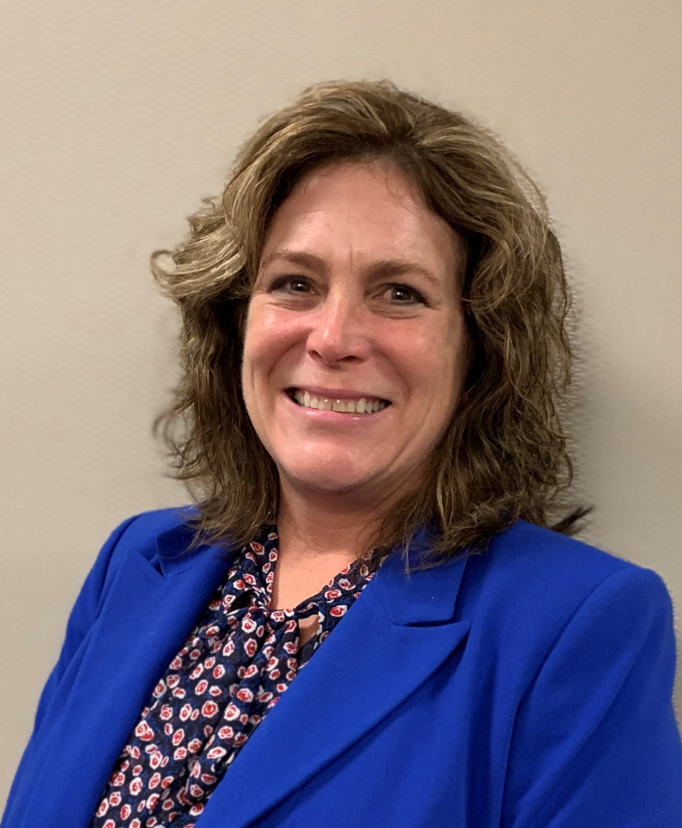
WELCOME!!
KIMBERLY MIRANDA CFO

Slide 8
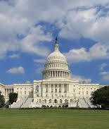
FEDERAL POLICY UPDATES
Notes:
New FFY starts 10/1 and Congress is set to be in recess as of tomorrow (barring no change relative to recent activities). There are several health-related proposed rules from the administration and bills in the Congress that are important to AHS, including:
Surprise Medical Billing Legislation- potential impact rate negotiations between AHS and plans
Prescription Drug Cost Legislation- potentially impact 340B program
Public Charge rulemaking- set to take effect 10/15 without intervention from the Courts
DSH Cuts- set to take effect 10/1 unless CR is passed by Senate and signed by the President
OPPS Rules- new requirements for posting of charges and “negotiated charges”

Slide 9
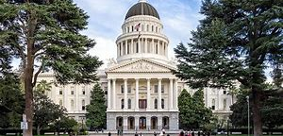
STATE POLICY UPDATES
Notes:
Meanwhile, in Sacramento- the legislation session ended September 13th. The Governor is in the process of signing various pieces of legislation that passed. Among them, are several laws that we see as beneficial to our mission and the community we serve, including:
-Expanded Medi-Cal coverage to undocumented adults age 19-25
-insurance subsidies for families earning between 400-600% FPL
-state-level insurance mandate
Of importance to us and our community (particularly Alameda), there was a bill sponsored to potentially offer some relief for hospitals still non-compliant with the 2030 seismic standards. This bill did not advance but has been extended into 2020 for further consideration.
There are ongoing efforts to work with DHCS and the Administration on understanding the future replacement options for Medi-Cal waiver set to expire in 2020.

Slide 10

LOCAL UPDATES
Notes:
Closer to home:
AHS FY20 Budget Efforts
Behavioral Health Fiscal Analysis and future contracting efforts
SHIE is live
APC Support
Medi-Cal Enrollment trends
Within AHS
SAPPHIRE Go-Live
Budget Completion and Approval
Ongoing quality improvement activities
Labor Negotiations
Leadership Transitions (John George, AHP)

Slide 11


Project Update

Slide 12
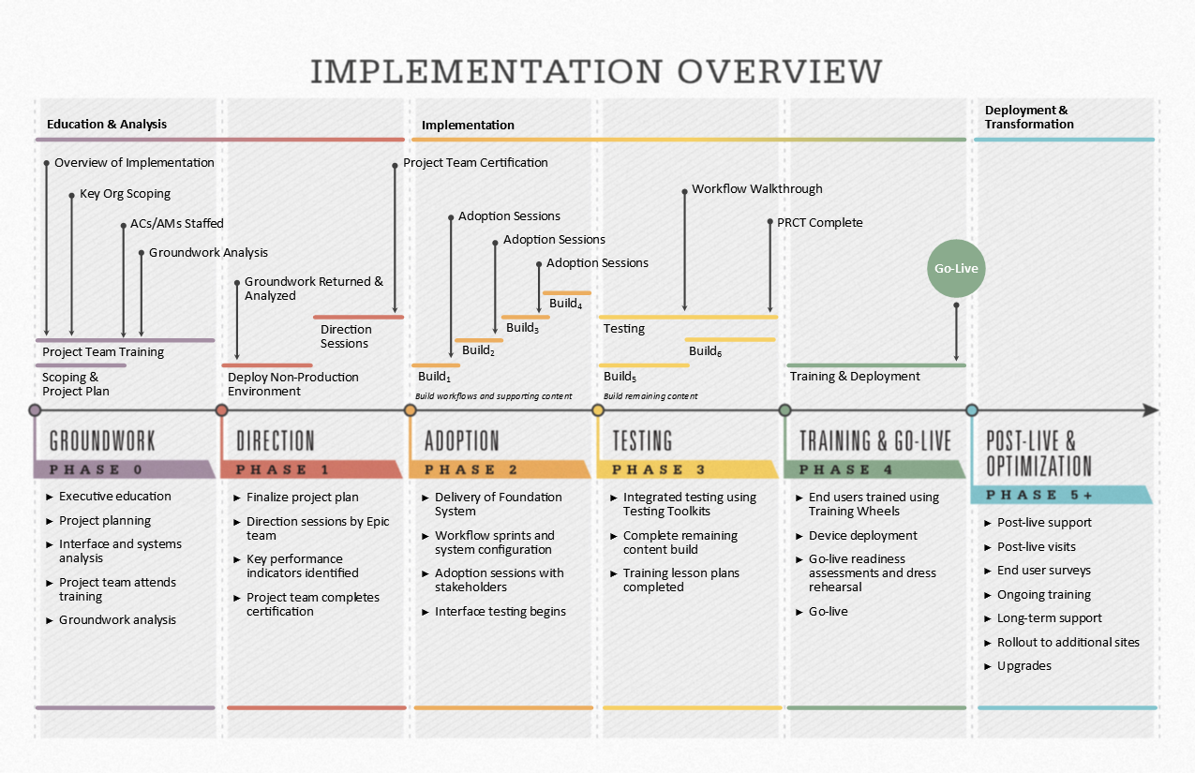
  Training, Cut-Over, and Go-Live
  (Sept - Oct 2019)
  Finish End User Training
  Login and Personalization Labs underway
  Finalize Cutover Activities
  Finalize Go-Live Prep

Slide 13
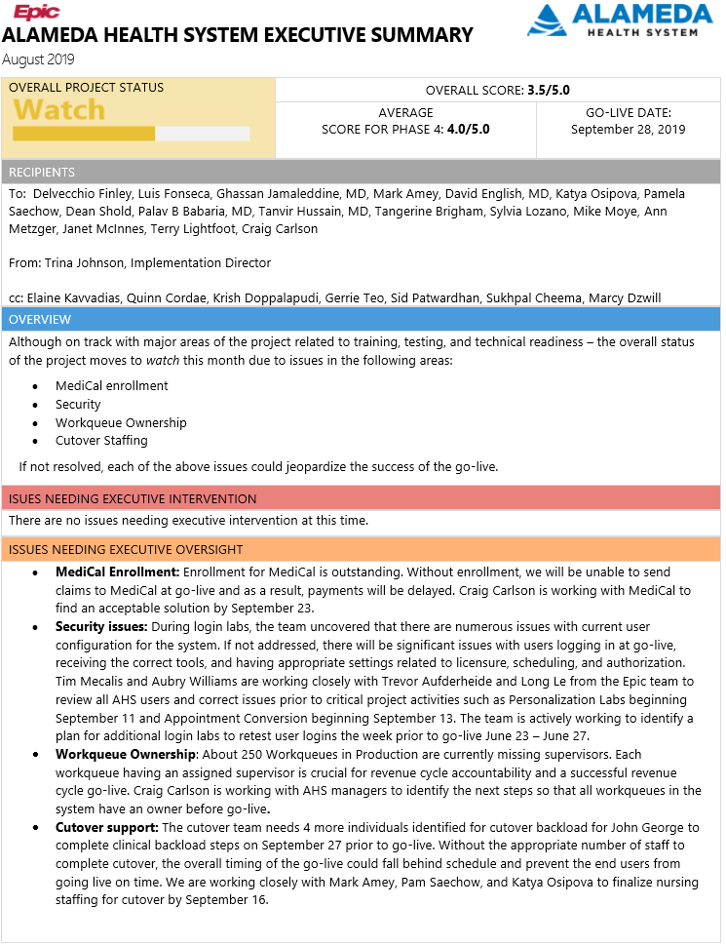
Overall Project Status: WATCH
User Access Control – Resolving (will be a watch item during go-live)
  Have run Turbo Rooms
  Doing ”catch-up login labs”
Work queue ownership in Rev Cycle - Resolved
MediCal Enrollment – In-Process (not a risk)
    Late enrollment in MediCal
    Claims will be able to be submitted ~ 10/1
Cutover Support - Resolved
    Nursing staff for backload has been identified

Slide 14
Project Major Accomplishments
Training Efforts
  Provider Personalization Labs started 9/11 and progressing (434 complete!)
  End User Training is at 92% (completed) (52 classes run on Wednesday’s alone)
Security
  Login Labs to verify user access started 9/23
Cutover – back load is going on as we speak
Soft Go-Live – We’re live!
  Post Acute backload in progress: 9/12 – 9/27
  Chart Abstraction in progress: 9/18 – 9/27
  Appointment and Case conversion: 9/13 – 9/15
Go-Live and Activation
  Final Preparations for 9/28 Go-Live
  Super User Orientations in progress: 9/23 – 9/25
  At the Elbow Support schedule finalized
  SAPPHIRE Command Center setup and support schedule complete

Slide 15
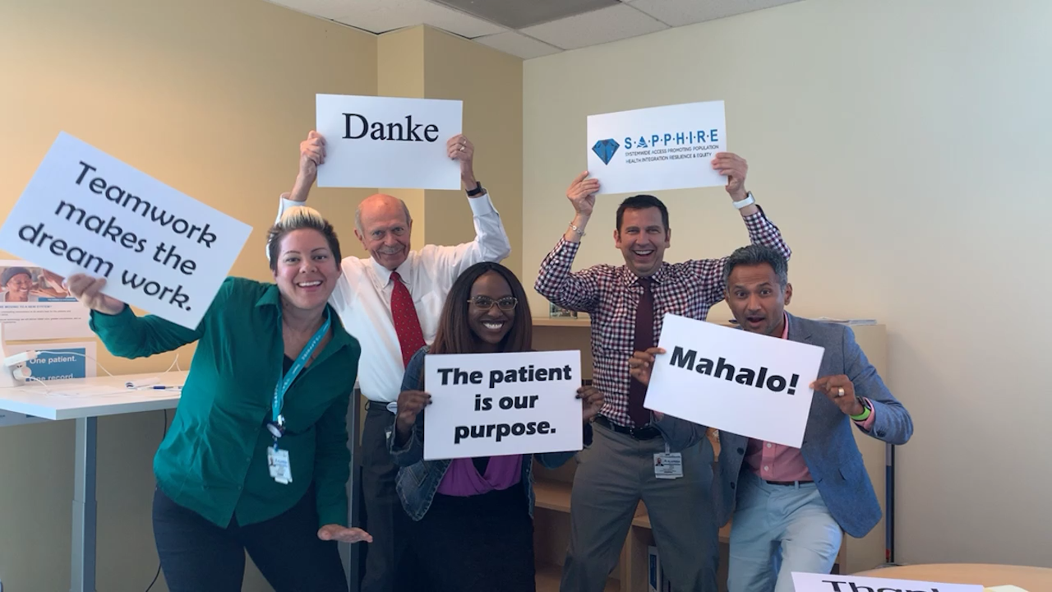
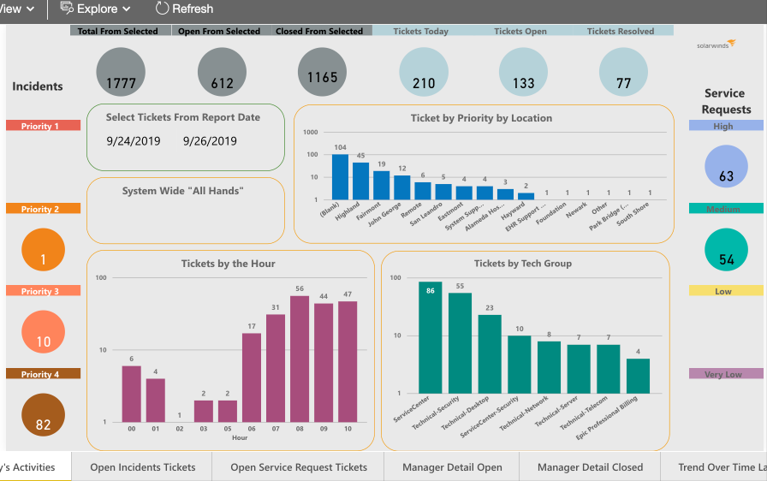
Upcoming Activities
Complete cut-over tasks Thur – Sat AM
Go / No-Go Call 4:00 AM Saturday
Go-Live! ~5:00 AM Saturday
Monitor post go-live metrics
Support our Customers

Slide 16
Budget Projections
Actual Spend
$26 mm positive variance is due largely to timing issues
August – December is a significant spend (catch-up) time
  For example:
  $11+ mill for go-live support
  Consultant due to staff attrition
Through FY2021 the project is projecting ~$4 mill positive variance

Slide 17
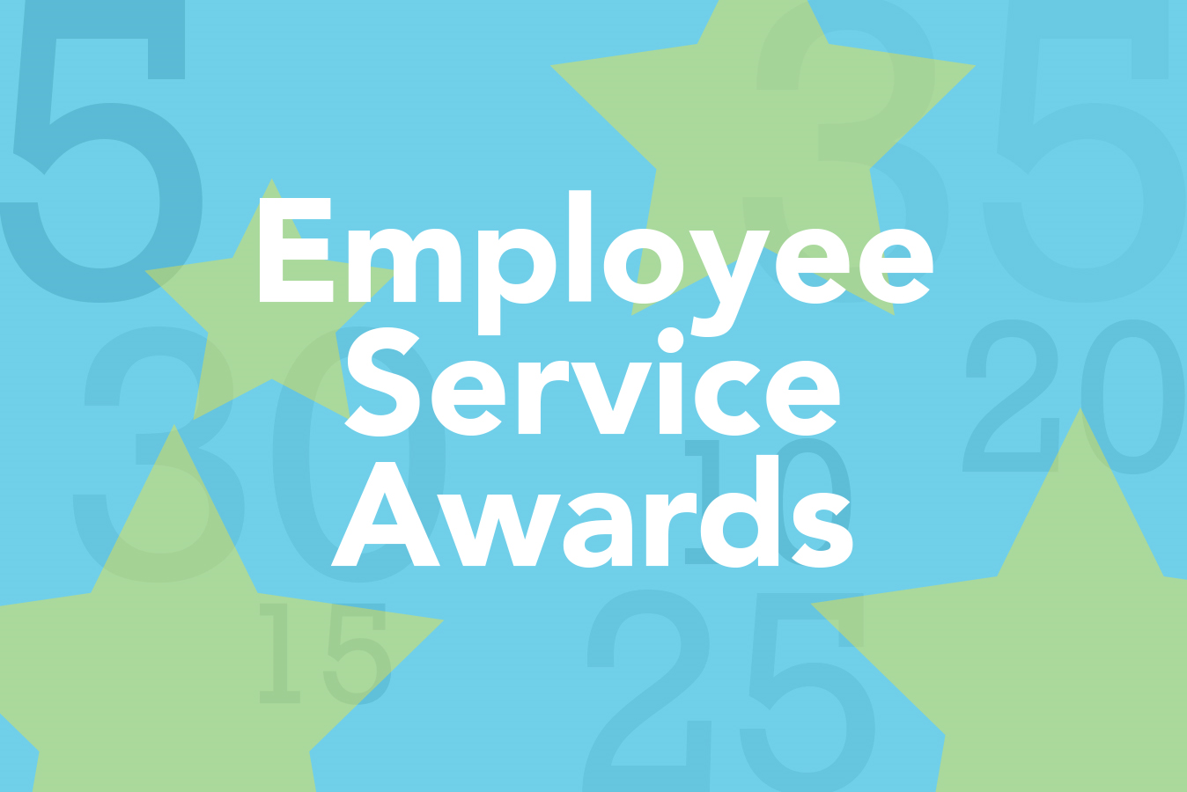
FRIDAY, OCTOBER 11, 2019

Slide 18
CEO Report september 26, 2019
AHS Board of Trustees Meeting

Slide 19
Board of Trustees Meeting
PLEASE USE MICROPHONE
SEPTEMBER 26, 2019
Audio Recording in Progress

