Slide 1


Project Update

Slide 2
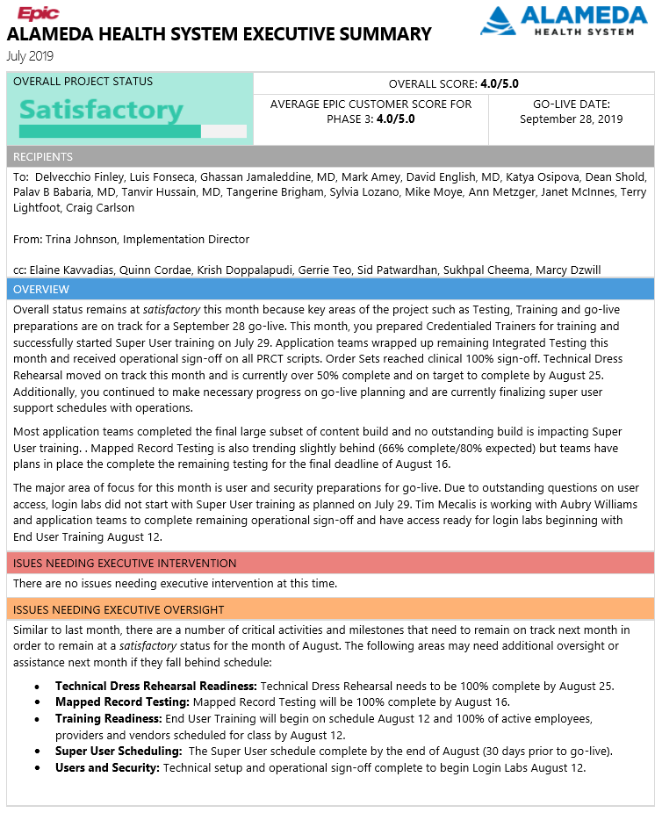

Slide 3
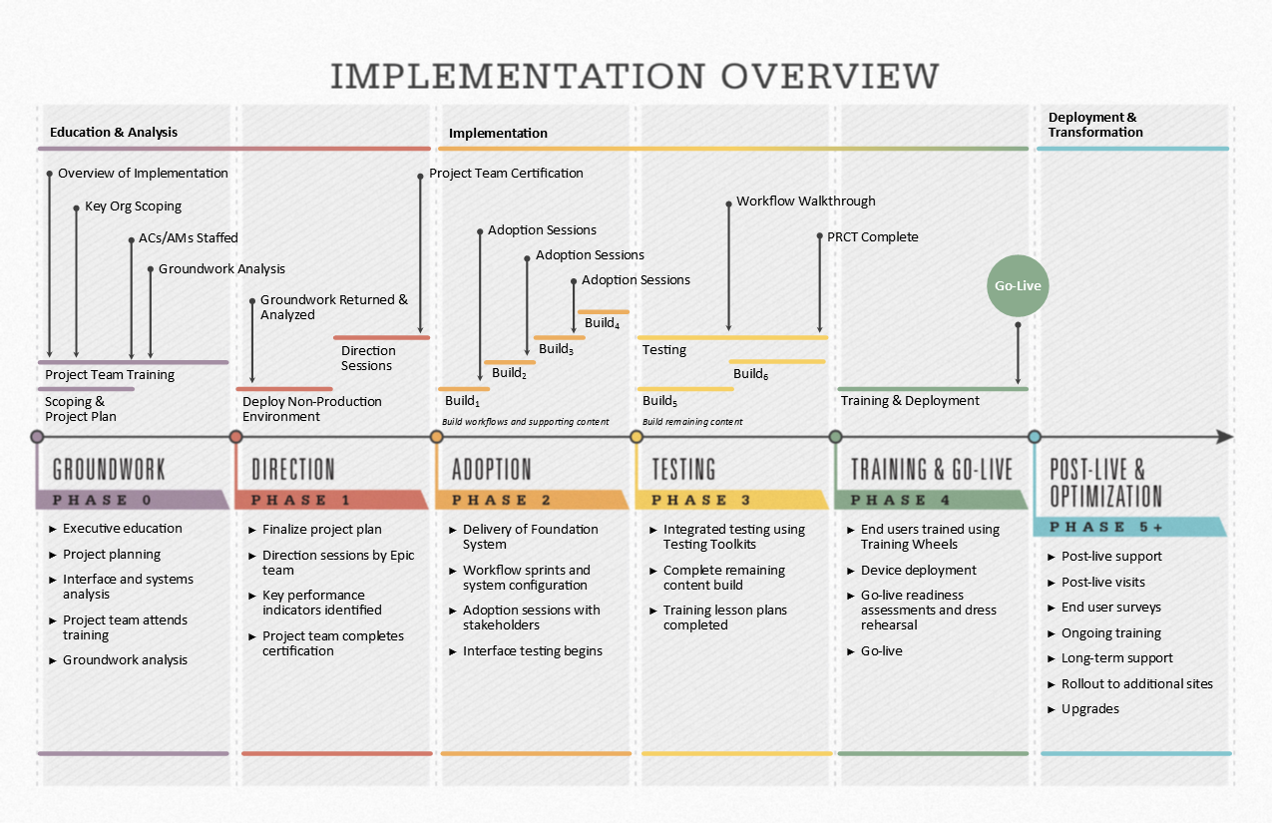
  Training and Go-Live (August 2019 – September 2019)
  Start End User Training
  Finalize go-live preparations
  Prepare for Cut-Over Activities
  Demonstrate final workflows during Workflow Walkthrough and other change management activities

Slide 4
Project Major Accomplishments
Testing Efforts:
  Integrated Testing & Scenario Based Testing (SBT) is 100% complete
  Mapped Record Testing (MRT) effort is 90% complete
Training Efforts:
  Credentialed Training (CT), Specialists Training Specialists (STS) and Super User (SU) Training is complete
  End User Training started on 8/12 as planned
LTC Workflow Walkthrough
  Activity Completed Successfully on 8/15 as scheduled
Cutover
  Dry Run complete on 8/14, one more planned on 9/5 and a potential one closer to go live.
  Cutover SME recruitment in progress.
Go Live and Activation:
  Go-Live support schedule gaps are being reconciled and planning is in progress.
  Command Center and satellite locations build out is in progress.
  Go-live logistics checklist being executed.
TDR
  TDR is 80 % Complete
Notes:
Note: Balloon pumps can be integrated

Slide 5
Areas of Focus
Security Access Controls within Epic
  Determination of “source of truth” for various user types
  Epic User Access validation and sign off with managers
Epic build freeze – no additional “late build” items
Go-live staffing
  Physician at the elbow support staff augmentation
  General user at the elbow support ratios & enrollment
  SAPPHIRE team staffing
Revenue Cycle operational risk mitigation strategy
Notes:
Note: Balloon pumps can be integrated

Slide 6
Focus for August/September
Complete MRT (Mapped Record Testing)
Complete End User Training
Complete TDR
Conduct GLRA 30 day on August 21
Continue working on Go-Live Planning and Activation
Finalize Go-Live scheduling slots
Disaster Recovery Failover Test on August 28
Finalize Cutover Activities and Schedule
Conduct Dress Rehearsal Activities the week of September 16
Finalize Go-Live logistics

