Slide 1
Board of Trustees Meeting
PLEASE USE MICROPHONE
June 27, 2019
Audio Recording in Progress

Slide 2
CEO Report
JUNE 27, 2019
AHS Board of Trustees Meeting

Slide 3
Updates
True North Metrics Dashboard
01
System Updates
02
SAPPHIRE January Performance Status Update
03
Closing Reflections
04

Slide 4
Performance dashboard
AHS OPERATIONAL PLAN FY 2019

Slide 5
Notes:
As usual, you have already received the monthly TNM Dashboard. The month of March was a challenging month in the areas of access, quality, and experience in particular. These results suggest a great deal of work to do in these areas to achieve/maintain the desired level of across-the-board performance. This thinking may need to inform the exec team and the board’s actions around setting goals for the next year, which we will begin to discuss more in the relevant committees and at the full board level in the coming months. Despite current performance, there is a growing sense across the organization that the quality teams

Slide 6

System UpdATEs

Slide 7

AHS recognized for Anchor efforts
Notes:
ADD SLIDE ABOUT HR RECOGNITION
CONSIDER SLIDE ABOUT IMMIGRATION ENFORCEMENT ACTIONS
CONSIDER SLIDE ABOUT PRIDE MONTH

Slide 8
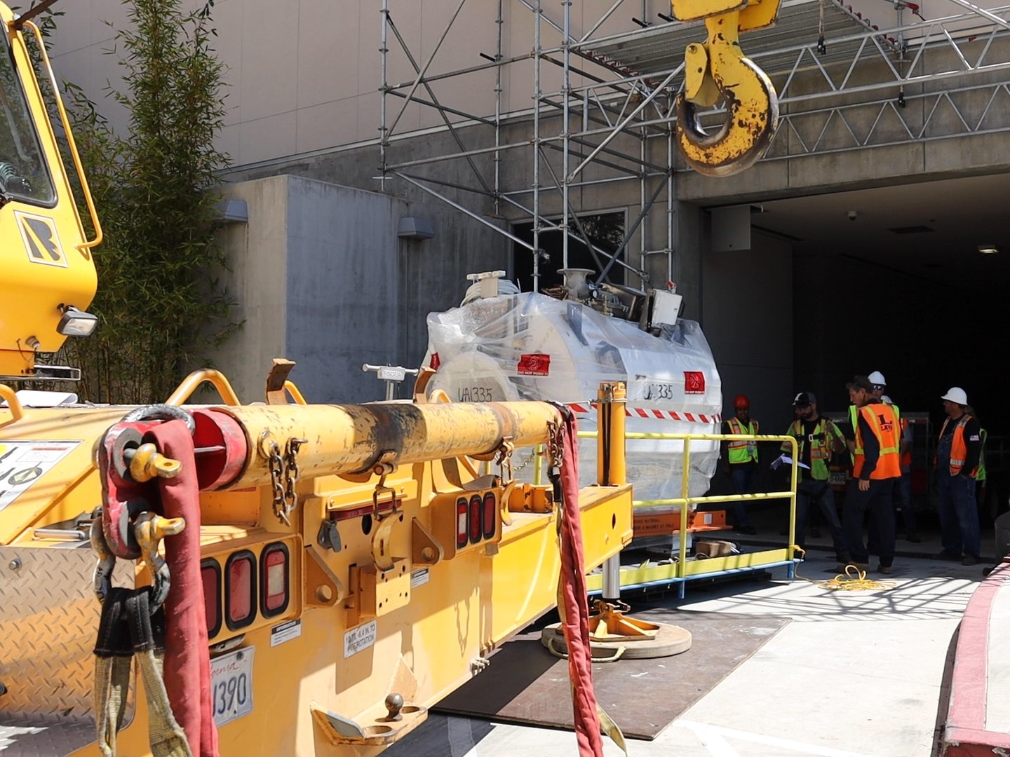
New MRI Unit arrives at Highland
Notes:
ADD SLIDE ABOUT HR RECOGNITION
CONSIDER SLIDE ABOUT IMMIGRATION ENFORCEMENT ACTIONS
CONSIDER SLIDE ABOUT PRIDE MONTH

Slide 9
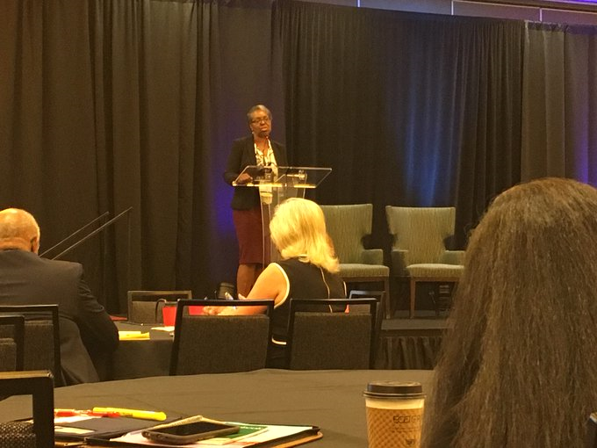
AHS sponsored and keynoted at National Conference on Health Disparities

Slide 10

President issues Executive Order on Hospital Pricing Transparency
Notes:
ADD SLIDE ABOUT UNIFICATION EFFORTS
CONSIDER SLIDE ABOUT FEDERAL LEGISLATION ON SURPRISE BILLING
CONSIDER SLIDE ABOUT PRESIDENTIAL EO ON BILLING TRANSPARENCY

Slide 11

Future of Physician Engagement and Partnership at AHS

Slide 12


Project Update

Slide 13
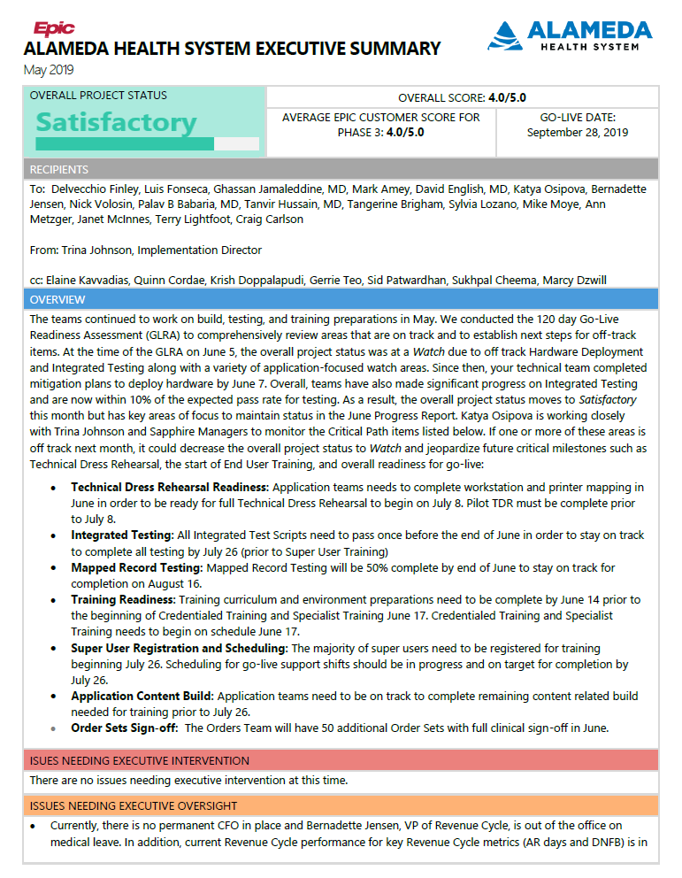

Slide 14
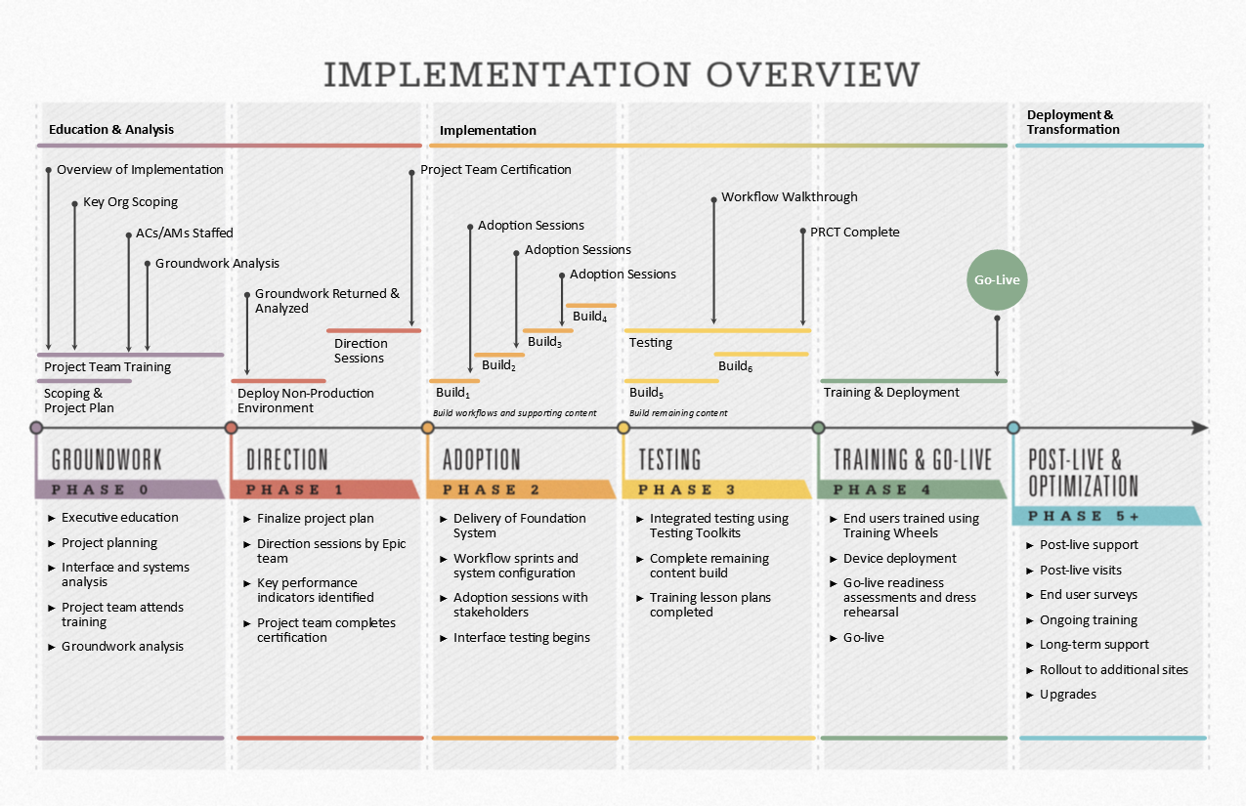
  TESTING (January 2019 – July 2019)
  Complete robust testing
  Begin go-live preparations
  Complete preparations for training
  Demonstrate final workflows during Workflow Walkthrough and other change management activities

Slide 15
Project Major Accomplishments
Testing Efforts:
  Integrated Testing Pass 1 is over 80% complete
  Round 2 with SME involvement is over 40% complete
  Mapped Record Testing (MRT) effort is underway
  Revenue Cycle Testing is in progress
Training Efforts:
  Credentialed Training (CT) started as planned on June 17
  Specialists Training Specialists (STS) Training started on June 18
  Super User recruitment is complete (751 SUs identified), currently under validation
  Super User enrollment for traininig is at 70%
  End User Training registration for training is at 50%
  341 unique classes are provided with 1,590 of training sessions offered
Project is favorable to budget
Cutover
  Dry Run dates are set: 7/30, 8/14 and 9/5
  Cutover SME recruitment in progress
Go Live and Activation:
  Go-Live scheduling in progress
  Command Center and satellite location build out in progress
  Go-live logistics checklist being executed
Notes:
Note: Balloon pumps can be integrated

Slide 16
Areas of Focus
Technical Dress Rehearsal – print mapping mitigation in place for TDR to begin on July 8
Order Sets review is trending behind. Mitigation plan in place and will continue to monitor closely.
Integrated Testing is trending behind. Mitigation plan in place and will continue to monitor closely.
Review and confirm key Long-Term Care Billing workflows to ensure functionality and workflows are ready for go-live.
Notes:
Note: Balloon pumps can be integrated

Slide 17
Focus for July
Complete Integrated Testing Pass 2 and MRT (Mapped Record Testing)
Complete Training for Specialist Trainers & Credentialed Trainers
Super User Training begins on July 29
TDR – Technical Dress Rehearsal execution in progress
Conduct GLRA 30 day on July 31
Continue Order Sets build, review and approval
Prepare for Scenario Based Testing (SBT) and Workflow Walkthrough that will be taking place in July
Continue Cutover Activities
Continue working on Go-Live Planning and Activation

Slide 19
CEO Report june 27, 2019
AHS Board of Trustees Meeting

Slide 20
Board of Trustees Meeting
PLEASE USE MICROPHONE
JUNE 27, 2019
Audio Recording in Progress

