Slide 1
Board of Trustees Meeting
PLEASE USE MICROPHONE
May 23, 2019
Audio Recording in Progress

Slide 2
CEO Report
May 23, 2019
AHS Board of Trustees Meeting

Slide 3
Updates
True North Metrics Dashboard
01
System Updates
02
SAPPHIRE January Performance Status Update
03
Closing Reflections
04

Slide 4
Performance dashboard
AHS OPERATIONAL PLAN FY 2019

Slide 5
Notes:
As usual, you have already received the monthly TNM Dashboard. The month of March was a challenging month in the areas of access, quality, and experience in particular. These results suggest a great deal of work to do in these areas to achieve/maintain the desired level of across-the-board performance. This thinking may need to inform the exec team and the board’s actions around setting goals for the next year, which we will begin to discuss more in the relevant committees and at the full board level in the coming months. Despite current performance, there is a growing sense across the organization that the quality teams

Slide 6

System UpdATEs
Notes:
When we focus on dashboards and budgets, we often lose sight of the stories behind the incredible mission-driven work that happens day in and day out at AHS. In this spirit, and because we will spend time tomorrow talking in great detail about budgets and quality, let’s spend a few moments reflecting on our mission and values.
Read letter from Doctor-father and story of family in ED/Inpatient

Slide 7
Thank you for your Support!
Notes:
Governor’s May Revise Budget

Slide 8
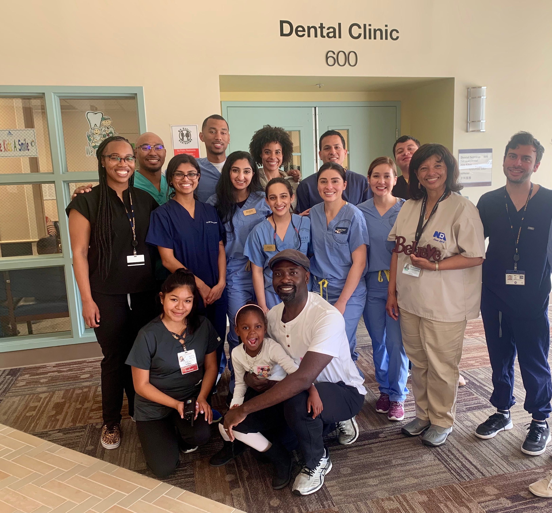
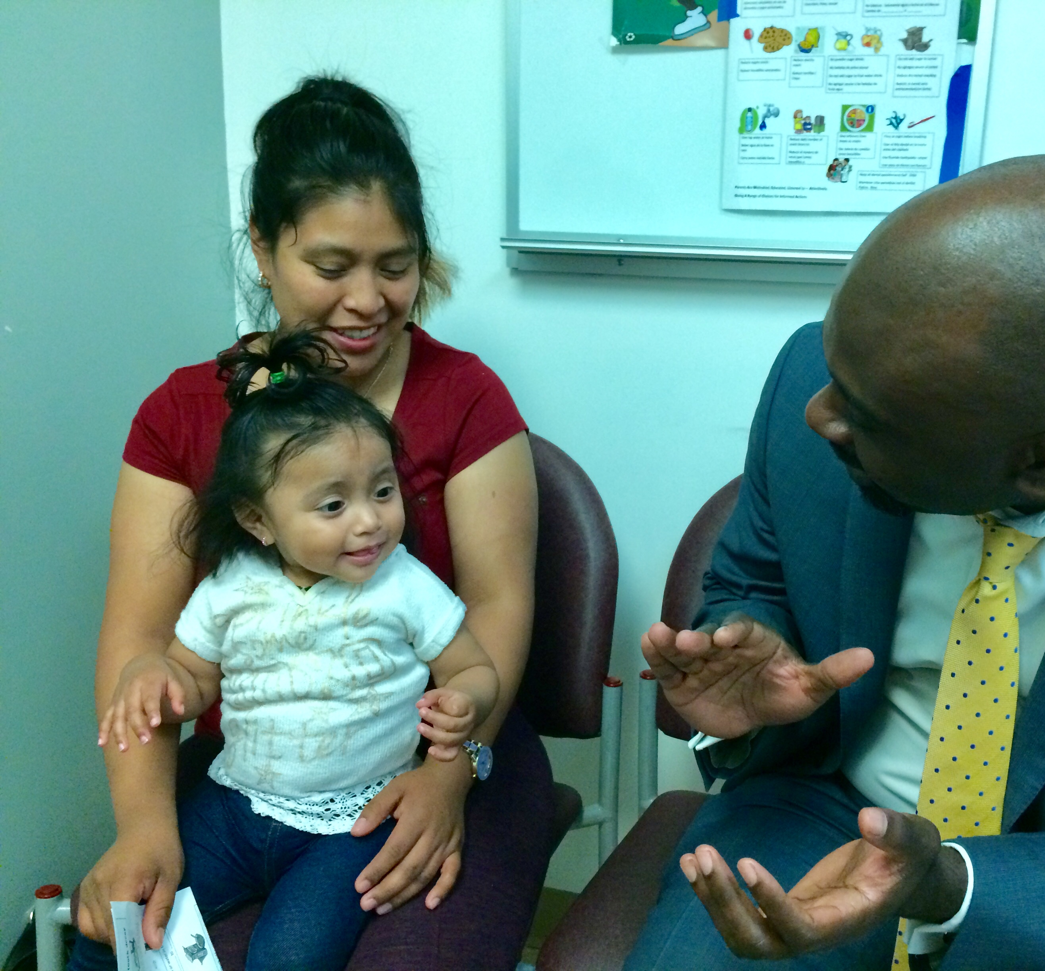
AHS continues to do our part in addressing disparities in dental health equity
Notes:
Federal Level
-AWI Changes
-DSH Cuts

Slide 9

Governor Newsom’s May Revise Budget strikes both positive and concerning chords for the safety net
Notes:
Note effort to advance a tool with the Board to better capture the commitment to Health Equity and D&I is in the works. Thank Maria.

Slide 10


Project Update

Slide 11
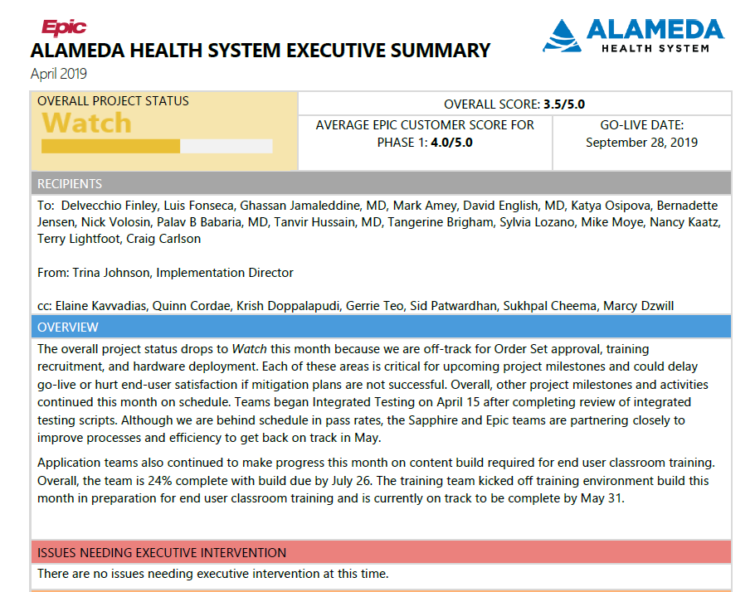

Slide 12
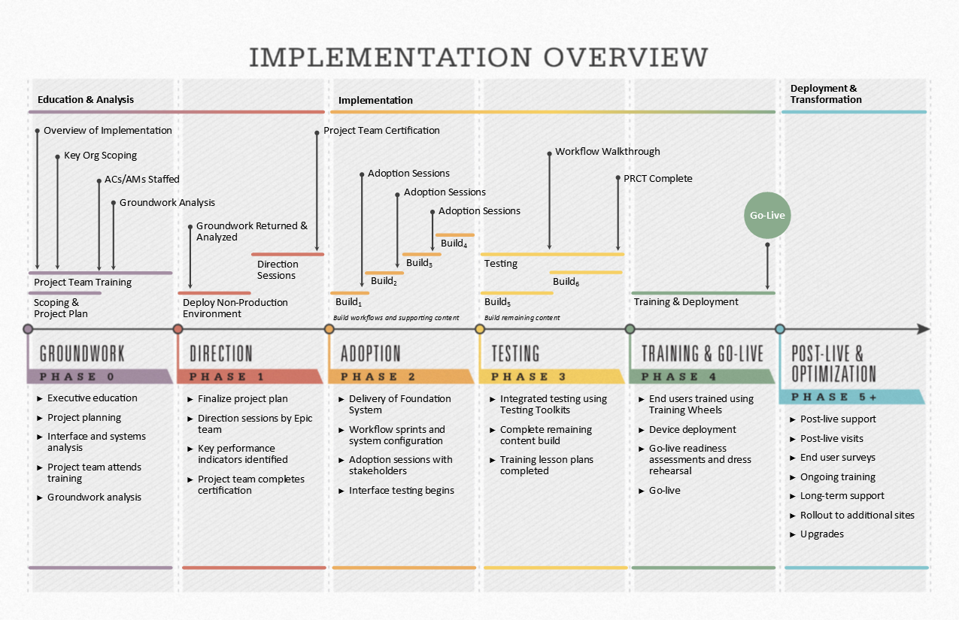
  TESTING (January 2019 – July 2019)
  Complete robust testing
  Begin go-live preparations
  Complete preparations for training
  Demonstrate final workflows during Workflow Walkthrough and other change management activities

Slide 13
Project Major Accomplishments
Testing efforts:
  Integrated Testing Round 1 is complete, Round 2 started on May 20th
  Parallel Revenue Cycle Testing (PRCT) with SME involvement started the week of May 20th
  Full Scale Conversion Testing Round 2 (data loads) started on May 20th
Project is favorable to budget
Technical efforts:
  Epic May 2019 Upgrade delivered successfully on May 15, last one before the Go Live
  24” monitor upgrades 93% completed
  Medical Device Integration testing continues
  2 Factor Authentication Pilot starting in May
  First phase of wireless site survey completed
  All new WOW units have now been received and are being staged for deployment
  Business Continuity Access (BCA) walkthroughs are complete
Notes:
Note: Balloon pumps can be integrated

Slide 14
Project Major Accomplishments
Training Efforts:
  Specialists Training Specialists (STS) are 100% identified (40/40)
  Required Credentialed Trainers (CT) are 100% identified (47/47)
  Super Users (SU) recruitment is in progress, ~ 43% identified (340/788)
  Class registration is underway
  Training space is secured. Next step is equipment setup in early June
Notes:
Note: Balloon pumps can be integrated

Slide 15
Areas of Focus
Device deployment behind schedule. Mitigation plan is in place to ensure on time start for TDR (Technical Dress Rehearsal) in July.
Order Sets review is trending behind. In progress of putting mitigation plan in place and will continue to monitor closely.
Super Users (SU) recruitment is trending behind. Mitigation plan incorporates focused outreach to department leaders.
Notes:
Note: Balloon pumps can be integrated

Slide 16
Focus for June
Complete Integrated Testing Round 2 and start Round 3
Finalize recruitment for Super Users and start scheduling for their respective training
Training for Specialist Trainers & Credentialed Trainers begins on June 17th
Continue preparation for Technical Dress Rehearsal (TDR)
Hold Go Live Readiness Assessment (GLRA) 120 day on June 5 and GLRA 90 day on June 26
Continue Order Sets build and review
Prepare for Scenario Based Testing (SBT) and Workflow Walkthrough that will be taking place in July
Continue working on Go-Live Planning and Activation

Slide 18
CEO Report
MAY 23, 2019
AHS Board of Trustees Meeting

Slide 19
Board of Trustees Meeting
PLEASE USE MICROPHONE
May 23, 2019
Audio Recording in Progress

