Slide 1
Board of Trustees Meeting
PLEASE USE MICROPHONE
April 25, 2019
Audio Recording in Progress

Slide 2
CEO Report
APRIL 25, 2019
AHS Board of Trustees Meeting

Slide 3
Updates
True North Metrics Dashboard
01
System Updates
02
SAPPHIRE January Performance Status Update
03
Closing Reflections
04

Slide 4
Performance dashboard
AHS OPERATIONAL PLAN FY 2019

Slide 5
Notes:
As usual, you have already received the monthly TNM Dashboard. The month of March was a challenging month in the areas of access, quality, and experience in particular. These results suggest a great deal of work to do in these areas to achieve/maintain the desired level of across-the-board performance. This thinking may need to inform the exec team and the board’s actions around setting goals for the next year, which we will begin to discuss more in the relevant committees and at the full board level in the coming months. Despite current performance, there is a growing sense across the organization that the quality teams

Slide 6

System UpdATEs
Notes:
When we focus on dashboards and budgets, we often lose sight of the stories behind the incredible mission-driven work that happens day in and day out at AHS. In this spirit, and because we will spend time tomorrow talking in great detail about budgets and quality, let’s spend a few moments reflecting on our mission and values.
Read letter from Doctor-father and story of family in ED/Inpatient

Slide 7
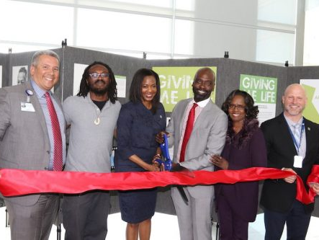
Giving Me Life Exhibition
Notes:
Janice Whaley, CEO

Slide 8


AHS continues to do our part in addressing disparities in maternal health equity
Notes:
Thank Kinkini
Kalayjah’s story
Recognize OB/GYN and Pediatrics leaders and providers (including Tanefer L.)
3 to 4 times more likely to die in childbirth
CenteringPregnancy and Midwifery resources
Margarite Curry video (https://www.youtube.com/watch?v=HjvtErSOnws&feature=youtu.be)

Slide 9

AHS Board Members and Executive Leaders providing local leadership on addressing implicit bias
Notes:
Note effort to advance a tool with the Board to better capture the commitment to Health Equity and D&I is in the works. Thank Maria.

Slide 10


Project Update

Slide 11
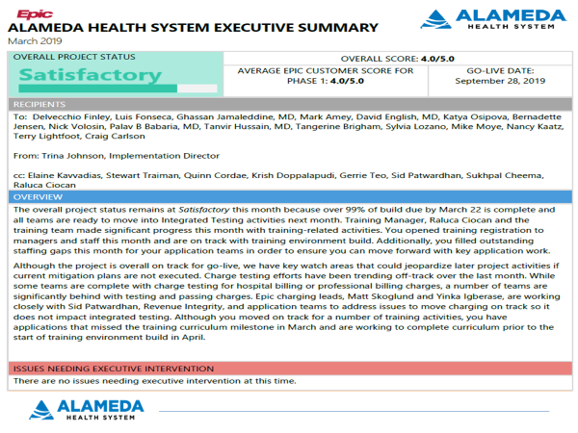

Slide 12
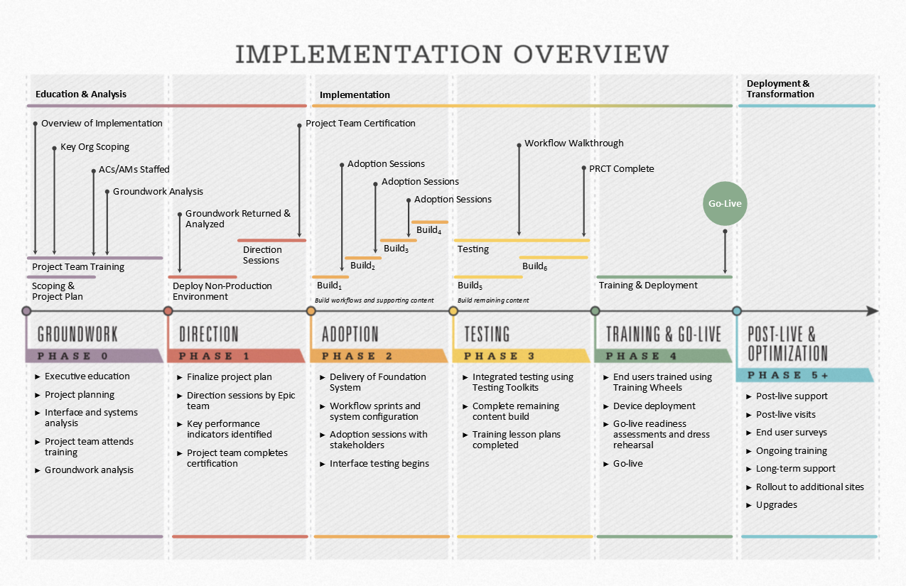
  TESTING (January 2019 – July 2019)
  Complete robust testing
  Begin go-live preparations
  Complete preparations for training
  Demonstrate final workflows during Workflow Walkthrough and other change management activities

Slide 13
Project Major Accomplishments
Testing efforts:
  Integrated Testing Round 1 scripts execution began on April 16
  Parallel Revenue Cycle Testing (PRCT) began on April 22
  Charge testing is in progress
  Full scale conversion testing Round 1 is in progress
Project is on track and favorable to budget
Technical efforts:
  24” monitor upgrades 93% completed
  Medical Device Integration testing continues
  BCA Walkthroughs are in progress
  2 Factor Authentication Pilot starting this month
  Non-IS SMEs starting to access Epic test and playground environment (physicians, Ambulatory scheduling, etc.)
Go Live Planning efforts:
  Go Live Readiness Assessment invites sent for 120, 90, 60 and 30 days
  Cutover and appointment conversion planning underway
Notes:
Note: Balloon pumps can be integrated

Slide 14
Project Major Accomplishments
Training Efforts:
  All Unions agreed to participate
  Training environment build started on April 22
  Recruitment underway for internal Credentialed Trainers (CT), Specialists Training Specialsts (STS) and Super Users (SU) to reduce need for external resources
  Final list of participant for computer literacy training is expected on 4/26. We have 267 individuals identified.
  Class registration is underway
  Training space is secured. Next step is equipment setup in early June
Notes:
Note: Balloon pumps can be integrated

Slide 15
Areas of Focus
TDR (Technical Dress Rehearsal) is trending behind, mitigation plan in place for application print mapping
Charge Testing is trending slightly behind; teams will catch up by mid-May
Ambulatory specialties content build and signoff is behind, mitigation plan in place in alignment with Ambulatory leadership
Order Sets review is trending behind, mitigation plan in place and will continue to monitor closely
Training Manager role has been transitioned this week to a new contract-to-hire resource
Clinical Charge Capture position has been open since August, recruitment is underway
Notes:
Note: Balloon pumps can be integrated

Slide 16
Focus for May
Complete Integrated Testing Round 1 and proceed with Round 2; continue with Charge testing
Finalize recruitment for internal Credentialed Trainers, Specialist Trainers, and Super Users and start scheduling for their respective training
Continue enrollment of training courses
Continue Technical Dress Rehearsal (TDR) work effort
Continue Order Sets build and review
Continue with Go Live Readiness Assessment (GLRA) and Go Live planning
Finalizing Help Desk process & Epic FAQs
Coordinating Cutover plan
Finalizing the equipment for go-live (workstations, printers, plotting floor maps, etc.)
Delivery of Epic May 2019 Quarterly Upgrade

Slide 17
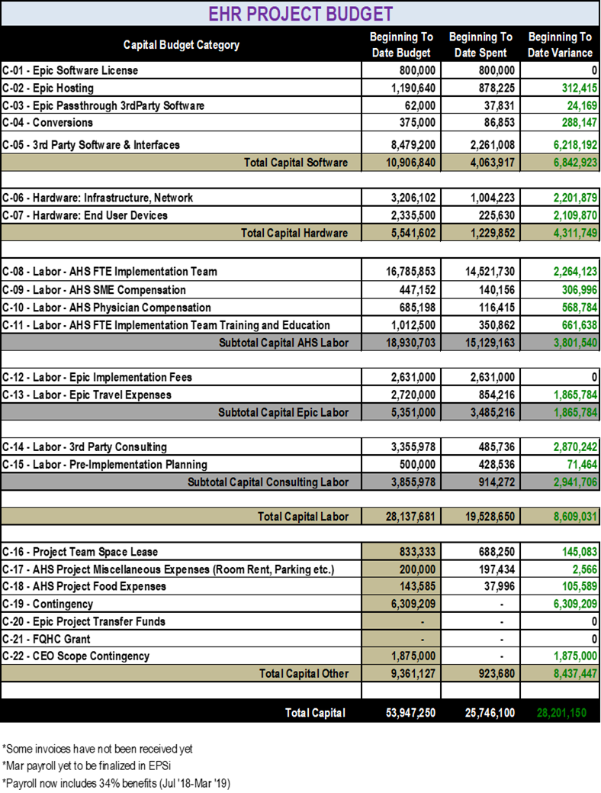

Slide 18
CEO Report
APRIL 25, 2019
AHS Board of Trustees Meeting

Slide 19
Board of Trustees Meeting
PLEASE USE MICROPHONE
April 25, 2019
Audio Recording in Progress

