Slide 1
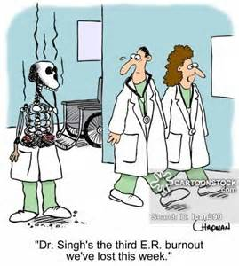
Burnout as a Quality Metric
Gene Hern, MD
Chair, Wellness Task Force

Slide 2
Why should YOU care? Because as the Board of Trustees you need to realize that more than ½ of your STAFF is burned out!
More likely to quit
Cost of replacement 2-3X MD Salary
More prone to alcohol abuse and dependence
More likely to commit suicide
Male doctors: 40% higher
Females: 130% higher

Slide 3
More mistakes and malpractice
Quality Indicators
Unprofessional conduct
Behavior Investigations
Treat patients as objects (depersonalization)
Poor Star Scores, Press Ganey Scores
Poor patient compliance and satisfaction
Poor Health Outcomes

Slide 4
Depressed Residents make 6x the number of medication errors

Slide 5
Major surgical errors strongly related to degree of Burnout

Slide 6
Increased Fatigue and Distress correlate with higher rates of Errors

Slide 7
Workforce
Reduced work effort
Mayo Study
Suicides: 400 a year nationwide (2 medical school classes)
Early Retirement 47%

Slide 8
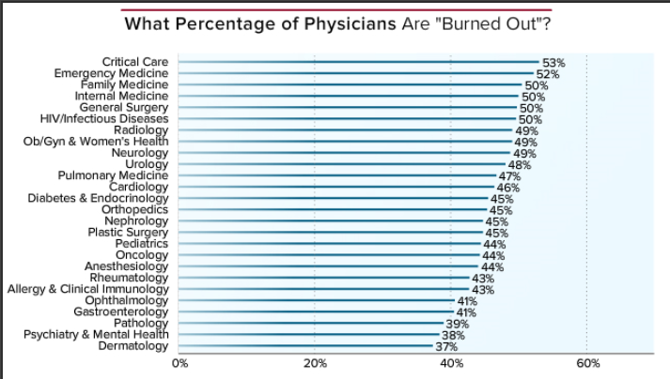

Slide 9
Burnout vs. Stress
Ability to recover in time off
Leads to:
Exhaustion
Depersonalization
Devaluation

Slide 10
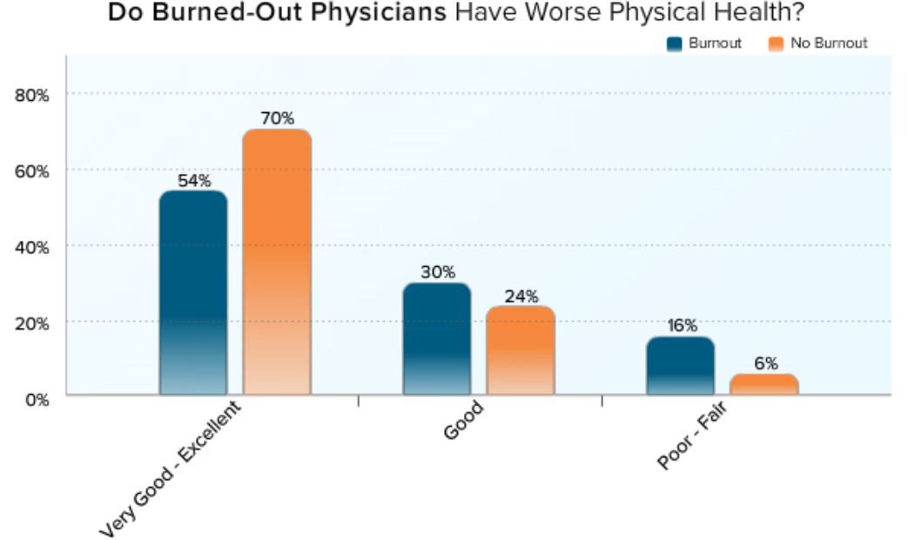

Slide 12
Personal Strategies to Prevent Burnout
Self Awareness and mindfulness training
Work-life Balance
Exercise
Hobbies/Philanthropy

Slide 13
Organizational Strategies to Prevent Burnout
Physician Wellness Committee
Value, track and support
CME on burnout
Physician support groups
Leadership skills training
Flexibility in work hours
Programs to support burned out physicians

Slide 14
Discussion

