Slide 1


Finance Committee
November 2018

Slide 2
September 2018 Financial Report
AGENDA
September 2018 highlights
Alameda Hospital Finances
Notes:
+

Slide 3
September 2018 Financial Report
Volume Highlights
Inpatient activity continues to be strong.
Acute days 5.2% > budget in September, 6.5% > budget YTD;
ALOS > budget 4.4% YTD.
Post Acute days < budget 0.3% in September, 0.6% > budget YTD.
Clinic Visits 10.3% < budget in September, 3.4% < budget YTD.
ER visits 14.0% < budget in September, 749 visits < prior year.
Physician wRVU’s 2.4% < budget in September, 5.5 > budget YTD, 17.1% > prior year.
Notes:
Inpatient activity continued to be strong in September.
Acute Patient days were 5.2% above budget for the month, 6.5% YTD, and 5.7% above prior year.
While Acute discharges were above budget by 2.0% YTD, the ALOS was above budget by 4.4% or .2 days, and 6.5% above prior year. Overall patients are staying longer.
Post acute days were 0.3% below budget for the month. Note that that budget increased in September. YTD Post acute days were 0.6% above budget and 2.3% above prior year.
Clinic visits were 10.3% below budget for the month, and 3.4% below budget YTD. They were 0.5% above prior year. I want to comment about the large variance for the month. It looks like there was a problem with the way that the budget was spread. While it took seasonality into consideration, it didn’t fully account for the number of clinic days per month compared to prior years. If you recall, July was over budget, august was under by 3.2% and now we are significantly below. This corresponds with the change in the numbers of “clinic days” per month since most cllinics are closed on weekends and holidays. This year had the same number of clinic days as prior year for the first 3 months, however July had one more day and September had one less. August had the same number in both years. The 3.4% variance YTD in September is consistent with the August variance of 3.2%.
ER visits continue to be below budget.
Physician wRVUS while under budget for the month are still over by 5.5% YTD and well above prior year.. Great work by our providers.

Slide 4
September 2018 Financial Report
Highlights
NPSR under budget by $2.7 million, consistent with $27-29 million annual shortfall.
Supplemental Revenue $4.4 million over budget due to additional County capital cost reimbursement recorded for FY16. Offset by County capital transfer in non-operating.
Expenses under budget by $1.6 million only partially offsets revenue shortfall this month.
Operating Income $3.3 million over budget in September is misleading.
EBIDA under budget by 1.5% in September, 0.5% YTD
Net Income over budget due to long term portion of Pension Expense.
Notes:
As we saw the past two months, Net Patient Services revenue is under budget, consistent with the $27 – 29 million annual shortfall we projected.
Due to the contract with Alameda County regarding the treatment of Capital cost reimbursement for county owed buildings, we are recognizing the income for FY 16 and showing the offset as a County Capital Transfer out. FY 16 is the first year finalized where the county capital costs were allowed by the state and the first year with partial claiming of the acute care tower. It is also the first year finalized through audit, requiring a cash transfer to the County. We will be bringing estimated revenues for FY 17-current into the financial statements as the amounts are calculated. Any amounts included in cost claiming for reimbursement were reserved in supplemental revenues pending outcome of cost report appeals .
This revenue is offset by a transfer to the County which shows up as non operating. Because of this, operating income looks high compared to budget.
September is the first month where expenses were not enough under budget to fully offset the revenue shortfall. I will talk a bit more about that later, but Expenses were $1.6 below budget compared to revenues under by $2.7 million. We would have expected operating income to be $1 millon below budget.
As you can see, the Operating Margin is 7% or 3.8% above budget, however the EBIDA Margin is 3.4% or 1.5% below budget
Because the Capital Cost recognition and transfer were not included in the FY 19 budget, we will see this variance all year.
Overall net income is over budget by $2 million for the month and YTD due to a reduction in the Long Term portion of Pension expense.

Slide 5
September 2018 Financial Report
Revenue Highlights
Gross Patient Service Revenue was consistent with activity for the month.
YTD Gross Revenue 7.8% above prior year. Professional 40.8% above prior year.
NPSR 5.1% above prior year.
Supplemental revenue $4.4 mil over budget from County Capital Cost Reimb FY16.
Notes:
Here ‘s just a closer look at the revenues which we’ve already discussed.
Gross patient service revenues were consistent with activity for the month. IP above budget and OP below budget. Professional revenues sometimes lag in hitting the financials due to coding, and system holds. But YTD professional charges are 40.8% above prior year. Overall YTD gross charges are 7.8% above prior year, and if you recall, the budget included a 2.4% overall price increase.
Increased patient acuity?
NPSR is 5.1% above prior year.
Supplemental revenue is right on budget without the $4.4 million in County capital cost claiming.

Slide 6
September 2018 Financial Report
Expense Highlights
FTEs under budget by 162 FTEs or 3.7% in September, 127 FTEs or 2.9% YTD
Labor Expense under budget $0.8 million or 1.3% in September, $3.3 Million or 1.9% YTD
Would have expected Labor Expense to be more consistent with FTE variance.
Worked Hours per APD below budget; Comp.Ratio skewed due to County Capital Adj.
YTD all Expenses under budget.
Notes:
FTEs were under budget by 162 FTEs or 3.7% in September
Total Labor expenses were $0.8 Million or 1.3% under budget.
YTD variance 127 FTEs 2.9% under budget but $3.3 mill or 1.9%in expense.
We would have expected expense to be lower, consistent with the FTEs.
In September we did have a $222,000 payment for settlement of missed breaks and lunch, but that wasn’t enough of a difference. Investigation into the variance determined that there is an issue with the budget spread that didn’t appropriately account for the amount of holiday overtime pay. We are respreading the budget on a go forward basis to account for this issues.
YTD, Just to note that Employee benefits were over in July by about $1.2 mill due to large claims that hit in our self funded plan. This should even out over time and/or be offset by reinsurance. This in addition to the settlement payment put the YTD much more in line with what we would expect.
Both our Worked hours per APD is below budget and below prior year which is great.
All expenses are under budget on a year to date basis.

Slide 7
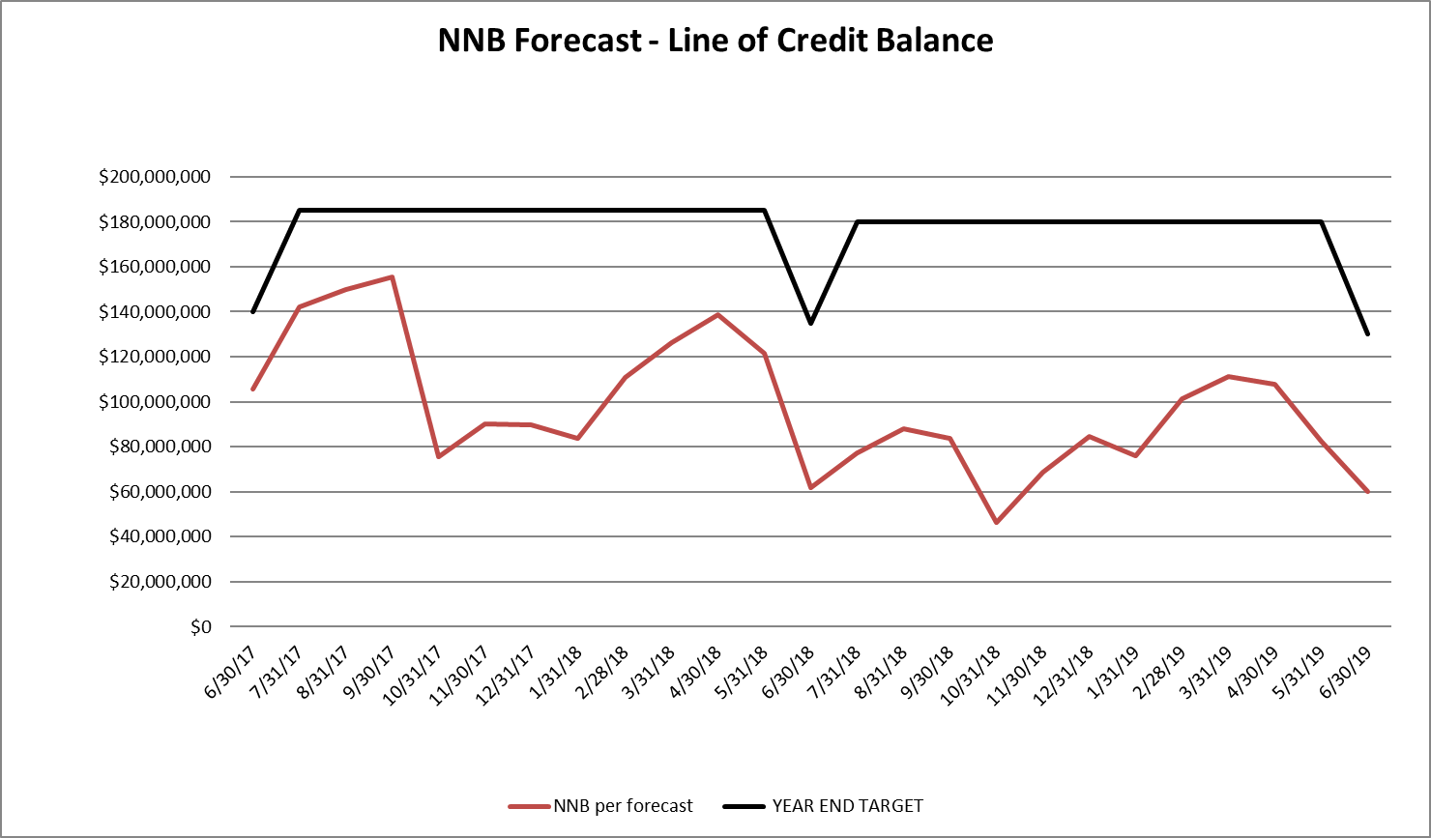
September 2018 Financial Report
Balance Sheet and Line of Credit
Below are the key Balance Sheet metrics and the forecast for the Line of Credit.
Notes:
While Net AR days have dropped, Gross AR days have increased since year end and prior month. We have had some staffing issues working some of the system holds on charges.
Days in AP have continued to decrease.
We continue to be complaint and expect to be compliant with the terms of our line of credit agreement with the county at the end of the year.

Slide 8
September 2018 Financial Report
Cash Collections
Notes:
I want to take a minute to acknowledge Patient Financial Services on the great work that they have been doing in collecting cash. Cash collected has been consistently higher than prior year, and YTD through the end of September cash is 30 million over the prior year.
Normally, I would have an updated Forecast and 12 month rolling forecast. However, I use the FY 19 budget as a based, and because of some of the issues we discovered, the budget is being respread. I will submit updated projections for the Board meeting at the end of the month.

Slide 9
September 2018 Financial Report
Alameda Hospital Finances
After noticing a decline in the reported net for Alameda Hospital, Finance Committee requested a “deeper dive” into Alameda Hospital’s finances.

Slide 10
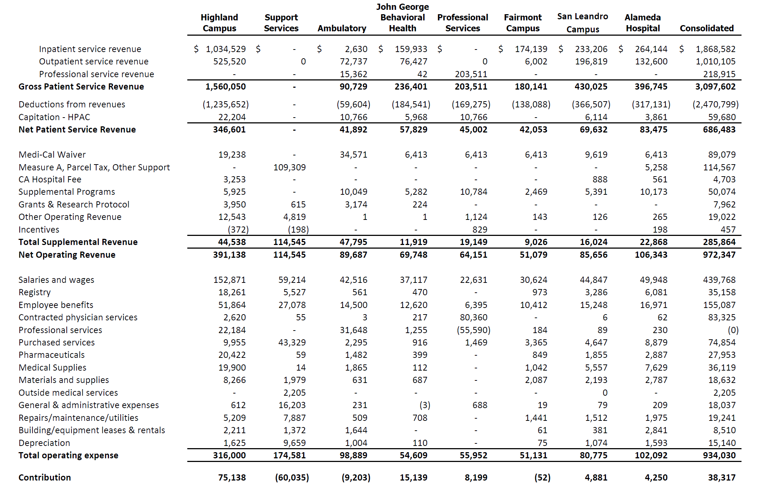
September 2018 Financial Report
Alameda Hospital Finances
Notes:
As part of the June 2017 financial statements, this report was provided reflecting a facility level view of the Income statement.
Second column from the right is Alameda Hospital, with $396.7 million in Gross Revenue, $83.5 in NPSR, $22.9 mill in supplemental revenue, $102.1 mill in expense, for a contribution margin of $4.3 mill.
This would lead you to believe that Alameda hospital is profitable, but its not a realistic view of the facility’s operations because, it does not include the support services cost.
If you look at the second column from the left, you see that there is $174.6 million in support services costs that belong to each of the other facilities. All of measure A is offset against this cost plus some other revenues, still leaving $60 million unallocated.
The thing is that the revenues generated by AH for Medicare, Medi-Cal and commercial payers are supposed to cover support services…like Information Technology, Billing and Collections, Administration, etc.

Slide 11
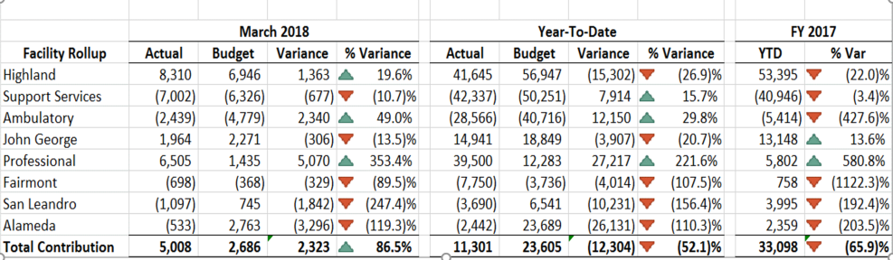
September 2018 Financial Report
Alameda Hospital Finances
Notes:
This schedule was reported to the Finance Committee in May as part of the March financial statements. As you can see Alameda Hospital was not showing a contribution, and was still not including an allocation of support services.
There was still an allocation of Medi-Cal waiver and supplemental revenues, however at this point the number was $6.2 million less than the prior year.
Again, not a true picture of the finances for the facility.
So how do we get a true picture of the finances for Alameda Hospital?

Slide 12
September 2018 Financial Report
Alameda Hospital Finances
COST
First need to determine real/full cost of services.
Allocation of support service is done by Home Office Cost Report – required by Medicare and Medi-Cal.
All system wide support service costs are reviewed and determined to be allocated on direct or indirect allocation basis, and by what statistic.
FY17 cost report determined AH received 13.8% of support services cost.
The Home Office costs are added to direct facility overhead costs and allocated in the cost report to all chargeable areas.
This creates cost to charge ratios which are used to calculate cost of services by service line, patient, etc.
Notes:
First we need to allocate overhead costs in the support services SBU out to the facilities. This is done using the methodology required by CMS for Medicare and Medi-Cal claiming.
This was done for FY 17 ( staff are still working on the Fy18 report which is due at the end of this month), and AH received 13.8% of the Support Services costs.
For FY 18, we took 13.8 % of the Support services costs.
In order to determine costs per service type, we use the cost report to allocate all overhead, direct plus home office- to the revenue producing departments, and then using ratio of cost to charges by department , applied to charges by services line we are able to determine the break out by service….. For AH we broke out by IP, OP and LTC.

Slide 13
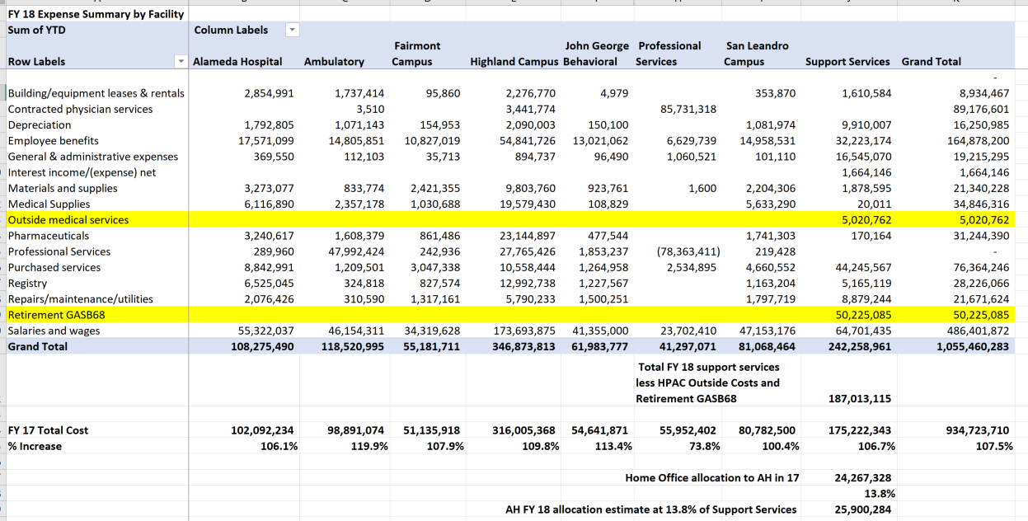
FY 18 Estimation of Support Service Allocation
September 2018 Financial Report
Alameda Hospital Finances
Notes:
This schedule shows the total cost by facility and support services for FY 18 compared to FY 17, and the calculation of support services for FY 18 based on the FY 17 amount.

Slide 14
September 2018 Financial Report
Alameda Hospital Finances
REVENUE
Net Patient Service Revenue is calculated at the Account/Payer level.
FY 17 NPSR known, FY 18 NPSR estimated
Supplemental Revenues are in some cases earned at the facility level, some at the system level.
System level revenues must be allocated.
Some FY 17 and most FY 18 supplementals are estimated.
Because of AB85 Realignment Redirection, Measure A allocations are done last, and based on uncompensated cost after all other allocations.
Notes:
Net patient service revenue is calculated at the account/payer level. FY 17 revenues are actual collections, as it’s been over a year and all billing limits have been reached.
Supplemental revenues are in some cases facility specific, others are at the system level
System level revenue must be allocated. Some FY 17 and most 18 supplemental revenues are estimated at this point. Because of AB85 realignment redirection, Measure A allocations are done last and based on uncompensated cost after all allocations. Because of the time involved in allocating supplemental revenues, I only did FY 18.

Slide 15
Allocation of Supplemental Revenue
September 2018 Financial Report
Alameda Hospital Finances
AB 915 – Outpatient Medi-Cal FFS Supplemental -FY 17 Actual for AH
SNF Medi-Cal FFS Supplemental - Estimated at FY 17 AH cost per day increased by 6% less rate paid per day.
Alameda Hospital District Tax - Allocated to all AH services.
Medi-Cal Managed Care Rate Range - Allocated based on Medi-Cal Managed Care Charges.
Hospital Fee (Direct Grant and Managed Care components) - Allocated based on Medi-Cal Managed Care Charges.
QIP/EPP - Allocated based on Medi-Cal Managed Care Charges.
PRIME - Allocated based on Medi-Cal Managed Care Charges.
HPAC - Allocated first to Outside Medical Services, Highland and Ambulatory Clinics.
GPP - Allocated based on Uninsured, HPAC and Restricted Medi-Cal Uncompensated Cost.
Measure A - Allocated to indigent uncompensated cost for Medi-Cal, Medi-Cal Managed Care, Dually Eligible, HPAC, Uninsured and Other Government.
Notes:
These are the methodologies for allocating the various supplemental revenues.
Mcal FFS supplementals and the district tax are specific to the facility.
All others are allocated .

Slide 16
September 2018 Financial Report
Alameda Hospital Finances
Notes:
For FY 17, you can see total gross charges are the same as reported in FY 17 report.
NPSR is slightly higher based on actual collections.
Costs are the same 102,092 million plus the 24 million that was allocated in the home office cost report.
In FY 17, prior to supplemental revenues, AH showed a loss of 42 million.
Facility Direct supplementals , the district tax and other operating revenue brought that loss down to 33 million.

Slide 17
September 2018 Financial Report
Alameda Hospital Finances
Notes:
This same picture for FY 18 looks worse as costs increases and revenue is estimated at a lower amount – in both IP and OP acute services.

Slide 18
September 2018 Financial Report
Alameda Hospital Finances
Notes:
This schedule shows what the bottom line looks like after allocation of supplementals.
The loss for the most part represents uncompensated cost for Commercial Insurance and Medicare Patients that were not allowed allocation of supplemental revenues.
I just want to note that this is informational only, and that Alameda Hospital is an important part of the system as a whole.

