Slide 1


Ambulatory Services Presentation to QPSC
September 27, 2018

Slide 2
AHS True North Metrics
Notes:
Primary care lead time – baseline: 75 and August: 73 minutes
Specialty care lead time – baseline: 94 and August: 81 minutes
CG CHAPS data is not final but preliminary June data = 74.8 and July = 75.6
Focus within Ambulatory is to use data to drive change.
Important that we align goals and incentives up/down/across Ambulatory.
Cascading this data down to annual performance goals and then, weekly data. For example, on Wednesday, all primary care staff are having round table discussions on how they contribute to our TNM, performance goals, CG CAHPS, and weekly data.

Slide 3
Ambulatory’s Annual Performance Goals
FY 19 – drafted; to be finalized by 10/15 |  | System Leader | Practice Manager | Medical Director
Pillar | Metric
Quality | Primary care – either: Colorectal cancer screening BP control HbA1c control Childhood access | X | X | X
 | Specialty care – flu vaccination rate | X | X
Workforce | Staff rounding | X | X | X
 | System turnover | X | X
Experience | CG CAHPS | X | X | X
Sustainability | Maintain budget | X | X
 | Visit volume |  |  | X
Access | Total lead time | X | X | X
Notes:
Process for Quality metrics: cross-walked P4P metrics including PRIME, then spent time with our system leaders, Medical Directors, RN supervisors, and Practice Managers to vote on which ones were the representative of work that felt was representative and important for our system. In October, that group will be deciding which measure will be included in their FY 19 performance goals.
CG CAHPS is aligned with our TNM and will share some updates with this data alignment in 2 slides.
Access Total Lead Time – as we wrote in our QPSC report, this will be our operational focus this year. It is aligned with our EPIC implementation.
In addition this year, we completed 360 feedback surveys on all of our managers and directors.

Slide 4
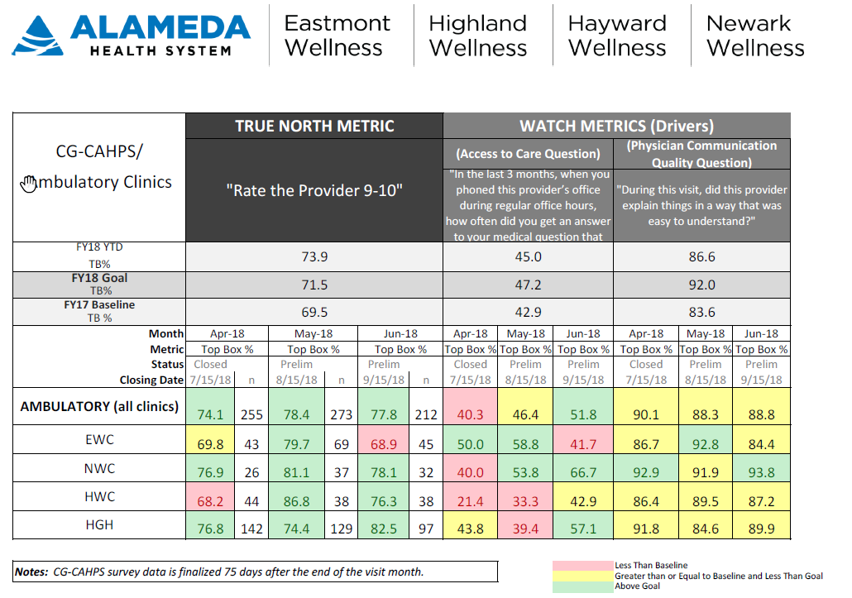
CG CAHPS Data
Changing this metric to: “…seen within 15 minutes of appointment”
X
Notes:
Changing our monthly deep-dive to include patient’s experience on lead time.
1 additional thing to highlight that is currently taking place in Ambulatory is the roll-out of revised job descriptions for Ambulatory RNs, LVNs, MAs, and ECs.

Slide 5
Weekly Data

