Slide 1
EHR Name
Terry Lightfoot, Dir. PACE
Notes:
Good Afternoon Board President DeVries, Trustees
My name is Terry Lightfoot, Director of Public Affairs and Community Engagement for Alameda Health System
Thank you for the opportunity to share with you the new name of AHS’s Electronic Health System Project.

Slide 2
EHR Naming Project
More than 200 official names submitted
EHR Oversight Committee narrowed to 5
The committee challenged PACE to bring forward a name that represented the comprehensive purpose and benefits that would be realized by the EHR project.
Notes:
Rules of the EHR naming contest stipulate that the Oversight Committee has the final say to accept or decline a winning name or to establish a different name. We were very pleased with the number of participants and appreciated the dedication of their time and creativity to this process.

Slide 3
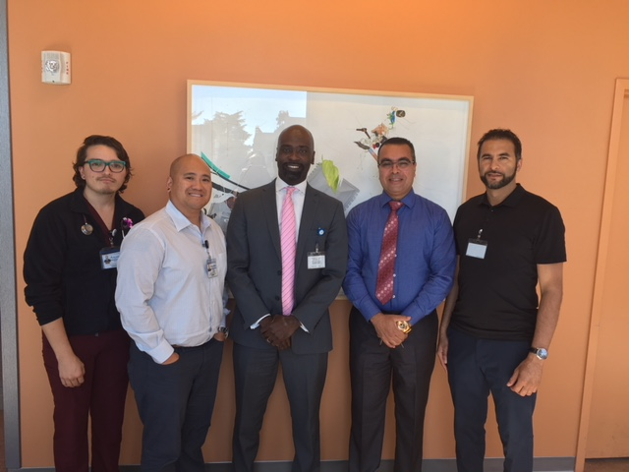
The Finalists
Notes:
The contestant whose name was ultimately selected for the project was to receive an I-pad. In recognition of their creativity and participation, the EHR Oversight Committee awarded all five finalists an I-pad.
There names are:
AJ Kocer , Youssef Youssef , Matthew S. Sardella, Richie Cabrales, Juner Valencia (Not pictured)
In many ways, their ideas helped inform the effort to craft a name that encompassed the significant contribution and impact that the EHR Project will have on Alameda Health System. We are here today to announce a name that has been approved by the ELT and the EHR Oversight Committee.

Slide 4
The Purpose …
Focus on the outcomes of the project
Serve as a reminder of our mission and vision
Notes:
Delineates benefits to the system and most importantly to our customers
Highlights key transformative changes
Connects with AHS vision and strategy
Encourages ongoing commitment
Anchors the system to a core value we hope to achieve for our patients and communities.

Slide 5
The Benefits
Systemwide
Notes:
Systemwide – reiterates our quest to function and form as a system on behalf of our patients and communities, through operational and clinical standardization

Slide 6
The Benefits
Access
Notes:
Access - with access to more information, we can provide greater access to care and deliver quality outcomes

Slide 7
The Benefits
Promoting Population Health
Notes:
Promoting Population Health – is our vision, it’s our commitment to transforming our care delivery system from one that is highly reactive to one that is proactive and focused on prevention and wellness – improves the patient experience, deliveries quality outcomes in an efficient manner; but it is also our commitment as an anchor institution to use our EHR to promote total health within the communities we serve

Slide 8
The Benefits
Integration
Notes:
Integration - internally breaking down silos to improve patient experience and outcomes and externally to provide a system that will allow all parts of the safety net and other healthcare providers to coordinate and collaborate to achieve total community wellness

Slide 9
The Benefits
Resilience
Notes:
Resilience – reflects our dedication to launch this project (As many of you will recall there was a lot of work done to bring forward a project plan that could garner Board approval.) but also serves as a reminder to never forget our ongoing quest to not just provide better health care but to continue to improve its effectiveness for those low income families and vulnerable populations that depend on us for their care.

Slide 10
The Benefits
Equity
Notes:
Equity – when we think of equity we should look at it in two ways: Equity of service, bringing a tool to our customers that is on par with other health care systems. It’s a given that an electronic health record is not a “like to have”, but a “must have” in order to deliver the kind of quality care and value-based outcomes demanded of our care for the future. The other way, and this may be the most foundational to Alameda Health System, is that this project will allow us to achieve our mission and vision of addressing inequity in service and disparities in outcomes in ways that are unimaginable today.

Slide 11
SYSTEMWIDE ACCESS PROMOTING POPULATION HEALTH INTEGRATION RESILIENCE & EQUITY
Notes:
Sapphires are blue, the same as the AHS company color
Sapphire is the birthstone of September, the month we are revealing this new name
A sapphire is a precious stone symbolizing wisdom (evidence-based care), truth (transparency in intent and purpose) and sincerity (faithful to our mission and genuine to our values).
Using the name of a gem, is indicative of our investment into something of lasting and increasing value. That is our EHR project – our most significant investment in the long term viability of AHS that will provide multiplying value as we are able to use it to increase health outcomes, expand access and address health inequity and disparities in our communities.
Back Pocket – There will be ongoing activities to further solidify the name with the project moving forward. In addition the giveaways we are sharing with you today, the name will be posted via stickers (removable); tent cards at all areas where folks are currently accessing multiple systems - registration stations, nursing stations, ancillary locations; as a reminder of the future when they will be able to access one electronic health record system – SAPPHIRE.
We are also working with the EHR project team to incorporate the new name ongoing collateral, meeting and training sessions as well as a number of other internal facing activities to support awareness and buy-in for this significant investment into our care for the future.

Slide 12
Next Steps
Visibility Efforts
Launch Communications
On-going integration
Notes:
There will be ongoing activities to further solidify the name with the project moving forward.
Visibility Efforts - In addition to the giveaways we are sharing with you today, the name will be posted via stickers (removable); tent cards at all areas where folks are currently accessing multiple systems - registration stations, nursing stations, ancillary locations; as a reminder of the future when they will be able to access one electronic health record system – SAPPHIRE.
Launch Communications –
The current EHR site will be branded with the new name; email and intranet announcements will be launched in the morning.
A net alert will go out over the Sorian System tomorrow morning announcing the new name
Ongoing Integration –
We are also working with the EHR project team to incorporate the new name on future collateral materials, meeting agendas, ongoing giveaways at upcoming meetings and training sessions.
We will also be doing audio spots with a range of leaders, physicians, nurses and other staff on the impact of SAPPHIRE on their work to build ongoing anticipation for when the system goes online next year.

Slide 13
QUESTIONS?

