Slide 1


Finance Committee
September 2018

Slide 2
June/July 2018 Financial Report
AGENDA
May 2018 Financials
May/June Revenue Analysis
FY 18 Year End Financial Status
July 2018 highlights
12 month rolling forecast
Notes:
+

Slide 3
May 2018 Financials
Volumes were mixed:
  IP days at budget, although Acute ALOS 5.6% above Budget.
  Clinic visits 2.9% below budget.
  Emergency Room visits continued to be under budget.
  Phys wRVUs only 47,919 for the month.
Expenses were under Budget and Projected
NPSR was significantly under Budget and Projected
Notes:
As you know we had noticed a significant variance in Revenues from expected in May, and did not report on the Financials in July - taking additional time to review what had happened.
So to give you a brief overview of May…
Volumes were relatively consistent with what we had been seeing. IP days were pretty much on budget, but acute discharges were below budget and length of stay above budget.
Clinic visits were below budget as well as ER visits.
Physician RVUs were low for the month…they had been running closer to 78,000 per month.
On the plus side Expenses were under budget and also under what was projected.
A large part of the lower gross revenues from projected had to do with a delay in getting Operating Room charges entered. Those charges were taken into consideration for revenue calculation.
As you can see here, Net Patient Services revenues was significantly lower than both budget and what we had projected.

Slide 4
May/June Revenue Analysis
What we did…. (in summary)
Calculated Net Patient Service Revenues based on services by site and payor
  Mcare IP based on discharges and DRG’s
  Mcal IP based on Days and per diems
  FQHC visits based on qualified visits and payors
  Others based on updated payment %’s
Reviewed calculated NPSR to collections to date and receivable balances to identify potential issues.
Reviewed calculation of Zero Balance Account (ZBA’s) and updated to include small dollar balances and credit balance accounts, and they were lower than previously calculated.
Notes:
So we started digging into the all of the calculations associated with revenue reporting.
As I have explained, net revenue has always been booked soley using the Balance Sheet approach, meaning that no calculation was done to determine what Net Revenue should have been based on the services provided. It was basically what ever fell out from what Patient Business services collected or posted to accounts, and a valuation of receivables. Then if revenues looked too low, an adjustment was made to make them closer to budget . The balance sheet review has to be done , but you how do you know if we are collecting all that we should? So, the first thing we did, was calculate a NPSR based on actual services provided. We calculated Mcare IP revenue based on discharges and DRGs., we calculated Medi-cal IP based on days, and the appropriate per – diem rate based on eligibility status. We calculated FQHC revenues based on allowable visits by site.
For other payers we used updated payment %’s.
Once we Calculated the expected net revenue, we compared it to collections to date and amounts still sitting in AR to identify any potential issues.
In doing this we also reviewed the calculation of Zero Balance accounts and determined that we were missing a large portion of accounts that had been substantially paid. When we updated the calculations to include small dollar balances and credit balances, our collection %’s were lower than previously calculated. Remember - Collection %’s are applied to Gross charges – which we have over $3 billion, so 1% times a big number is a big number.

Slide 5
May/June Revenue Analysis
What we found... (in summary)
Projected
Calculated
Final
Notes:
What we found was that the collection % that had been booked through April was 19.9%, but what we calculated for the year was 19.6%.
.3% times our gross revenue is only a 10 mil variance, but we found a few other things…
We had projected net revenue to be $666 mill for the year.
May and June lower charges at the 20.6% we projected
Then adjusting for the lower pmt % for may and June
We identified errors in the valuations for AH and AHP
And then we had an unanticipated adjustment to our Medicare/medi-cal cost report
Receivables that run throught NPSR.
This got us down to our “calculated “ NPSR.
Final NPSR for the year – using both balance sheet / income statement approach came out to $637 million which was a 8.9 mill or 1.4% variance in our total.

Slide 6
May/June Revenue Analysis
Why is revenue less than we calculated?
Services not billable but payments are anticipated in the calculation.
While we try to adjust for denials and administrative days, reimbursement estimates don’t account for transfer payment reductions, inordinate numbers of denied or administrative days, variation in Medi-Cal aid codes and payment amounts, or patient coinsurance/deductibles.
System and processing errors that are not corrected timely causing lower payment or write off of services.
In general, payment %’s will have variance from actual payments due to variation in services. Insurance plans with limited volume don’t have reliable payment %’s.
Notes:
Why would net revenue be less than we calculated?
There are services that are not billable, but they are included in the charges . For example…services that are bundled for physician billing. Charges are there for all services , however some services may be bundled together for billing. Or we may be contracted for a perdiem for an insurance payor, and we are using a % of charges calculation.
When we calculate Medi-cal net revenue we anticipate a % denial/admin day factor, however it’s an overall average, and we may see more or less depending on the mix of patients. We also use insurance plans to determine the mix of pre and post ACA eligible patients as they are paid at different rates, but they are not always accurate. There many nuances that we cannot always account for in our calculations.
There are system and processing errors that are not always corrected timely. These are being addressed, however during FY 18 we continued to see some services written off for untimely billing.
In general, payment %’s wil have variance from actual payments due to variations in services….Insurance plans with limited volume don’t have reliable %’s…. Etc.

Slide 7
May/June Revenue Analysis
Going forward….
NPSR will be calculated based on services provided by site and by payor.
Calculated estimates will be given to Patient Financial Services as their cash goals for two months later. (July net = Sept Cash Goal)
Variance from calculated revenue will be analyzed and calculations adjusted as appropriate.
Reimbursement staff will be monitoring collections vs estimates, and communicating with Patient Financial Services regarding variances to be investigated.
Increased focus on denials management, determining root causes, and identifying underpayments.
Notes:
Going forward….what are we doing to address this?
NPSR will be calculated based on services provided by site and by payor.
Calculated estimates will be given to Patient Financial Services as their cash goals for two months later. (July net = Sept Cash Goal)
Variance from calculated revenue will be analyzed and calculations adjusted as appropriate. Any significant adjustments effecting our revenues in a month will be identified and noted.
Reimbursement staff will be monitoring collections vs estimates, and communicating with Patient Financial Services regarding variances to be investigated.
Increased focus on denials management, determining root causes, and identifying underpayments.

Slide 8
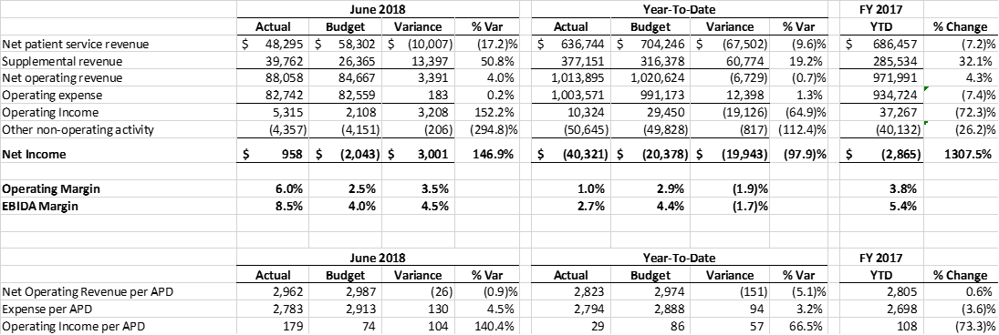
June 2018 Financial Report (not final/unaudited)
Highlights
NPSR below budget per prior discussion
Supplemental revenue over budget due to GPP and Prime
Positive bottom line for the month of $1 million.
8.5% EBIDA for month, 2.7% YTD (as of 8/31/18).
YTD Revenue and Expense per APD both below budget, but revenue down more than Expense.
Reminder that we did have to reserve approx.$25 million for prior yr. FQHC issues
Notes:
. Highlights for June / year to date
NPSR was below budget for the month.
This was offset by increased supplemental revenues.
I’m happy to report that we did better than anticipated for both GPP and Prime.
For GPP we were just about at 100% of our threshholds and for Prime we achieved 55 out of 57 measures due to great work by the staff.
We had a positive bottom line for the month.
YTD revenue and expenses were both below budget in total and per adjusted patient day. Operating income was just under $20 million under budget. YTD EBITA is 2.7% compared to the 3.5% we had projected.
Note – these numbers will change. These financials are as of 8/31 and are not final or audited. There will be additional adjustments for finalization of Actuarial reports for the Pension plans and some county revenues.

Slide 9
June 2018 Financial Report (not final/unaudited)
Highlights
YTD IP days .3% over budget, but discharges below budget, ALOS 4.5% above budget
Clinic visits were 4.1% below budget YTD
Emergency Room Visits 4.2% below budget YTD
Notes:
Overall volumes for the year were just over budget for IP days….although ALOS was 4.5% over budget for the year.
Clinic visits were 4.1% below budget for the year.
ER visits were 4.2% below for the year.

Slide 10
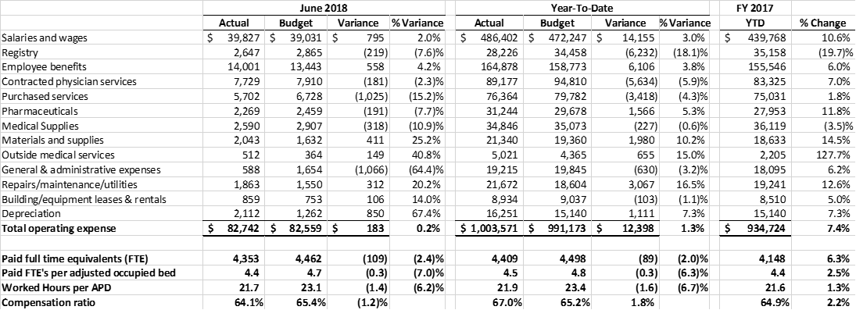
June 2018 Financial Report (not final/unaudited)
Highlights
FTE’s below budget by 89 YTD or 2.0%, but Salaries/Registry 1.6% over budget.
YTD Labor Expense $14.0 mill over budget – mostly due to structural issue in budget.
YTD Total Operating expenses $12.4 mill over budget (1.3%).
Notes:
FTE’s were 2% below budget for the year, but Salaries and wages and registry were 1.6% over budget. YTD Labor expense incl benefits was 14 mill over budget. Most of this is due to the structural issue in the budget discussed previously.
YTD total operating expense was 12.4 mill over budget.

Slide 11
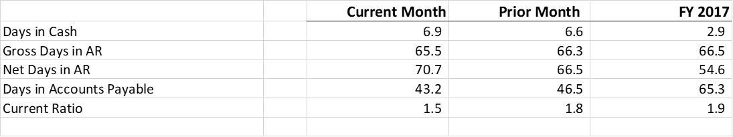
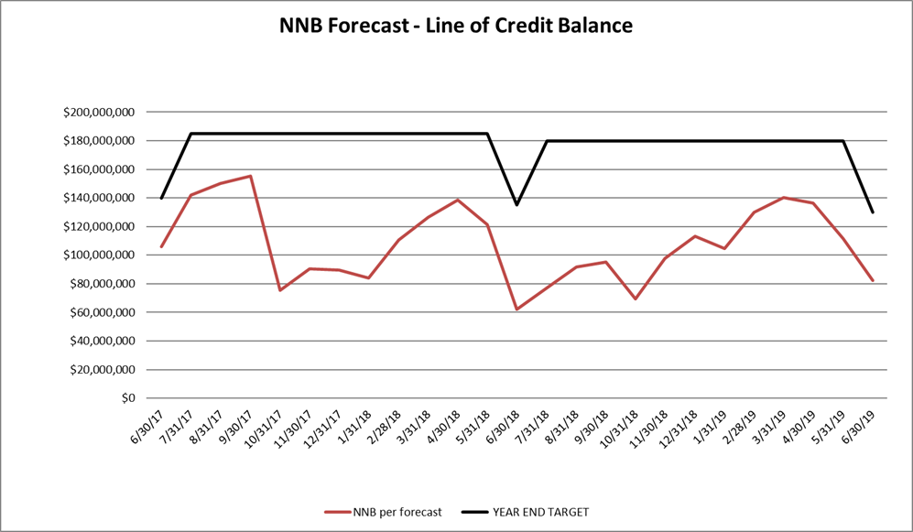
June 2018 Financial Report (not final/unaudited)
Balance Sheet and Line of Credit
Below are the key Balance Sheet metrics and the forecast for the Line of Credit.
Notes:
Key balance sheet metrics are improved across the board. Days in AR moving down, and Days in AP down. Gross days in AR ended the year lower at its lowest for the year.
We were complaint with the terms of our line of credit agreement with the county at the end of the year.

Slide 12
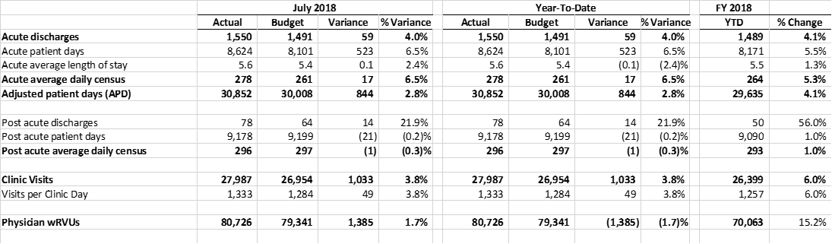
July 2018 Financial Report
Highlights
Patient Activity was strong.
Acute days 6.5% above budget; ALOS up 2.4%.
Post Acute days on budget.
Clinic Visits 3.8% above budget.
ER visits 10.3% below budget .
Physician wRVU’s 1.7% above budget.
Notes:
Moving on to July
Patient Activity was strong.
Acute Patient days were 6.5% above budget. Discharges were below budget so the ALOS was 2.4% over budget.
Post acute days wer on budget.
Clinic visits were 3.8% above budget which is great progress. 6% above prior yr..
ER visits continue to drop. They were 10.3% below budget for the month.
Physician wRVUS….we have a budget now, and they were 1.7% above budget.

Slide 13
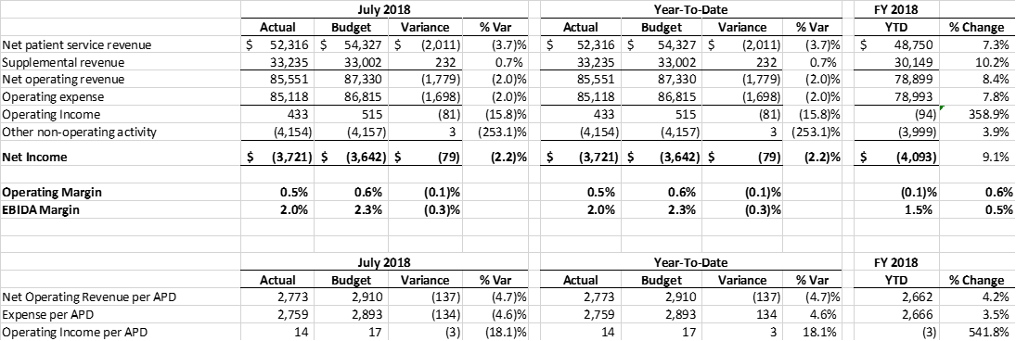
July 2018 Financial Report
Highlights
While activity was above budget, NPSR under budget by $2 million.
Net Operating Revenue under budget by $1.8 million.
Issue with Budgeted NPSR due to ZBA issues.
$27-29 million shortfall in annual NPSR budget
Expenses under budget by $1.7 million to offset revenue shortfall this month.
Notes:
Normally, with activity over budget, we would expect NPSR to be above budget.
Unfortunately, that’s not the case. NPRS was under budget by $2mil.
As we saw in our revenue for May and June, when we revisited the Net patient services revenue budget calculation for FY 19, we determined that the ZBA’s used were too high, and in fact we have a $27-29 million shortfall with the updated calculation.
This is confirmed by the Estimated NPSR calculation we did for July services.
The month of July looks ok because Operating expenses were under budget by 1.7 million, offsetting the revenue shortfall., however we foresee problems ahead without intervention.

Slide 14
July 2018 Financial Report
FY 2019 Forecast (12 Month Rolling Forecast)
Notes:
This shows a summary of the 12 month projection – that happens to be FY 19, compared to the budget.
As you can see revenues are projected to be about $27 million below what was budgeted.
We have made some adjustments to expenses for this forecast, however executive leadership is working on a ways to address this shortfall which we plan to bring back to the October committee..

Slide 15
July 2018 Financial Report
FY 2019 Forecast
Assumptions:
Used FY19 Budget spread :
  Volumes adjusted by historical seasonality
  Salaries and supplies spread by volume
  Salaries adjusted for holidays and contractual increases
  Revenues adjusted based on reduced collection %’s
  Salary savings factor applied based on potential to hold vacancies of approximately 100 FTE – best case scenario
  Assumed 1% savings on purchased services
This would reduce Net Operating Income by $12.8 million, and reduce the EBIDA margin from 4.6% to 3.4%
Executive Leadership is working on a plan to mitigate this issue and will bring it back to the committee in October.
Notes:
Assumptions for this forecast :
Used FY19 Budget spread :
Volumes adjusted by historical seasonality
Salaries and supplies spread by volume
Salaries adjusted for holidays and contractual increases
Revenues adjusted based on reduced collection %’s
A Salary savings factor applied based on potential to hold vacancies of approximately 100 FTE – this is a best case scenario without specific actions.
Assumed 1% savings on purchased services
This would reduce Net Operating Income by $12.8 million, and reduce the EBIDA margin from 4.6% to 3.4%
Again, Executive Leadership has a Budget Oversite Committee meeting weekly and working on a plan to mitigate this issue and will bring it back to the committee in October.

