Slide 1


Finance Committee
June 2018

Slide 2
April Financial Report
April highlights
Cash on Hand
12 month rolling forecast
Notes:
+

Slide 3
April 2018 Financial Report
Patient Activity
Patient Activity: IP > Budget, OP < Budget
Acute ADC was 291, 5.1% > Budget ; YTD 0.5% > Budget
ALOS up to 5.9 days, 10% > Budget ; YTD 5.3% > Budget
Post Acute ADC was 300, 1.7% > Budget ; YTD = Budget
Emergency Department Visits (not shown below) were 10,817, 5.3% < Budget.
Clinic Visits were 29,611, 2.6% < Budget ; YTD 4.2% < Budget
Physician wRVUs were 83,239; Prior monthly average 76,716
Notes:
Patient activity was mixed in April. IP activity was above budget, but OP activity was below budget.
Acute ADC was up to 291, 5.1% above budget. However Discharges were below budget
Increasing Length of stay to 5.9 days. 10% over for the month, 5.3% YTD and about the same YTD.
Post Acute ADC 1.7% over budget at 300 for the month and right on budget YTD
Emergency visits continue to be below budget.
Clinic visits were under budget 2.6% for the month.
Physician RVUs were 83.239 for the month compared to a monthly average of 76,716 through March.

Slide 4
April 2018 Financial Report
Revenue
Net Patient Service Revenues (NPSR) includes $22.1 million adjustment for prior yr FQHC.
The Collection Ratio NPSR was 15.6% for the month, but 23.2% w/o FQHC adj.
The Budgeted Collection Ratio of 20.6% w/o FQHC adj to be achieved by June 30^{th.}
Supplemental Revenue $22.6 mill > Budget.
Overall Collection Ratio 31.2% YTD, 1.3% > Budget
Notes:
The Net Patient Service Revenues look extremely low for the month because we needed to adjust our books for the outcome of our Highland Wellness FQHC rate setting audit for FY 12 and the impact on all subsequent years. This required an adjustment of $22.1 million which has to run through the income statement.
At the same time, we adjusted current and prior year supplemental revenues for known/anticipated adjustments of 22.8 million, however they don’t all hit the same line on the income statement.
Gross patients revenues were overbudget for the month, so net revenues would have been over for the month as well. In addition we have been cleaning up our calculations. Without the impact of the FQHC adjustment, the Collection ratio for NPSR would have been 23.2 % for the month and 20.8% YTD.
With improved contracted rates, the collection ratio of 20.6% is expected for the rest of the year.
The overall collection ratio for the month was 32.5% for the month and 31.2% YTD compared to a budgeted ration of 29.9%.

Slide 5
April 2018 Financial Report
Operating Expenses
April Operating Expenses were $84.8, $2.6 million (3.1%) > Budget.
Salaries, Wages and Registry together were UNDER budget.
Benefits over for AHS Retirement plan $700K.
Contracted services include a performance incentive payment.
Pharmaceuticals continue to be > budget, consistent with higher IP activity.
General and Admin expense includes increased expense for Foundation Gala.
Notes:
April expenses continue to be over budget, however we definitely seeing improvements from the Back to Budget Plan. While we know we have a structural issue with the labor budget, combined Salaries, Wages and Registry together were over $500K under budget.
Other large dollar variances were:
Benefits were over budget due to increased salaries, but mostly due to additional expenses for the AHS retirement plan.
Contracted physician expenses increased due to the Oakcare contract for ER physicians and a performance incentive payment for the hospitalist group.
Pharmaceuticals continue to be over budget…consistent with acute IP days being over budget.
Finally, General and Administration expense included increased expenses for the Foundation Gala which I hear was a great success. I’m sorry I had to miss it.

Slide 6
April 2018 Financial Report
Net Income
Operating margin was 10.0%, exceeding Budget by 7.2%.
Positive bottom line for the month of $5.2 million.
11.1% EBIDA for month, 4.0% YTD.
Notes:
Overall April results were great.
Operating margin exceeded budget again.
We had a positive overall net income of $5.2 mill for the month with a 10.0% EBIDA margin. I wish we could see that all the time.
YTD the EBIDA margin is 4.0%, up from 3.1% March YTD.

Slide 7
April 2018 Financial Report
Contribution Variance Summary
The Contribution Variance Summary provides the ability to see variances in contribution to budget at the SBU and Facility level.
Notes:
Here are the summaries by strategic budget unit and facility rollups,
Provider delivery and Professional rollups Ambulatory continue to be the standouts compared to budget both for the month and YTD.
Ambulatory shows poor performance in April due to the 22.1 mill adjustment for the Highland FQHC rate setting audit.
While there gross patient services revenue was just over budget for the month, there was a large increase in deductions from revenue causing net operating revenues to be 1.7 mill under budget for the month… As requested, we will be bringing a deeper dive into Alameda Hospital’s finances to the committee later this year.

Slide 8
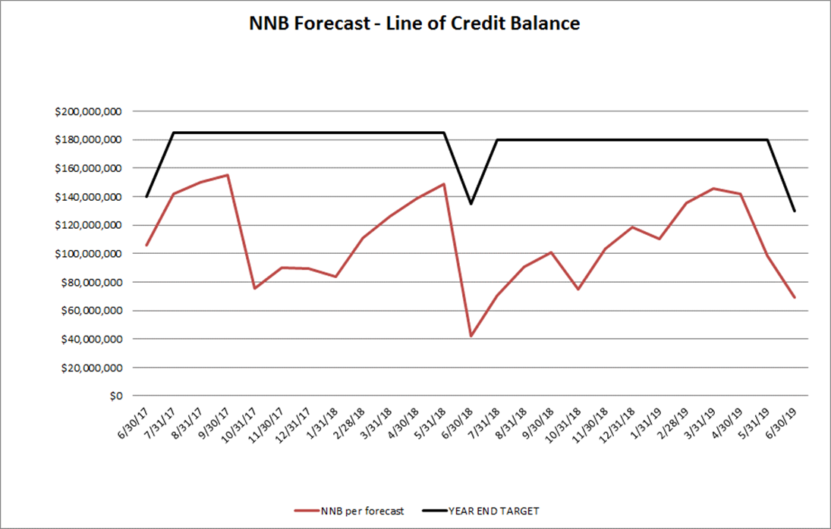
April 2018 Financial Report
Balance Sheet and Line of Credit
Below are the key Balance Sheet metrics and the forecast for the Line of Credit.
Notes:
Key balance sheet metrics are improved across the board. Days in AR moving down, and Days in AP down.
We are complaint with the terms of our line of credit agreement with the county. And we have actually received the cash for Managed care supplementals we’ve been waiting for, so we know for sure that we will be in a good position at year end.

Slide 9
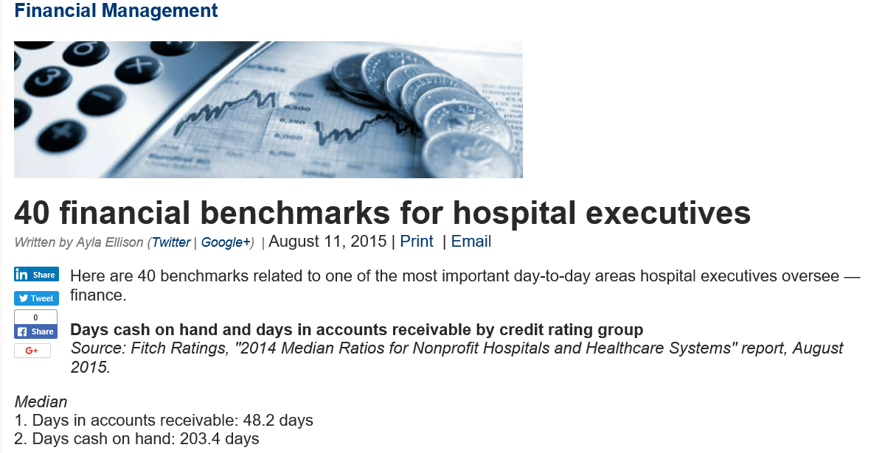
April 2018 Financial Report
Days in Cash
Notes:
At the last meeting, we were asked why we only had 3.1 days of cash on hand, which is general not nearly enough for an on going operation. Think about it if you only had 3.1 days of cash in your own bank account – and you weren’t a high school student that had the bank of mom and dad… it would be concerning.
A quick internet search on days cash on hand for hospitals came up with the following
2014 Median ratios for Non profit Hospitals and Healthcare systems had a median of 203.4 days….

Slide 10
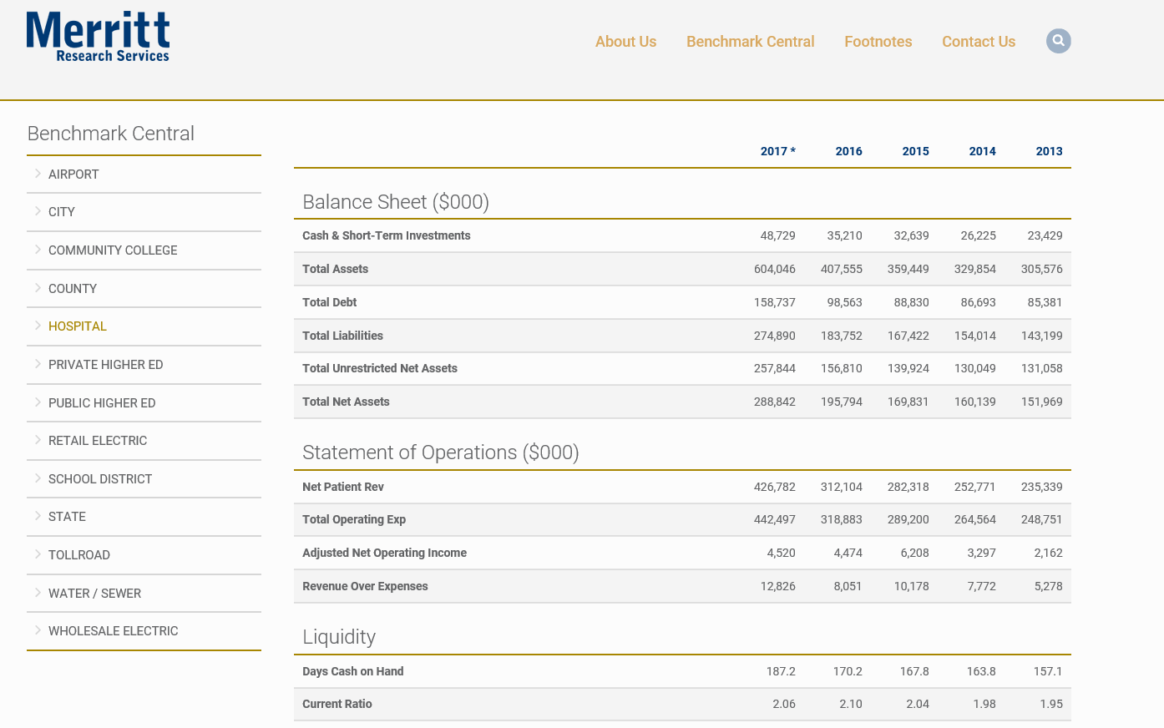
April 2018 Financial Report
Days in Cash
187.2 Median for Hospitals in 2017
Notes:
This Merritt Research services Median information for all hospitals
Shows a 2017 median of 187.2 days.

Slide 11
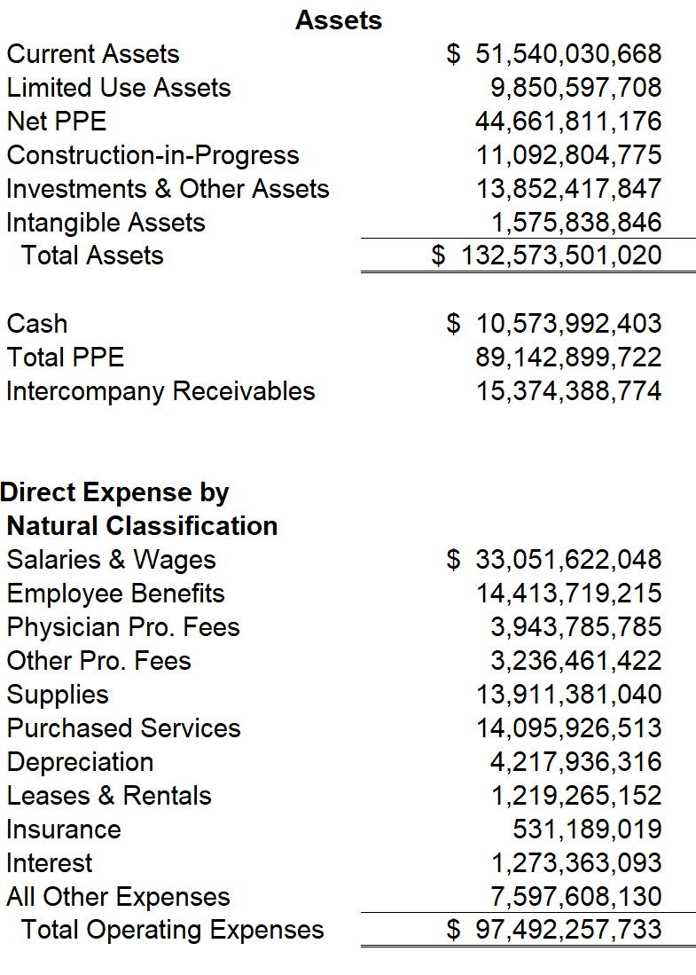
April 2018 Financial Report
Days in Cash
2016 Calif Hospitals per OSHPD
Days cash on hand calculation
Cash/ ([operating expense - depreciation expense]/365).
(Operating Expense – Depreciation)/365=
(97,492,257,733-4,217,936,316)/365=
255,546,086
Calculated Average for All CA Hospitals
Cash/Expense per day 10,573,992,403/255,546,086=41.38 days
Notes:
Using 2016 OSHPD data for California Hospitals, I was able to calculate an average of 41.38 days across all California hospitals.
SO why does AHS only have 3.8 days in cash at the end of April???

Slide 12
April 2018 Financial Report
Days in Cash
Why do we only have 3 to 4 days of cash on hand?
Per agreement with the County, all deposit activity is swept daily and applied against AHS’s Line of Credit or NNB.
No savings or investment accounts are held in AHS’s name only.
On a weekly basis, AHS requests funding from the County, based on the cash forecast, to cover anticipated disbursements (payroll and vendor payments).
AHS maintains a small reserve, approximately $3-5 million in the Accounts Payable checking account for unforeseen disbursements.
Notes:
Per agreement with the County, all deposit activity is swept daily and applied against AHS’s Line of Credit or NNB.
No savings or investment accounts are held in AHS’s name only.
On a weekly basis, AHS requests funding from the County, based on the cash forecast, to cover anticipated disbursements (payroll and vendor payments).
AHS maintains a small reserve, approximately $3-5 million in the Accounts Payable checking account for unforeseen disbursements
We essentially have access to the county’s cash up to our NNB in addition the county prefunds our IGTs.

Slide 13
April 2018 Financial Report
FY 2018 Forecast
Notes:
In doing the 12 month rolling forecast, we needed to first project to year end. So your package includes the FY 18 projection. This was done somewhat separately from the budget forecast, so it is extremely close but not exact…..
It’s hard to see, so I have shrunken the last few months so you can see the numbers.
Just a note that the grey columns are actual, the while columns are projected.

Slide 14
April 2018 Financial Report
FY 2018 Forecast
Assumptions:
Increased NPSR from AAH contract and Oakcare ED billing.
Increased GPP, Prime, EPP and QIP projections offset by prior year adjustment in April. No big adjustments anticipated for May and June.
Expenses include savings from Back to Budget.
Notes:
Assumptions included here are that we have increased net patient services revenues from the AAH contract and Oakcare ED billing.
Supplementals from GPP, Prime, EPP and QIP had additional amounts, however they are offset by a need for a prior year adjustment.
We had additional supplemental funding including the receipt of the Kaiser EPIC grant…. 1 mill of this was booked to revenue, however 9mil was booked directly to the Fund balance
Expenses include savings from the back to budget plan, as well as some continued increases in Pharmaceuticals and higher employee benefits were projected.
At this point, we are anticipating a 3.5% EBIDA.

Slide 15
April 2018 Financial Report
12 Month Rolling Forecast
Notes:
The 12 month rolling forecast is from April 2018 through March 2019
. This is very hard to see but you can refer to your handouts.

Slide 16
April 2018 Financial Report
12 Month Rolling Forecast
Notes:
Here are just the FY 19 projected months and the 12 month total.
You can see that the monthly EBIDA ranges from 2.9% to 5.8%, with a 12 month average at 5.4%.

Slide 17
April 2018 Financial Report
12 Month Rolling Forecast
Assumptions:
Based on FY 19 budget.
Work in Progress.
Revenues and Expense adjusted by days in month – Not yet based on specific volumes and seasonal adjustments.
Labor adjusted for holiday OT.
Notes:
This is based on the FY 19 budget presented here.
It is still a work in progress….We did not have the actual volumes by site, by month, seasonally adjusted, so Revenues and Expenses were adjusted by days in the month. Labor expenses were adjusted for Holiday OT.
Just a note, you will see a significant increase in the supplemental line starting in july due to the movement of EPP and QIP from NPSR where it is currently reported.
This will continue to be refined.
With that I’ll ask if there are any questions regarding the monthly financials.

