Slide 1
EMPLOYEE RECOGNITION
May 24, 2018

Slide 2
JOHN GEORGE PSYCHIATRIC HOSPITAL DR. KARYN TRIBBLE CAO, BEHAVIORAL HEALTH

Slide 3
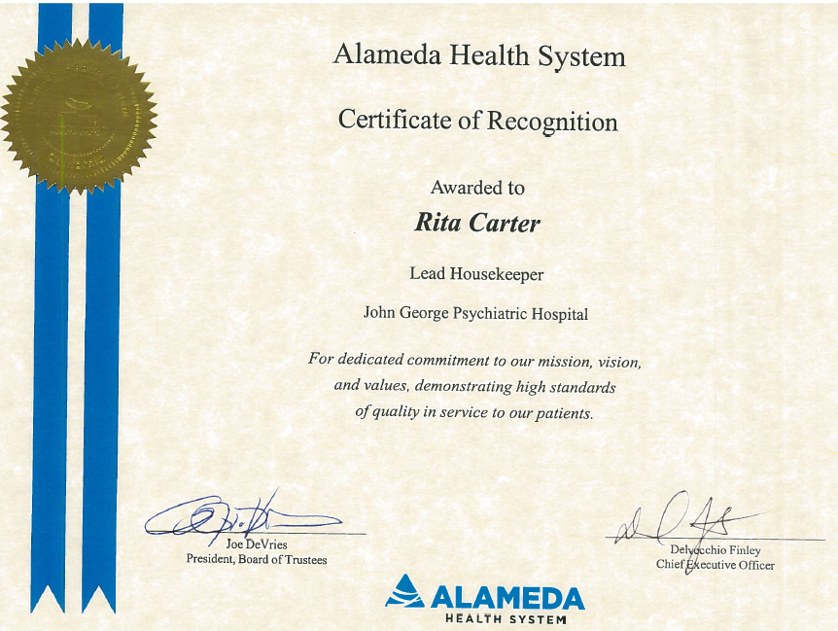

Slide 4
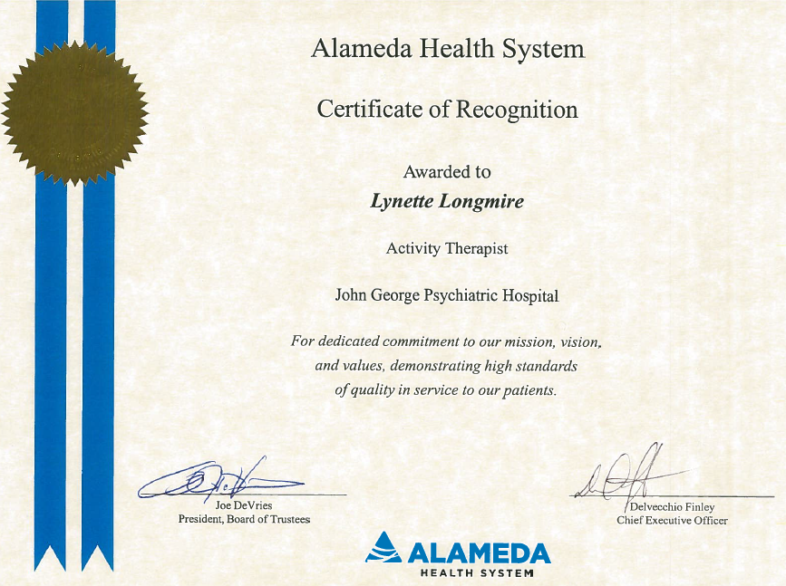

Slide 5
HIGHLAND GENERAL HOSPITAL John chapman CHIEF ADMINISTRATIVE OFFICER

Slide 6
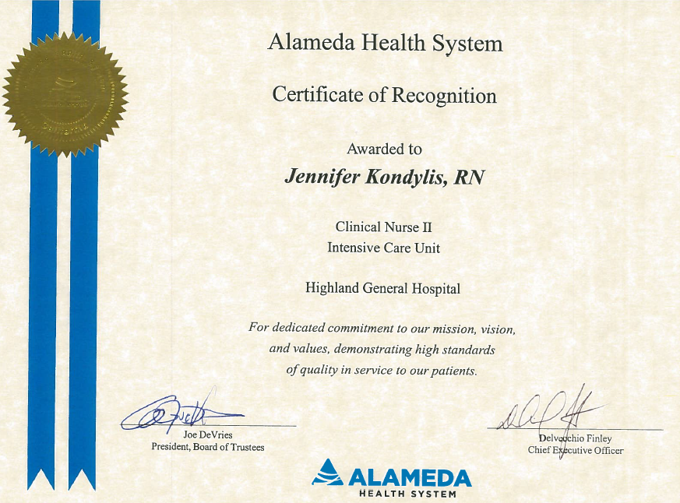

Slide 7
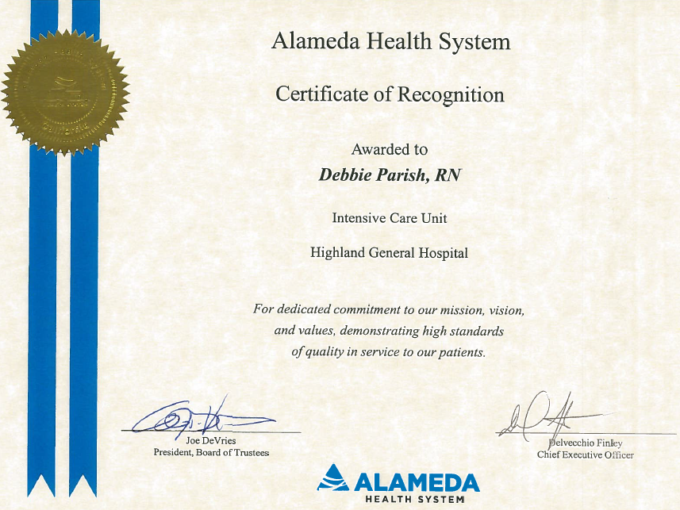

Slide 8
ALAMEDA HOSPITAL Fefe Tequame, RN, MSN, CNS Director, Nursing Services and Professional Practice

Slide 9
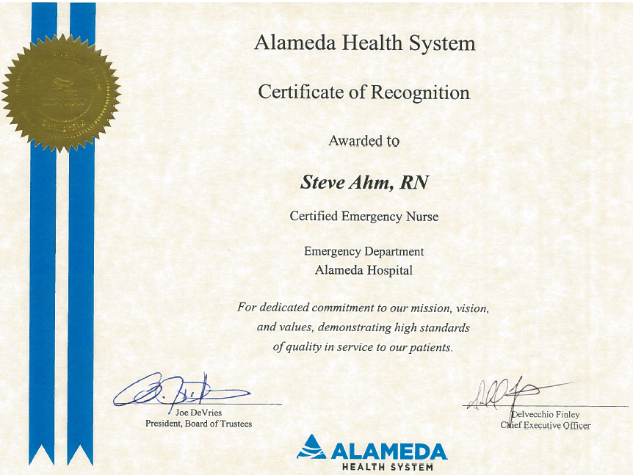

Slide 10
FAIRMONT HOSPITAL Christine Pelgone-Herz, MA, LNHA Administrator

Slide 11
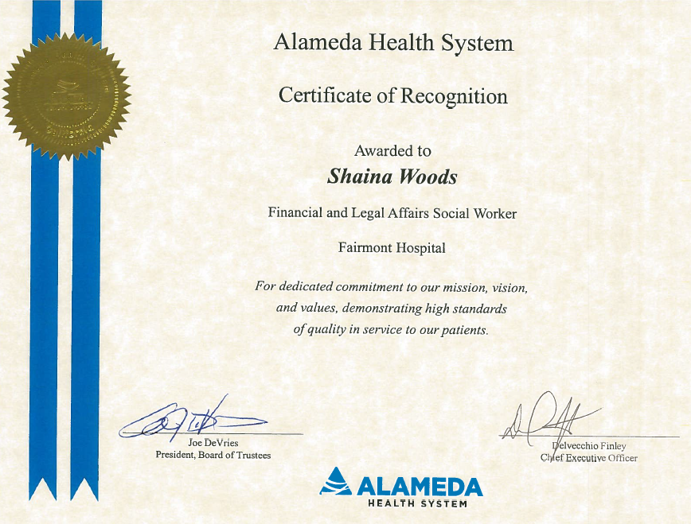

Slide 12
This concludes the presentation. Thank you.

