Slide 1
CEO Report
May 24, 2018
AHS Board of Trustees Meeting

Slide 2
Updates
April System Dashboard Update
System Updates
  Serving All: Community Outreach
  Maternal Health Disparities and Centering Health
  Leadership Update
  Annual Employee Appreciation Day
Epic Performance Status Update
  April Epic performance update
  Project Kickoff
  County Agreement Update

Slide 3
Performance dashboard
AHS OPERATIONAL PLAN FY 2018

Slide 4
AHS FY’18 Performance Management Dashboard
Notes:
John George Inpatient Behavioral Health Patient Experience Goal:
The FY2017 goal for the overall measure for the Inpatient Behavioral Health patient experience survey was set back by a couple of percentages points in order to align with national improvement and set a more realistic performance expectation.
Press Ganey reviewed the incremental change for top 50% improving hospitals with comparable percentile ranks (within the same decile) and found that the average point movement was -1.4. Hospitals implementing the Inpatient Behavioral Health patient experience survey have topped out the measure by reporting high performance so consistently that the distribution of performance has shifted below last year’s.
Taking into account the national incremental difference in performance (-1.4) and John George Psychiatric Hospital’s baseline performance for Fiscal Year 2016 (88.5), the goal for Fiscal Year 2017 (87.1) is below last year’s goal (89.0).

Slide 5
System UpdATEs
AHS OPERATIONAL PLAN FY 2018

Slide 6

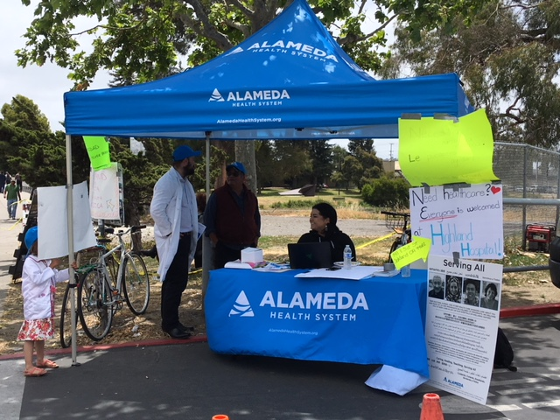
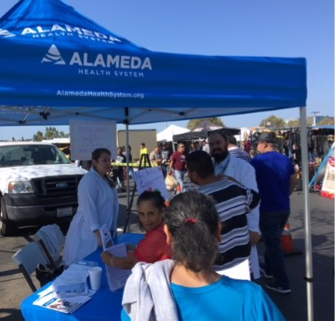
We Serve All- Alameda Swap Meet

Slide 7
Eliminating Disparities in Maternal Health

Slide 8
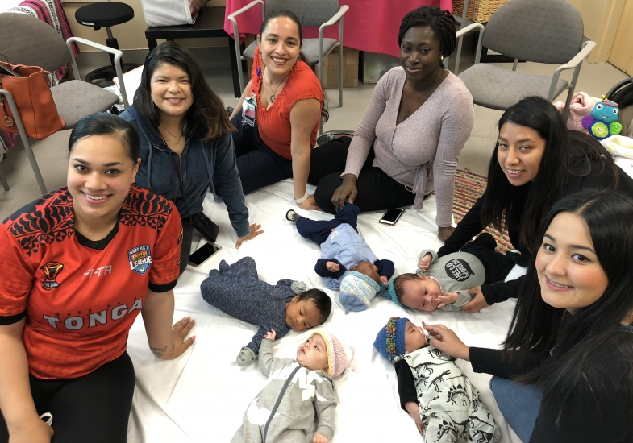
Eliminating Disparities in Maternal Health- Centering Pregnancy

Slide 9
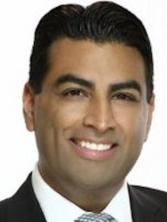
HE’S BACK!!
Richard Espinoza,
CAO Post- Acute Services SBU

Slide 10

AHS Annual Employee Appreciation
May 26, 2018

Slide 11

EPIC Performance Status UpdATE
AHS OPERATIONAL PLAN FY 2018

Slide 12
CRITICAL INITIATIVE - EHR

Slide 13
CRITICAL INITIATIVE - EHR

Slide 14
Project Accomplishments
Project Team recruitment is 90% complete and continues
Project Team training is on track
  55 team members have gone to training
  10 analysts successfully passed Epic Certification Exams
Project Leadership team attended Epic Overview of Implementation in Verona, May 14-15
Epic managers and coordinators assigned
Notes:
Executive
CPOE policy, training requirements, mobile devices, who owns billing errors, clinic schedules…
Revenue Cycle
CDM, Welcome kiosks, referral management…
Clinical
Training, Decision support, preference codes…

Slide 15
May – Kickoff Events
Implementation Project Team – Wed 5/23 at 8.30am at EHR Center
ARCR – Wed 5/23 at 1pm at EHR Center
CORe owners + Project Team Thu 5/24 at 9am
  Location: Berkeley City College
  120+ AHS staff + Epic team
Epic Website Launch on 5/23

Slide 16
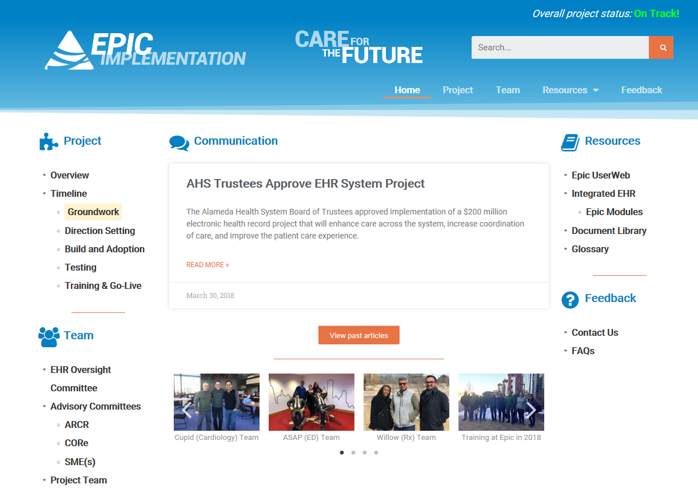
Epic EHR Web Site Launch on 5/23

Slide 17
Next Steps
Direction Setting sessions
  6/12 – 6/14 (Tue-Thu)
    Location: Berkeley City College
  6/26 – 6/28 (Tue-Thu)
  7/24 – 7/26 (Tue-Thu)
EHR Naming Contest

Slide 18
EHR Project Budget

Slide 19
Project Budget Monthly View

Slide 20
County Agreement Update
Draft document sent and reviewed
Scheduling follow-up discussions
At-risk of missing BoS assigned deadline to achieve concensus

Slide 21
CEO Report
MAY 24, 2018
AHS Board of Trustees Meeting

