Slide 1
Finance Committee
May 2018

Slide 2
March Financial Report
March highlights
12 month rolling forecast
Revenue Cycle
Quick overview
Collection %’s, why so low?
How are charges set?
Notes:
Good afternoon. I’m Nancy Kaatz, Interim CFO.
Rather than go through all the details from the finance memo, I thought I would point out some highlights as Luis will be providing more details regarding back to budget and operations, the rolling forecast and then talk a little about the revenue cycle and some of the questions that came up in our last meeting.

Slide 3
March 2018 Financial Report
Patient Activity
Patient Activity close to budget
Acute Average Daily Census was 286, same as Feb 2.9% > Budget.
Post-Acute Average Daily Census was 296, 0.3% > Budget for the month.
ALOS down to 5.6 days, 5.5% > Budget.
Emergency Department Visits (not shown below) were 11,281, 5.4% < Budget.
Clinic Visits were 31,318, only 1% > Budget.
Physician wRVUs increased to 87,679 from 83,634 last month (no budget for this).
Notes:
Patient activity continued to be was strong in March
Acute ADC was same as Feb, 2.9% above budget
Length of stay dropped from 6 to 5.6, but remains above budget.
Post Acute ADC just slightly over budget at 296
Emergency visits continue to be below budget.
Clinic visits were slightly over budget.
Physician RVUs continue to improve. Feb monthly average YTD was 75,345, and we were at 87,679 for the month.
YTD volume variance to budget are still under, however improved over the prior month.

Slide 4
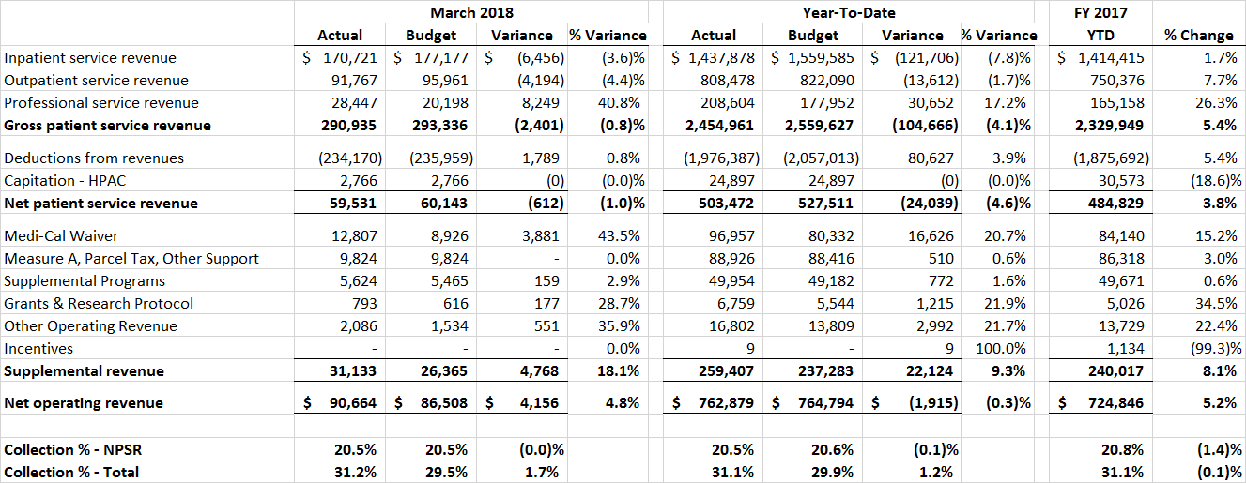
March 2018 Financial Report
Revenue
Net Patient Service Revenues (NPSR) improved 1% < Budget.
The Collection Ratio was 20.5% for the month, and was 20.5% YTD.
The Budgeted Collection Ratio of 20.6% is expected to be achieved by June 30^{th.}
Supplemental Revenue 18.1% > Budget.
Notes:
There was some improvement in NPSR for the month of March mainly due to improved inpatient activity compared to budget.
The collection ratio was 20.5%, right on budget for the month.
With improved contracted rates, the collection ratio of 20.6% is expected by year end.
Supplemental revenues were 18.1% over budget. Reserves were adjusted to bring in an additional $4.2 million from prior year adjustments.
This is likely going to be the last month that you will see positive adjustments to the reserves. While we will be bringing in additional supplemental revenues for the Medi-Cal waiver and QIP/EPP programs, we have determined the need to establish a greater reserve for prior year issues surrounding rate setting for the FQHC clinics at Highland Wellness . This issue is currently under appeal with DHCS.

Slide 5
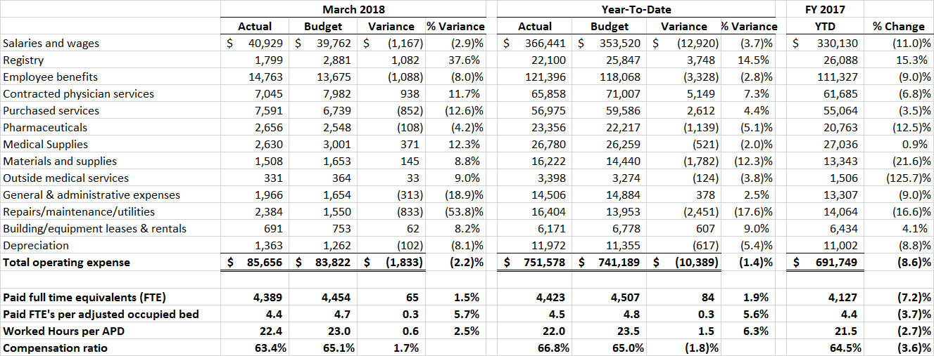
March 2018 Financial Report
Operating Expenses
March Operating Expenses were $85.7, $1.8 million (2.2%) > Budget.
Salaries, Wages and Registry together were just about on budget. We are starting to see improvement from the Back to Budget plan work.
Purchased services for the month included $415K for Population Health Capitation work, and $300K in catch up expense for IT consulting.
General and Admin expense included $248K in legal invoices.
Repair and maintenance continue to be over budget.
Notes:
March expenses continue to be over budget, however we are seeing some improvements due to the Back to Budget Plan. While we know we have a structural issue with the labor budget, combined Salaries, Wages and Registry together were just about on budget for the month.
Purchased services included a one time expense for Population Health capitation work and some catchup of IT consulting expense.
General and Administration expense included Legal Expenses for benefit and EHR related work
Repairs and Maintenance expense continues to be over budget mainly due to work at Fairmont and John George facilities, and medical equipment repairs.

Slide 6
March 2018 Financial Report
Net Income
Operating margin exceeded budget for the first time this fiscal year.
Positive bottom line for the month.
7.1% EBIDA for month, 3.1% YTD
Notes:
Overall March results were great.
Operating margin exceeded budget for the first time this year.
We had a positive overall net income for the month with a 7.1% EBIDA margin.
YTD the EBIDA margin is 3.1%, up from 2.6% February YTD.
Based on our projections, we expect to meet our budgeted EBIDA of 4.1% for the year.

Slide 7
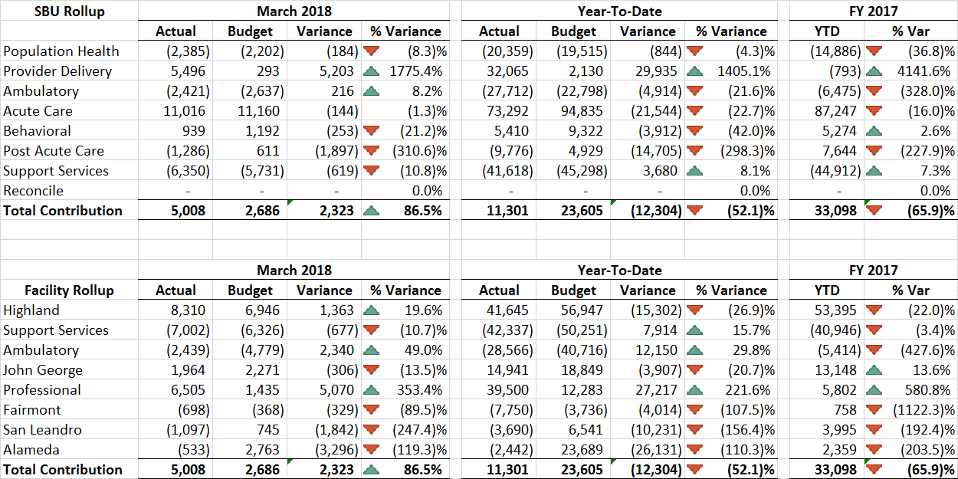
March 2018 Financial Report
Contribution Variance Summary
The Contribution Variance Summary provides the ability to see variances in contribution to budget at the SBU and Facility level.
Notes:
In summary by strategic budget unit and facility rollups, you can see that Provider delivery and Ambulatory continue to be the standouts compared to budget.

Slide 8
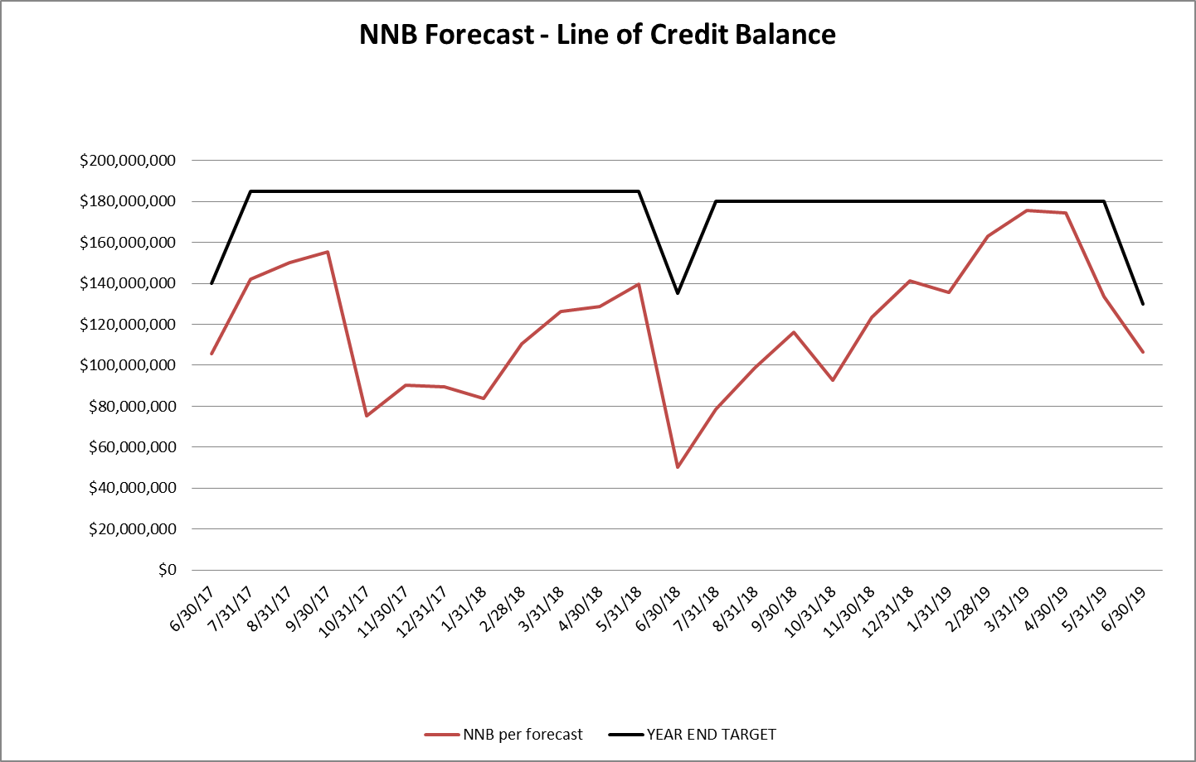
March 2018 Financial Report
Balance Sheet and Line of Credit
Below are the key Balance Sheet metrics and the forecast for the Line of Credit.
Notes:
Key balance sheet metrics are improved across the board. Cash up, Days in AR moving down, and Days in AP down.
We’ve increased the Net Negative Balance forecast to cover through the end of FY 19, and expect to be complaint with the terms of our agreement with the county.

Slide 9
March 2018 Financial Report
FY 2018 Forecast
FY 18 Year End Forecast | Actual | Actual | Actual | Actual | Actual | Actual | Actual | Actual | Actual | Projected | Projected | Projected
 | Jul-17 | Aug-17 | Sep-17 | Oct-17 | Nov-17 | Dec-17 | Jan-18 | Feb-18 | Mar-18 | Apr-18 | May-18 | Jun-18 | FY2018
Inpatient service revenue | 151,438,498 | 164,271,336 | 151,174,545 | 158,630,367 | 152,672,913 | 166,453,331 | 173,464,162 | 149,052,326 | 170,720,754 | 164,412,414 | 169,892,827 | 164,412,414 | 1,936,595,888
Outpatient service revenue | 90,737,260 | 90,094,895 | 89,780,588 | 98,138,355 | 85,308,040 | 82,647,297 | 92,949,702 | 87,055,207 | 91,766,885 | 90,590,598 | 93,610,284 | 90,590,598 | 1,083,269,708
Professional service revenue | 17,824,978 | 21,398,796 | 20,330,825 | 25,564,478 | 21,407,080 | 22,982,396 | 25,889,955 | 24,758,686 | 28,447,222 | 26,515,288 | 27,554,131 | 26,815,288 | 289,489,122
Gross Patient Service Revenue | 260,000,736 | 275,765,027 | 261,285,959 | 282,333,201 | 259,388,033 | 272,083,025 | 292,303,819 | 260,866,218 | 290,934,860 | 281,518,299 | 291,057,242 | 281,818,299 | 3,309,354,718
Deductions from revenues | (209,433,998) | (222,185,852) | (210,292,167) | (227,029,564) | (208,351,255) | (218,407,374) | (236,583,803) | (209,932,296) | (234,170,263) | (225,502,977) | (233,180,767) | (225,743,444) | (2,660,813,761)
Capitation - HPAC | 2,766,362 | 2,766,362 | 2,766,362 | 2,766,362 | 2,766,362 | 2,766,362 | 2,766,362 | 2,766,362 | 2,766,362 | 2,766,362 | 2,766,362 | 2,766,362 | 33,196,344
Net Patient Service Revenue | 53,333,100 | 56,345,537 | 53,760,154 | 58,069,999 | 53,803,140 | 56,442,012 | 58,486,377 | 53,700,284 | 59,530,959 | 58,781,684 | 60,642,837 | 58,841,217 | 681,737,301
Medi-Cal Waiver | 8,925,000 | 8,925,000 | 8,925,000 | 8,925,000 | 15,675,298 | 10,925,000 | 10,925,000 | 10,925,000 | 12,806,952 | 10,266,583 | 10,266,583 | 10,266,583 | 127,757,000
Measure A, Parcel Tax, Other Support | 9,731,321 | 9,731,321 | 10,009,359 | 9,824,000 | 9,824,000 | 10,333,898 | 9,824,000 | 9,824,000 | 9,824,000 | 9,880,701 | 9,880,701 | 9,880,701 | 118,568,000
CA Hospital Fee | - | - | - | - | - | - | - | - | - | - | - | - | -
Supplemental Programs (FY19 incl shift from NPSR) | 5,011,182 | 4,930,180 | 6,131,411 | 5,939,668 | 2,525,671 | 6,380,638 | 6,717,893 | 6,694,059 | 5,623,672 | 3,916,876 | 3,916,876 | 3,916,876 | 61,705,000
Grants & Research Protocol | 507,592 | 517,832 | 513,070 | 521,751 | 538,327 | 2,095,825 | 753,598 | 518,446 | 792,886 | 10,750,891 | 750,891 | 750,891 | 19,012,000
Other Operating Revenue | 1,390,808 | 1,902,542 | 1,685,318 | 2,261,729 | 1,882,353 | 2,067,491 | 1,761,084 | 1,764,598 | 2,085,755 | 1,866,773 | 1,866,773 | 1,866,773 | 22,402,000
Incentives/Reserve Adjustment | - | - | - | - | - | - | 8,500 | - | - |  |  |  | 8,500
Total Supplemental Revenue | 25,565,903 | 26,006,875 | 27,264,158 | 27,472,148 | 30,445,649 | 31,802,852 | 29,990,076 | 29,726,103 | 31,133,266 | 36,681,824 | 26,681,824 | 26,681,824 | 349,452,500
Net Operating Revenue | 78,899,003 | 82,352,412 | 81,024,312 | 85,542,147 | 84,248,789 | 88,244,865 | 88,476,453 | 83,426,387 | 90,664,224 | 95,463,508 | 87,324,661 | 85,523,041 | 1,031,189,801
Salaries and wages | 38,256,638 | 37,947,256 | 39,049,678 | 40,122,540 | 42,472,469 | 45,124,995 | 43,524,189 | 39,014,286 | 40,928,787 | 40,238,058 | 41,490,398 | 40,099,356 | 488,268,649
Registry | 3,100,284 | 3,730,184 | 3,836,117 | 2,050,558 | 1,843,666 | 1,941,192 | 1,908,382 | 1,890,525 | 1,798,600 | 1,798,600 | 1,858,553 | 1,798,600 | 27,555,259
Employee benefits | 13,128,482 | 13,563,236 | 12,813,379 | 12,494,014 | 13,670,132 | 12,857,285 | 14,904,835 | 13,201,757 | 14,763,112 | 14,513,964 | 14,965,686 | 14,463,934 | 165,339,816
Contracted physician services | 7,064,846 | 7,348,391 | 6,675,939 | 7,372,673 | 7,753,734 | 7,726,104 | 7,891,363 | 6,980,620 | 7,044,640 | 7,044,640 | 7,279,462 | 7,544,640 | 87,727,052
Purchased services | 5,780,481 | 6,565,550 | 6,272,999 | 5,919,576 | 5,499,319 | 5,627,557 | 7,250,395 | 6,468,090 | 7,590,642 | 5,899,512 | 5,899,512 | 5,899,512 | 74,673,143
Pharmaceuticals | 2,325,959 | 2,473,651 | 2,015,401 | 2,908,093 | 2,494,564 | 2,586,968 | 2,277,432 | 3,617,571 | 2,655,943 | 3,604,818 | 3,724,979 | 3,593,818 | 34,279,198
Medical Supplies | 2,785,183 | 3,376,555 | 2,924,654 | 3,023,624 | 2,725,169 | 2,956,551 | 3,256,321 | 3,101,137 | 2,630,349 | 2,775,505 | 2,868,022 | 2,775,505 | 35,198,574
Materials and supplies | 1,509,944 | 1,504,890 | 1,588,571 | 1,772,019 | 2,003,639 | 2,282,608 | 2,135,964 | 1,916,826 | 1,507,710 | 1,652,463 | 1,557,546 | 1,652,463 | 21,084,644
Outside medical services | 446,155 | 371,885 | 154,638 | 643,536 | 327,605 | 105,973 | 408,552 | 608,881 | 331,187 | 331,187 | 331,187 | 331,187 | 4,391,971
General & administrative expenses | 1,351,381 | 1,487,859 | 1,484,504 | 1,631,810 | 1,569,113 | 2,148,587 | 1,657,437 | 1,209,065 | 1,966,319 | 2,111,786 | 1,611,786 | 1,611,786 | 19,841,432
Repairs/maintenance/utilities | 1,512,906 | 1,750,975 | 1,895,039 | 2,069,127 | 1,760,479 | 1,590,377 | 2,260,670 | 1,180,396 | 2,383,854 | 1,913,779 | 1,913,779 | 1,913,779 | 22,145,162
Building/equipment leases & rentals | 452,360 | 476,672 | 1,115,325 | 677,380 | 633,394 | 641,606 | 725,413 | 757,428 | 691,480 | 691,480 | 691,480 | 691,480 | 8,245,500
Depreciation | 1,278,800 | 1,315,944 | 1,345,529 | 1,376,969 | 1,324,894 | 1,322,820 | 1,322,784 | 1,320,716 | 1,363,282 | 1,363,282 | 1,363,282 | 1,363,282 | 16,061,583
Total operating expenses | 78,993,420 | 81,913,047 | 81,171,771 | 82,061,918 | 84,078,177 | 86,912,623 | 89,523,737 | 81,267,298 | 85,655,905 | 83,939,075 | 85,555,670 | 83,739,342 | 1,004,811,983
Operating Income | (94,417) | 439,365 | (147,459) | 3,480,230 | 170,612 | 1,332,242 | (1,047,284) | 2,159,088 | 5,008,319 | 11,524,433 | 1,768,991 | 1,783,699 | 26,377,818
Non-Operating Income/(Expense) | (3,998,780) | (4,103,428) | (4,085,794) | (3,892,641) | (4,452,898) | (4,339,762) | (4,210,217) | (4,331,304) | (4,336,135) | (2,538,014) | (2,538,014) | (2,538,014) | (45,365,000)
Net Income | $ (4,093,198) | $ (3,664,063) | $ (4,233,253) | $ (412,412) | $ (4,282,286) | $ (3,007,520) | $ (5,257,500) | $ (2,172,216) | $ 672,185 | $ 8,986,419 | $ (769,023) | $ (754,315) | $ (18,987,182)
Operating Margin | (0.1)% | 0.5% | (0.2)% | 4.1% | 0.2% | 1.5% | (1.2)% | 2.6% | 5.5% | 12.1% | 2.0% | 2.1% | 2.6%
EBIDA Margin | 1.5% | 2.2% | 1.5% | 5.8% | 1.8% | 3.0% | 0.3% | 4.2% | 7.1% | 13.5% | 3.6% | 3.7% | 4.1%
Collection % - NPSR | 20.5% | 20.4% | 20.6% | 20.6% | 20.7% | 20.7% | 20.0% | 20.6% | 20.5% | 20.9% | 20.8% | 20.9% | 20.6%
Collection % - Total | 30.3% | 29.9% | 31.0% | 30.3% | 32.5% | 32.4% | 30.3% | 32.0% | 31.2% | 33.9% | 30.0% | 30.3% | 31.2%
Notes:
In doing the 12 month rolling forecast, we needed to first project to year end. So your package includes the FY 18 projection. This was done somewhat separately from the budget forecast, so it is extremely close but not exact…..
It’s hard to see, so I have shrunken the last few months so you can see the numbers.
Just a note that the grey columns are actual, the while columns are projected.

Slide 10
March 2018 Financial Report
FY 2018 Forecast
Assumptions:
Increased NPSR from AAH contract and Oakcare ED billing.
Increased GPP, Prime, EPP and QIP projections offset by prior year adjustment.
Increased supplementals including receipt of Kaiser EPIC grant funding.
Expenses include savings from Back to Budget.
FY 18 Year End Forecast | Actual | Projected | Projected | Projected
 | Mar-18 | Apr-18 | May-18 | Jun-18 | FY2018
Gross Patient Service Revenue | 290,934,860 | 281,518,299 | 291,057,242 | 281,818,299 | 3,309,354,718
Net Patient Service Revenue | 59,530,959 | 58,781,684 | 60,642,837 | 58,841,217 | 681,737,301
Total Supplemental Revenue | 31,133,266 | 36,681,824 | 26,681,824 | 26,681,824 | 349,452,500
Net Operating Revenue | 90,664,224 | 95,463,508 | 87,324,661 | 85,523,041 | 1,031,189,801
Total Operating Expenses | 85,655,905 | 83,939,075 | 85,555,670 | 83,739,342 | 1,004,811,983
Operating Income | 5,008,319 | 11,524,433 | 1,768,991 | 1,783,699 | 26,377,818
Non-Operating Income/(Expense) | (4,336,135) | (2,538,014) | (2,538,014) | (2,538,014) | (45,365,000)
Net Income | $ 672,185 | $ 8,986,419 | $ (769,023) | $ (754,315) | $ (18,987,182)
Operating Margin | 5.5% | 12.1% | 2.0% | 2.1% | 2.6%
EBIDA Margin | 7.1% | 13.5% | 3.6% | 3.7% | 4.1%
Collection % - NPSR | 20.5% | 20.9% | 20.8% | 20.9% | 20.6%
Collection % - Total | 31.2% | 33.9% | 30.0% | 30.3% | 31.2%
Notes:
Assumptions included here are that we have increased net patient services revenues from the AAH contract and Oakcare ED billing.
Supplementals from GPP, Prime, EPP and QIP have additional amounts, however they are offset by a need for a prior year adjustment.
We have additional supplemental funding including the receipt of the Kaiser EPIC grant….Some of this may have to be booked directly to the Fund balance as it is specifically for a capital project, so the numbers may move around some.
Expenses include savings from the back to budget plan, as well as some continued increases in Pharmaceuticals and Repairs and Maintenance.
We expect to achieve the budgeted 4.1% EBIDA.

Slide 11
March 2018 Financial Report
12 Month Rolling Forecast
March 2018 12 Month Rolling Forecast | Actual | Projected | Projected | Projected | Projected | Projected | Projected | Projected | Projected | Projected | Projected | Projected
 | Mar-18 | Apr-18 | May-18 | Jun-18 | Jul-18 | Aug-18 | Sep-18 | Oct-18 | Nov-18 | Dec-18 | Jan-19 | Feb-19 | Total 12 Months
Inpatient service revenue | 170,720,754 | 164,412,414 | 169,892,827 | 164,412,414 | 166,131,208 | 166,131,208 | 160,772,137 | 166,131,208 | 160,772,137 | 166,131,208 | 166,131,208 | 150,053,995 | 1,971,692,718
Outpatient service revenue | 91,766,885 | 90,590,598 | 93,610,284 | 90,590,598 | 94,585,841 | 94,585,841 | 91,534,685 | 94,585,841 | 91,534,685 | 94,585,841 | 94,585,841 | 85,432,373 | 1,107,989,312
Professional service revenue | 28,447,222 | 26,515,288 | 27,554,131 | 26,815,288 | 26,791,559 | 26,791,559 | 26,791,559 | 26,791,559 | 26,791,559 | 26,791,559 | 26,791,559 | 24,198,827 | 321,071,668
Gross Patient Service Revenue | 290,934,860 | 281,518,299 | 291,057,242 | 281,818,299 | 287,508,608 | 287,508,608 | 279,098,381 | 287,508,608 | 279,098,381 | 287,508,608 | 287,508,608 | 259,685,195 | 3,400,753,698
Deductions from revenues | (234,170,263) | (225,502,977) | (233,180,767) | (225,743,444) | (233,780,930) | (233,780,930) | (226,239,609) | (233,780,930) | (226,239,609) | (233,780,930) | (233,780,930) | (211,156,969) | (2,751,138,288)
Capitation - HPAC | 2,766,362 | 2,766,362 | 2,766,362 | 2,766,362 | 2,898,667 | 2,898,667 | 2,898,667 | 2,898,667 | 2,898,667 | 2,898,667 | 2,898,667 | 2,898,667 | 34,254,781
Net Patient Service Revenue | 59,530,959 | 58,781,684 | 60,642,837 | 58,841,217 | 56,626,345 | 56,626,345 | 55,757,438 | 56,626,345 | 55,757,438 | 56,626,345 | 56,626,345 | 51,426,892 | 683,870,191
Medi-Cal Waiver | 12,806,952 | 10,266,583 | 10,266,583 | 10,266,583 | 9,545,917 | 9,545,917 | 9,545,917 | 9,545,917 | 9,545,917 | 9,545,917 | 9,545,917 | 9,545,917 | 119,974,035
Measure A, Parcel Tax, Other Support | 9,824,000 | 9,880,701 | 9,880,701 | 9,880,701 | 10,025,000 | 10,025,000 | 10,025,000 | 10,025,000 | 10,025,000 | 10,025,000 | 10,025,000 | 10,025,000 | 119,666,102
CA Hospital Fee | - | - | - | - | - | - | - | - | - | - | - | - | -
Supplemental Programs (FY19 incl shift from NPSR) | 5,623,672 | 3,916,876 | 3,916,876 | 3,916,876 | 10,670,583 | 10,670,583 | 10,670,583 | 10,670,583 | 10,670,583 | 10,670,583 | 10,670,583 | 10,670,583 | 102,738,965
Grants & Research Protocol | 792,886 | 10,750,891 | 750,891 | 750,891 | 1,068,583 | 1,068,583 | 1,068,583 | 1,068,583 | 1,068,583 | 1,068,583 | 1,068,583 | 1,068,583 | 21,594,225
Other Operating Revenue | 2,085,755 | 1,866,773 | 1,866,773 | 1,866,773 | 1,592,417 | 1,592,417 | 1,592,417 | 1,592,417 | 1,592,417 | 1,592,417 | 1,592,417 | 1,592,417 | 20,425,409
Incentives/Reserve Adjustment | - |  |  |  | - | - | - | - | - | - | - | - | -
Total Supplemental Revenue | 31,133,266 | 36,681,824 | 26,681,824 | 26,681,824 | 32,902,500 | 32,902,500 | 32,902,500 | 32,902,500 | 32,902,500 | 32,902,500 | 32,902,500 | 32,902,500 | 384,398,736
Net Operating Revenue | 90,664,224 | 95,463,508 | 87,324,661 | 85,523,041 | 89,528,845 | 89,528,845 | 88,659,938 | 89,528,845 | 88,659,938 | 89,528,845 | 89,528,845 | 84,329,392 | 1,068,268,928
Salaries and wages | 40,928,787 | 40,238,058 | 41,490,398 | 40,099,356 | 42,518,721 | 41,768,721 | 41,171,342 | 41,768,721 | 42,671,342 | 42,518,721 | 43,268,721 | 38,476,586 | 496,919,473
Registry | 1,798,600 | 1,798,600 | 1,858,553 | 1,798,600 | 2,673,219 | 2,673,219 | 2,586,986 | 2,673,219 | 2,586,986 | 2,673,219 | 2,673,219 | 2,414,521 | 28,208,941
Employee benefits | 14,763,112 | 14,513,964 | 14,965,686 | 14,463,934 | 15,043,305 | 14,777,952 | 14,566,597 | 14,777,952 | 15,097,304 | 15,043,305 | 15,308,658 | 13,613,181 | 176,934,950
Contracted physician services | 7,044,640 | 7,044,640 | 7,279,462 | 7,544,640 | 7,601,583 | 7,601,583 | 7,601,583 | 7,601,583 | 7,601,583 | 7,601,583 | 7,601,583 | 7,601,583 | 89,726,049
Purchased services | 7,590,642 | 5,899,512 | 5,899,512 | 5,899,512 | 6,202,167 | 6,202,167 | 6,202,167 | 6,202,167 | 6,202,167 | 6,202,167 | 6,202,167 | 6,202,167 | 74,906,511
Pharmaceuticals | 2,655,943 | 3,604,818 | 3,724,979 | 3,593,818 | 3,311,748 | 3,311,748 | 3,204,917 | 3,311,748 | 3,204,917 | 3,311,748 | 3,311,748 | 2,991,256 | 39,539,386
Medical Supplies | 2,630,349 | 2,775,505 | 2,868,022 | 2,775,505 | 2,564,810 | 2,564,810 | 2,482,075 | 2,564,810 | 2,482,075 | 2,564,810 | 2,564,810 | 2,316,603 | 31,154,184
Materials and supplies | 1,507,710 | 1,652,463 | 1,557,546 | 1,652,463 | 1,377,697 | 1,377,697 | 1,333,255 | 1,377,697 | 1,333,255 | 1,377,697 | 1,377,697 | 1,244,371 | 17,169,548
Outside medical services | 331,187 | 331,187 | 331,187 | 331,187 | 372,917 | 372,917 | 372,917 | 372,917 | 372,917 | 372,917 | 372,917 | 372,917 | 4,308,080
General & administrative expenses | 1,966,319 | 2,111,786 | 1,611,786 | 1,611,786 | 1,824,833 | 1,824,833 | 1,824,833 | 1,824,833 | 1,824,833 | 1,824,833 | 1,824,833 | 1,824,833 | 21,900,344
Repairs/maintenance/utilities | 2,383,854 | 1,913,779 | 1,913,779 | 1,913,779 | 1,669,667 | 1,669,667 | 1,669,667 | 1,669,667 | 1,669,667 | 1,669,667 | 1,669,667 | 1,669,667 | 21,482,526
Building/equipment leases & rentals | 691,480 | 691,480 | 691,480 | 691,480 | 733,417 | 733,417 | 733,417 | 733,417 | 733,417 | 733,417 | 733,417 | 733,417 | 8,633,255
Depreciation | 1,363,282 | 1,363,282 | 1,363,282 | 1,363,282 | 1,358,333 | 1,358,333 | 1,358,333 | 1,358,333 | 1,358,333 | 1,358,333 | 1,358,333 | 1,358,333 | 16,319,793
Total operating expenses | 85,655,905 | 83,939,075 | 85,555,670 | 83,739,342 | 87,252,416 | 86,237,063 | 85,108,089 | 86,237,063 | 87,138,796 | 87,252,416 | 88,267,770 | 80,819,435 | 1,027,203,040
Operating Income | 5,008,319 | 11,524,433 | 1,768,991 | 1,783,699 | 2,276,429 | 3,291,782 | 3,551,849 | 3,291,782 | 1,521,142 | 2,276,429 | 1,261,075 | 3,509,958 | 41,065,887
Interest income/(expense) net | (95,461) | (95,461) | (95,461) | (95,461) | (66,667) | (66,667) | (66,667) | (66,667) | (66,667) | (66,667) | (66,667) | (66,667) | (915,178)
Retirement GASB68 | (4,261,897) | (4,261,897) | (4,261,897) | (4,261,897) | (4,113,000) | (4,113,000) | (4,113,000) | (4,113,000) | (4,113,000) | (4,113,000) | (4,113,000) | (4,113,000) | (49,951,587)
Support Services Allocation | - | 1,798,121 | 1,798,121 | 1,798,121 | - | - | - | - | - | - | - | - | 5,394,363
Other Non-operating income(expense) | 21,223 | 21,223 | 21,223 | 21,223 | 27,333 | 27,333 | 27,333 | 27,333 | 27,333 | 27,333 | 27,333 | 27,333 | 303,559
Non-Operating Income/(Expense) | (4,336,135) | (2,538,014) | (2,538,014) | (2,538,014) | (4,152,333) | (4,152,333) | (4,152,333) | (4,152,333) | (4,152,333) | (4,152,333) | (4,152,333) | (4,152,333) | (45,168,842)
Net Income | $ 672,185 | $ 8,986,419 | $ (769,023) | $ (754,315) | $ (1,875,905) | $ (860,551) | $ (600,484) | $ (860,551) | $ (2,631,191) | $ (1,875,905) | $ (2,891,258) | $ (642,376) | $ (4,102,955)
Operating Margin | 5.5% | 12.1% | 2.0% | 2.1% | 2.5% | 3.7% | 4.0% | 3.7% | 1.7% | 2.5% | 1.4% | 4.2% | 3.8%
EBIDA Margin | 7.1% | 13.5% | 3.6% | 3.7% | 4.1% | 5.2% | 5.6% | 5.2% | 3.3% | 4.1% | 3.0% | 5.8% | 5.4%
Collection % - NPSR | 20.5% | 20.9% | 20.8% | 20.9% | 19.7% | 19.7% | 20.0% | 19.7% | 20.0% | 19.7% | 19.7% | 19.8% | 20.1%
Collection % - Total | 31.2% | 33.9% | 30.0% | 30.3% | 31.1% | 31.1% | 31.8% | 31.1% | 31.8% | 31.1% | 31.1% | 32.5% | 31.4%
Notes:
The 12 month rolling forecast is from March 2018 through February 2018. This is very hard to see but you can refer to your handouts.

Slide 12
March 2018 Financial Report
12 Month Rolling Forecast
March 2018 12 Month Rolling Forecast | Projected | Projected | Projected | Projected | Projected | Projected | Projected | Projected
 | Jul-18 | Aug-18 | Sep-18 | Oct-18 | Nov-18 | Dec-18 | Jan-19 | Feb-19 | Total 12 Months
Gross PSR | 287,508,608 | 287,508,608 | 279,098,381 | 287,508,608 | 279,098,381 | 287,508,608 | 287,508,608 | 259,685,195 | 3,400,753,698
Net PSR | 56,626,345 | 56,626,345 | 55,757,438 | 56,626,345 | 55,757,438 | 56,626,345 | 56,626,345 | 51,426,892 | 683,870,191
Total Supplemental Rev. | 32,902,500 | 32,902,500 | 32,902,500 | 32,902,500 | 32,902,500 | 32,902,500 | 32,902,500 | 32,902,500 | 384,398,736
Net Operating Revenue | 89,528,845 | 89,528,845 | 88,659,938 | 89,528,845 | 88,659,938 | 89,528,845 | 89,528,845 | 84,329,392 | 1,068,268,928
Total Operating Expenses | 87,252,416 | 86,237,063 | 85,108,089 | 86,237,063 | 87,138,796 | 87,252,416 | 88,267,770 | 80,819,435 | 1,027,203,040
Operating Income | 2,276,429 | 3,291,782 | 3,551,849 | 3,291,782 | 1,521,142 | 2,276,429 | 1,261,075 | 3,509,958 | 41,065,887
Non-Operating Inc./(Exp.) | (4,152,333) | (4,152,333) | (4,152,333) | (4,152,333) | (4,152,333) | (4,152,333) | (4,152,333) | (4,152,333) | (45,168,842)
Net Income | $ (1,875,905) | $ (860,551) | $ (600,484) | $ (860,551) | $ (2,631,191) | $ (1,875,905) | $ (2,891,258) | $ (642,376) | $ (4,102,955)
Operating Margin | 2.5% | 3.7% | 4.0% | 3.7% | 1.7% | 2.5% | 1.4% | 4.2% | 3.8%
EBIDA Margin | 4.1% | 5.2% | 5.6% | 5.2% | 3.3% | 4.1% | 3.0% | 5.8% | 5.4%
Collection % - NPSR | 19.7% | 19.7% | 20.0% | 19.7% | 20.0% | 19.7% | 19.7% | 19.8% | 20.1%
Collection % - Total | 31.1% | 31.1% | 31.8% | 31.1% | 31.8% | 31.1% | 31.1% | 32.5% | 31.4%
Notes:
Here are just the FY 19 projected months and the 12 month total.
You can see that the monthly EBIDA ranges from 3% to 5.8%, with a 12 month average at 5.4%.

Slide 13
March 2018 Financial Report
12 Month Rolling Forecast
Assumptions:
Based on FY 19 budget.
Work in Progress.
Revenues and Expense adjusted by days in month – Not yet based on specific volumes and seasonal adjustments.
Labor adjusted for holiday OT.
Notes:
This is based on the FY 19 budget presented here.
It is still a work in progress….We did not have the actual volumes by site, by month, seasonally adjusted, so Revenues and Expenses were adjusted by days in the month. Labor expenses were adjusted for Holiday OT.
Just a note, you will see a significant increase in the supplemental line starting in july due to the movement of EPP and QIP from NPSR where it is currently reported.
This will continue to be refined.
With that I’ll ask if there are any questions regarding the monthly financials.

Slide 14
Revenue Cycle in Simplest View
March 2018 Financial Report
REVENUE CYCLE
Scheduling and Registration
Provision of service and documentation (coding, charge entry)
Billing and collection
Notes:
At the last Finance committee meeting there were several questions regarding the Revenue Cycle and a request for some more information. So I thought I would try to start the education process and try to address some of the questions….
In it’s simplest form, the revenue cycle is:
The patient is scheduled and registered, service is provided and documented ( including coding and entering of charges), then the patient is billed and payments are received.
Although there much more that goes into it.

Slide 15
Revenue Cycle with Finance Activities
March 2018 Financial Report
REVENUE CYCLE
Authorizations
Scheduling /Pre-registration
Revenue Integrity
Billing
Follow Up Collections
Bad Debt /Agency Management
HIM
Charge Capture
Case Management
Admissions / Patient Access
Collection%
CDM Mgmt
Rate Setting
* Once charges entered and accounts coded, we can calculate net revenue and set collection goals for billing and collections.
*
Notes:
Here we look a the revenue cycle Finance related activities:
Scheduling / preregistration – Here is where we are working on authorization activities to make sure that the services will be approved by the patient’s payer
Admissions and registration – including Patient access activities of facilitating medi-cal enrollment/ financial counseling
Once the service is provided, charge capture… in the background here we have the CDM or charge description master maintenance and the setting of charges that we will touch on later.
Case management – to ensure that patients are at the proper level of care
HIM – where accounts are coded for diagnosis and procedures – necessary for billing.
Its at this point where we can actual calculate the net revenue that we should receive….and if done on a monthly basis, we can use that information to set collection goals for billing and collections.
Continuing on the rev cycle…we have revenue integrity activities making sure that all of the entered charges can be billed.
We bill, and then collect, and send accounts to collection agencies if necessary…..and we can calculate our collection %. Which we will discuss in detail
All along the cycle there are human factors and system factors that can impact the final disposition of an account and effect the collection %.

Slide 16
Collection %
March 2018 Financial Report
REVENUE CYCLE
Collection % NPSR = NPSR/Gross Charges
This is the amount that is the Patient Services Dept./Revenue Cycle management responsibility to collect.
NPSR in March should be cash collection goal for May.
Collection % Total = Net Oper. Rev./Gross Charges
Includes supplemental revenues considered patient revenues but not patient specific.
Notes:
What is the collection %...
We show two on our financial statement… NPSR and Total
NPSR is net patient services revenue divided by Gross charges. Basically it is the amount that the patient services department/Revenue cycle management is responsible for collecting. It’s based on actually billing and collection activities. Basically, Net patient services revenue in March is what the billing office should see as cash receipts in May.
Now this number has not been pure in the past….we included some medi-cal managed care supplementals in this number, which we have moved to supplemental revenue starting in FY19, and it also includes HPAC and capitation (which need to be billed for encounters, but are not paid based on actual billings). These amounts will be accounted for in the cash collection goals.
The trustees had asked how we know if PBS is collecting all that they should. By calculating an expected net patient services revenue based on the charges and activity for the month (the income statement approach) and comparing it to the cash collections one of the best tools. Unfortunately, AHS has not been doing that monthly calculation and has been using balance sheet approach – which reviews receivables and calculates an appropriate reserve. This methodology also needs to be done, but essentially assumes that PBS has collected what it should. This was noted in my assessment back in 2014, and has not adequately been addressed. We are in the process of putting an income statement calculation in place and will be setting PBS cash goals. Currently they have had set monthly goal that is not based on actual activity.
Collection % total is Net Operating Rev/Gross charges – so it includes all supplemental revenues- which while considered patient revenues are not patient specific.

Slide 17
Collection% - Why so low?
March 2018 Financial Report
REVENUE CYCLE
Hospitals required to charge all patients/payers the same amount for same service.
Gov’t payers reimburse under fee schedules or at cost and hospitals must accept if they want to be paid for services to enrollees.
Commercial payers generally negotiate contracted rates or may pay based on charges, but many times patient have high deductibles.
Uninsured patient may or may not qualify for charity or reduced charges, and may or may not pay.
Patients may need services that insurance won’t authorize = no payment.
Because of issues above, there is a big difference between gross charges and what will be collected.
Notes:
So why is our collection % so low.
Well….we don’t operate like a fast food restaurant where they require payment in full before you order your food, and unless you have a coupon, you pay the price that’s listed for the item you want on the menu.
Hospitals, like a restaurant have a menu of gross charges, and by federal requirements hospitals are required to charge all patients and their payors the same gross charge for the same service. But not all payers pay the same or at all, and very very few pay our gross charges.
Government payers reimburse under fee schedules or at cost and hospitals must accept the amount that they pay if they want to be paid for services provided to enrollees.
Commercial payers generally pay contracted rates, or may pay based on charges…but many times patients have high deductibles and co insurance that they may or may not pay – or be able to afford.
Uninsured patients may or may not qualify for charity care and may or may not pay. Especially if they have already received the service.
Patients may need services that their insurance won’t authorize or won’t cover – which means no payment if the service is provided.
Because of these issues, there is a big difference between gross charges and what will actually be collected. In the budget presentation we show the payment percentages by major payer.

Slide 18
Collection% - Why so low?
March 2018 Financial Report
REVENUE CYCLE
Gross vs Net payments from Medi-Cal.
We book revenue at “Net” but Federal Government says we got gross amount.
Managed Care IGT
We put up $20 mill IGT for non-federal share
We pay DHCS 20% IGT fee of $4 mill
We receive $40 mill payment from plan
We book $16 mill Net Revenue
CMS says we got $40 mill
Similar issue for CPE based Mcal FFS payments and supplementals, and IGT based Prime, GPP, QIP and EPP.
If we showed that income at Gross, our collection % would be much greater but would not reflect our true net revenue.
Notes:
There is another quirk with government payers.
The Medi-Cal program is a state/federal program. For pre ACA enrollees, Medi-Cal payments were funded 50% by the state and 50% by the feds (FFP or Federal Financial Participation). The federal % is much higher for the newly eligible currently at 94%. For much of the Medi-Cal funding at AHS ( IP FFS, Mcal and Waiver and Supplemental payments) AHS must put in the state or non federal share. When we book the payments as revenue, we only book as income the Federal payment or our Net payment. But the Federal Government says we really got the gross amount including the non federal share.
For example…..The Managed Care Rate Range IGT. See slide
It is similar with all IGT programs and with CPE cost based programs where we expend 5000 and get 2500 in payment….but they consider us as having received 5000.
If we showed all of the CPE and IGT based income at Gross our collection rate would be much higher, however it would not reflect our true net revenue.
So why don’t we lower our charges?????

Slide 19
Collection% - Why so low?
March 2018 Financial Report
REVENUE CYCLE
Usual and Customary Charge Limitation (UCC)
Can’t get paid more than charges
Medi-Cal DSH (starting long ago) we were limited to lower of 175% of our Medi-Cal and Unsponsored uncompensated cost, or charges.
Forced public hospitals to increase charges.
Contracts assume annual charge increases.
If charges were lowered, it would impact net revenues.
Notes:
We also have to deal with another regulation - The usual and customary charge limitation….which says that for certain funding we cannot get paid more than our charges.
Back when the Medi-Cal DSH program started where public hospitals had to put up IGT funding for the non-federal share, public hospitals were able to draw down DSH up to 175% of our uncompensated Medi-cal and Uninsured costs however we were limited to the lower of that calculation or our charges for those services.
This forced public hospitals to increase charges .
In addition, based on current charging and what insurance companies pay, lowing our charges would lower actual net revenues.

Slide 20
Rate Setting/CDM Management
March 2018 Financial Report
REVENUE CYCLE
Majority of patients have government payers and are not effected by charges.
We must have charges > highest reimbursement.
We want to be around the median on average for pricing in surrounding area. In 2017 prices were lowered in some areas.
We utilize software that provides us with area average charge data.
We are working to have consistent charging across all AHS facilities and will have one charge master under EPIC.
Notes:
So the trustees had asked how we set our charges.
The vast majority of our patients have government payers and are not effected by charges, but we try to fit within the following parameters
We must have charges greater than reimbursement at the specific service level as well as overall to fit under the UCC where our overall reimbursement is calculated at the gross payment.
We want to be around the median on average for pricing in our surrounding area. In fact to get closer to this, in 2017 charges were reduced for some services.
We utilize a program called Craneware that provides us with area average charge data….we able to select the facilities that we want to be compared with.
Finally we are working to have consistent charging for service across all AHS facilities. We are not there yet, but will have one charge master under EPIC.
I know that this is a lot and I’m trying to make a complicated system easy to understand. I hope that this helps.

