Slide 1
Finance Committee
April 2018

Slide 2
February 2018 Financial Report
Operating Profit of $2.2 million in February.
Operating Expenses > Fixed Budget by $3.2 million (4.1%).
Salaries and Pharmaceuticals major contributors.
YTD EBIDA Margin of 2.6% below the budget of 4.6%.
YTD Revenues and Expenses unfavorable to budget by 0.9% and 1.3%, respectively.
Year over year, Revenues and Expenses increased by 5.0% and 9.0%, respectively.
EBIDA Margin dropped from 6.1% last year to 2.6% this year.
2018 Budget is frozen for the remainder of the year.

Slide 3
February 2018 Financial Report
Patient Activity
Patient Activity close to budget except for Acute and Post-Acute discharges.
Acute Average Daily Census was 286, 3.2% > Budget.
ALOS remained at 6.0 days, 12.2% > Budget.
Emergency Department Visits (not shown below) were 10,038, 4.0% < Budget.
Clinic Visits were 27,339, only 0.1% < Budget.
Physician wRVUs decreased to 83,634 from 88,197 last month (no budget for this).
Post-Acute Average Daily Census was 298, 1% > Budget for the month.

Slide 4
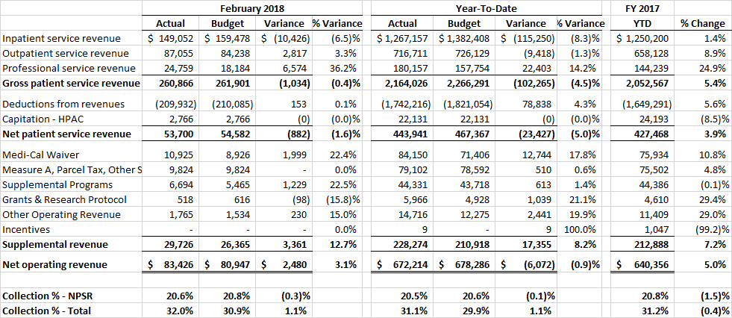
February 2018 Financial Report
Revenue
Net Patient Service Revenues (NPSR) consistent at 1.6% < Budget.
The Collection Ratio was 20.6% for the month, and was 20.5% YTD.
The Budgeted Collection Ratio of 20.6% is expected to be achieved by June 30^{th.}
Completion of the new agreement with Alameda Alliance.

Slide 5
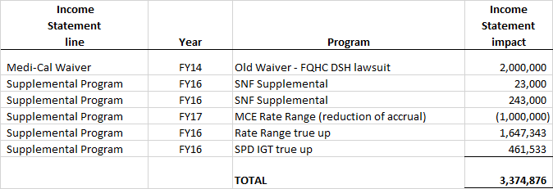
February 2018 Financial Report
Supplemental Reimbursement
The favorable performance in reported Supplemental Reimbursement is due to favorable development in certain current year and prior year supplemental reimbursement programs and our ability to bring this into income through the end of the year. Presented below is the detail of the additional $3.4 million that we are booking as additional revenue in February. Please note that there are some negative adjustments offsetting positives.

Slide 6
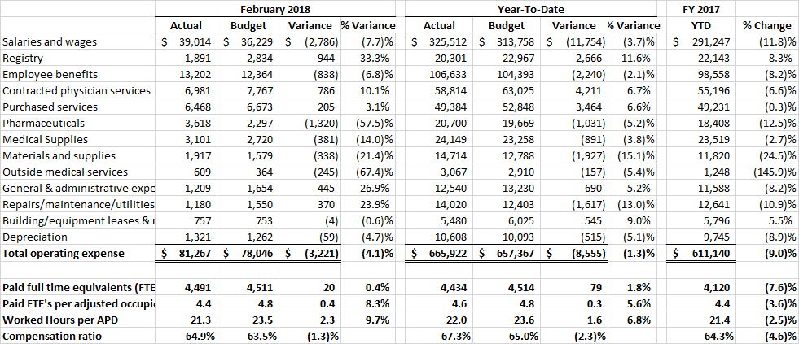
February 2018 Financial Report
Operating Expenses
February Operating Expenses were $81.3 million, $3.2 million (4.1%) > Budget.
Detailed analysis of Salaries Budget to Actual variance identified two major
contributing factors:
A structural issue with a budgeted salaries due to using the average hourly rate of incumbents rather than a weighted average hourly rate, which understated budgeted salaries.
A change in skill mix and the hiring of new employees into positions at a higher rate than the budgeted average hourly rate.

Slide 7
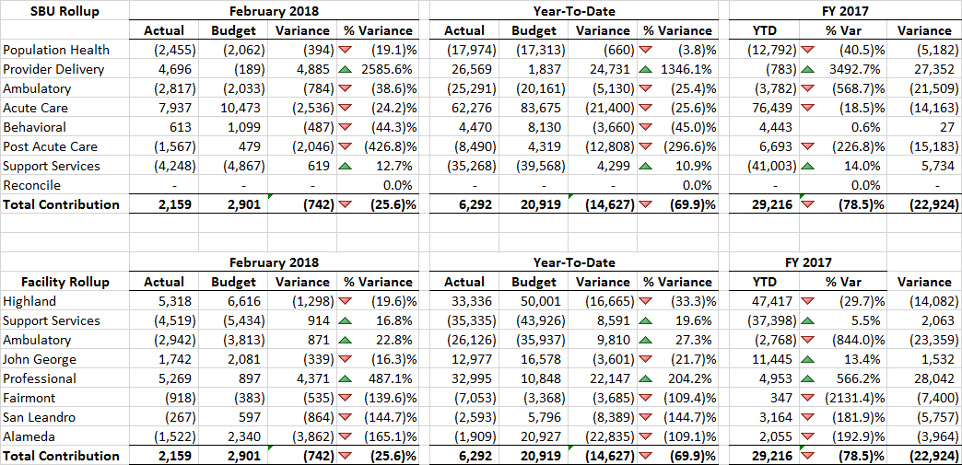
February 2018 Financial Report
Contribution Variance Summary
The Contribution Variance Summary provides the ability to see variances in contribution to budget at the SBU and Facility level.

Slide 8
February 2018 Financial Report
Accountability Report
The Accountability Report provides the ability to see variances in operating expenses by management area.

Slide 9
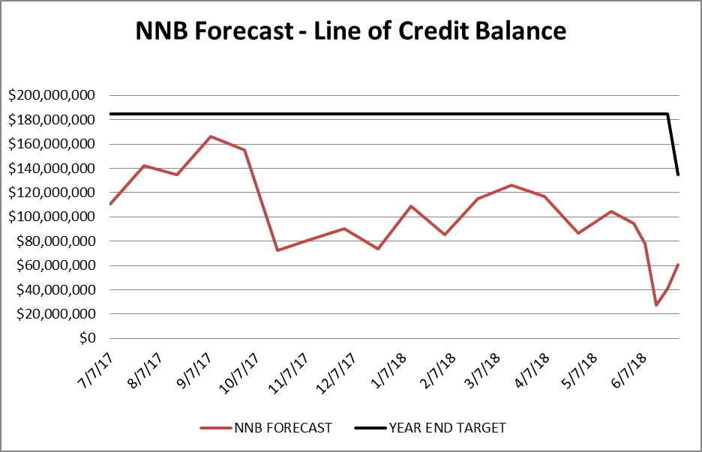
February 2018 Financial Report
Balance Sheet and Line of Credit
Below are the key Balance Sheet metrics and the forecast for the Line of Credit.

